Slide 1
Immunization Stress-Related Responses (ISRRs)
Based on “ISRR Manual for Immunization Program Managers" 2019
Power point by Cameron Taylor
With Noni MacDonald, Lisa Menning, C. Meghan McMurtry, Oleg Benes, Madhava Balakrishnan, and Michael Gold
1
Notes:
Welcome
Introduction
Image: https://elem.hcdsb.org/stjohnpaulii/wp-content/uploads/sites/20/2018/01/Vaccine-pic.jpg

Slide 2
Conflicts of Interest
No relationship with commercial interests
Professor, Dalhousie University & IWK Health Centre, Halifax NS
WHO : member of SAGE, chair Decade of Vaccines M&E Cmt
Adviser to WHO EURO, SEARO
Consultant CPS Imm/ID cmt; CPHA CANVax
Grants & contracts: CIHR, CIRN, NSHRF, WHO, PHAC

Slide 3
Session Objectives
Following the session Participants will be able to
1.Identify key role health care providers play in vaccine acceptance decisions
2. Outline key principles in communicating with vaccine hesitant individuals
3. Describe and use skills to listen and engage in conversations with those that are hesitant
4. Be able to respond to parental concerns regarding vaccine safety and effectiveness using motivational interviewing strategies

Slide 4
Case #1
KS is a 12yo female.
After standing in line for 15 minutes with her two friends to get her HPV vaccine in the school program, she seems hesitant to receive it.
You reassure her about the vaccine. Once you administer the vaccine, KS complains about light headedness.
She then faints approximately one minute after the vaccine was administered.
2
Notes:
Begin with a simple case.
This scenario may be familiar to front-line immunization workers.
Ask for initial impressions, thoughts, or comments.
Image: http://pinkribbonredribbon.org/where-we-work/zambia/

Slide 5
Questions To Consider:
What could likely cause these signs and symptoms?
How should you manage KS and her two friends also in line?
Should KS be given any medications and/or sent to the hospital?
3
Notes:
Comments:
1.) This is likely an ISRR. The anxiety prior to getting the vaccine, and the fainting (vasovagal syncope) happening so shortly after are all indicative of ISRR and help rule out a more serious cause like anaphylaxis.
2.) Remaining calm, reassuring the friends and informing them that this is perfectly normal in a confident manner are crucial. You should allow PT to lay down somewhere comfortable and well-lit, monitoring her until she comes to, and continuing to observe her for 15-30min. You should make sure that Pt and her friends do not encounter anyone else getting a vaccine. This can be accomplished by having a separate space away from the waiting area or vaccine administration site. A simple curtain can accomplish this if necessary.
3.) No medications or hospitalization is needed for an ISRR. In fact, they can often make things worse.

Slide 6
Case #2
CK is a 12 year old girl who appears very anxious when she is in line for you to give her next HPV vaccine in the school program.
On gentle probing you find out that she fainted last time. She is afraid that this time it will be much worse. She hardly slept a wink last night worrying about this immunization.
4

Slide 7
Questions To Consider:
What would be the next steps in managing CK’s immunization?
What can you do to make this a more “pleasant” experience ?
How should this episode be followed up?
What is your communication strategy if this has become a serious concern among students and parents?
5
Notes:
There are a number of aspects about this case that raise the risk for ISRR: history of fainting, anxious last night and lack of sleep, fearful of fainting again
1 AND 2) Tell CK that you will work together to make this a more comfortable experience for her. Thank her for letting you know about what happened last time.
Move CK to a private space so that she is not in view of others
Repeat that you will work together to make this better and this will happen in a few different ways. First ask whether she tried anything last time to help comfort her before, during or after the needle. Follow up/problem solve as needed. Then go into detail about a two pronged approach (below): fainting, pain. If topical anesthetic is available, apply while doing other tasks.
Ask if she tried anything last time to stop the fainting. And did she notice any symptoms in her body before she fainted (e.g., dizziness, seeing spots, feeling clammy etc.) – if yes, explain what these symptoms were.
If she did not try anything last time, introduce the muscle tension technique and begin practicing it with her (before prepping the needle); this should be continued before, during and after the needle (especially in response to prodromal signs such as dizziness, seeing spots, feeling clammy etc.) If she did try something last time, then figure out what it was and whether anything needed to be done differently if it was muscle tension.
Ask if she tried anything last time about the pain. Work together to identify a distraction strategy she can use before, during, and after the needle.
Ask if she has a preferred arm or would like to look/not look during and implement as possible.
Inject vaccine
Keep CK in private space for 20-30 minutes for observation of any vasovagal reaction. She can be practicing the muscle tension technique as needed.
Check in about her experience with this needle. She could write down things she learned and what worked well so she can refer to it next time. If things went really well, get her to write down the positive experience in detail. If things didn’t go so well, try to identify one thing that went really well and get her to write that down along with suggestions for next time.

Slide 8
Case #3
MJ, a 35yo male has come in for his yearly influenza shot. He expresses some anxiety about getting the shot, but is otherwise compliant. The administration of the vaccine is uneventful, but about 7 minutes later, MJ begins having a persistent cough and some abdominal cramps.
On further examination , MJ is noted to a heart rate of 120, and seems to be experiencing transient loss of consciousness. Getting MJ to lie down does not appear to help with these “fainting” episodes.
6

Slide 9
Questions To Consider:
With the given information, would this be classified as an ISRR?
What would be the next steps in treating MJ?
How should this episode be followed up?
How would your approach change if MJ had appeared pale and sweaty, with a reduced heart rate, and his loss of consciousness improved with lying down?
7
Notes:
Comments:
1.) This does not appear to be an ISRR, rather it seems to be an anaphylactic reaction.
2.) Anaphylaxis is life-threatening, so determining that it is the cause quickly is crucial. Blood Pressure, peripheral circulation, stridor or wheeze in the lungs, and the presence of a rash on the skin should be assessed. If MJ has an Epi-pen, it should be used, otherwise some other form of epinephrine should be injected into MJ's thigh. Getting MJ to a hospital or tertiary care centre of some sort should be done as quickly as possible.
3.) Since an anaphylactic reaction can be caused by a product within the vaccine, an investigation into the cause and source of the antigen may be advised. Communicating the nature of the incident to management and the communications team.
4.) Given this different scenario, Vasovagal Syncope would be suspected. In this case MJ would remain in a supine position and practice muscle tension (e.g. squeeze a rubber ball with his hand). He should be monitored and calmed in a positive manner until the symptoms resolve. Medications and Hospitalization should be avoided. This is because it is probably Vasovagal Syncope.

Slide 10
Case #4
You're working in your clinic during the flu season. Over past few days, there has been a rise in AEFIs vaccine both at your clinic and at other clinics in the area. You know that this vaccine lot has been distributed and used in different facilities across the province. The described AEFI is not a known reaction this particular vaccine.
Upon further investigation, you confirm that there have not been any similar illness noted in the community amongst those not getting the vaccine nor in communities outside of your area.
8

Slide 11
Questions To Consider:
Is it possible that this could be a MISRR (Mass Immunization Stress Related Response)?
How would that conclusion change if only people at your clinic experienced adverse events?
What if there were known vaccine reactions, and the rate of reaction was within the expected rate?
What if there was similar illness in others who did not get the vaccine?
9
Notes:
Comments:
1.) Given the scenario, there are a number of possibilities. It could be an Immunization error, a coincidental event, or even unknown. It is still possible that it is an ISRR though.
2.) In this scenario It would be an Immunization error or an ISRR.
3.) In this scenario you would conclude that it was a vaccine product related reaction.
4.) In this scenario you would conclude that it was a coincidental event.

Slide 12
Example of a MISRR
Kazakhstan, 2015
Measles Vaccine
Pseudo-seizures
https://www.youtube.com/watch?v=EonxRK8E1pI
10

Slide 13
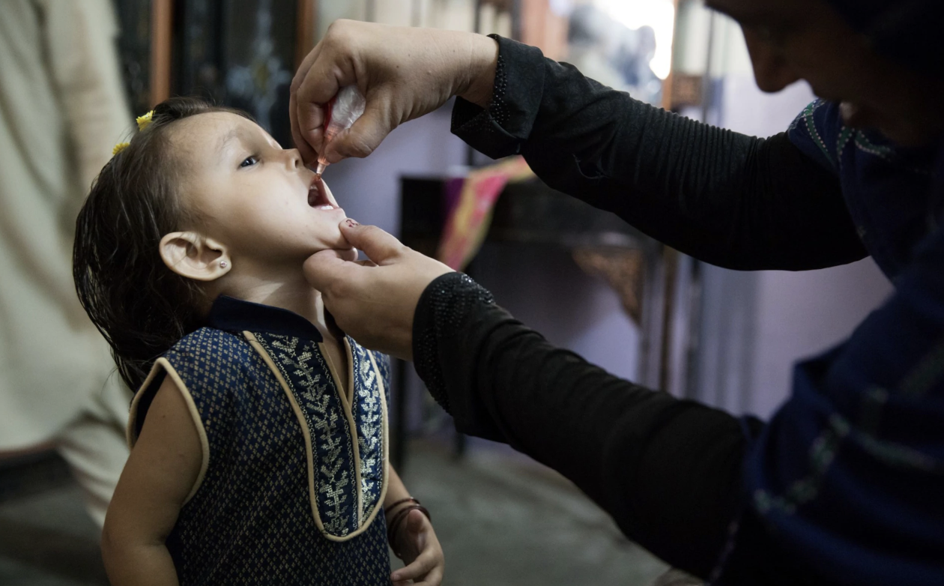
MISRR (continued)
Pakistan, 2019
Polio Vaccine
40,000 ER visits following vaccine
Legacy of Taliban spread rumours of Vaccine purpose, and CIA attempt to use Immunization workers to find Osama bin Laden in 2011
Denmark, 2013
HPV vaccine
AEFI reporting following HPV vaccine.
Media reporting and public fears decreased trust in HPV program, lead to decreased uptake of vaccine (see next slide)
Immunization providers were unprepared to discuss the problem, and lost trust in the vaccine themselves.
11

Slide 14
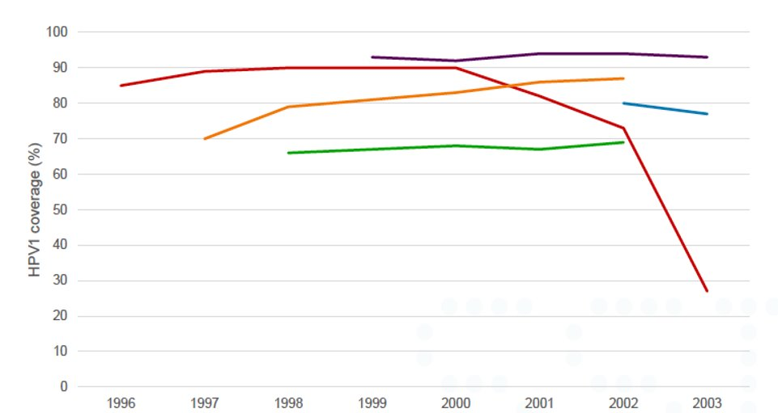
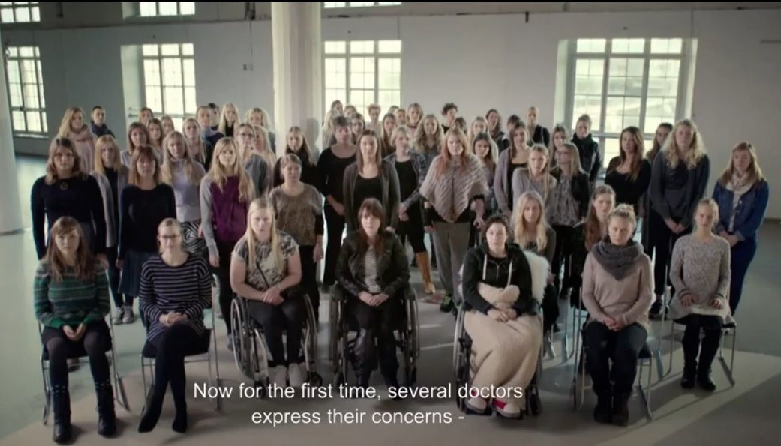
MISRR (continued) HPV vaccine coverage 1st dose by Birth Cohort in Nordic Countries
Anti-HPV-vaccine book that contributed to the decreased vaccine uptake
Birth Cohort
Denmark
Sweden
Norway
Finland
Iceland
12

Slide 15
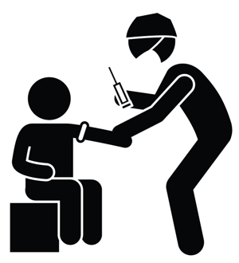
Further Cases
13
Notes:
Image: http://www.southbahamasconference.org/rw_common/plugins/stacks/armadillo/media/immmm.JPG

Slide 16
Case #5
You are providing immunizations in the community. On a particularly busy and hot day, a patient who has already received the vaccine comes up to you complaining of nausea and dizziness. On examination, the patient appears distressed and has an elevated heart rate. While you are examining this patient, three more people who have received the vaccine begin to complain of similar symptoms.
14
Notes:
This is a fairly basic case to reinforce a very important point about Anaphylaxis.

Slide 17
Questions To Consider:
Are these Anaphylaxis or ISRRs? What makes this more likely?
What should be done in the short term for these patients?
What should be done for everyone else who has not yet had the vaccine?
Should any medications be administered in the long term? Should they be moved to a hospital in the long term?
15
Notes:
Comments:
1.) These are most likely ISRRs. The symptoms are common to both Anaphylaxis and ISRRs, and no time frame is given to help differentiate them. However, Anaphylaxis is so rare, that the odds of having four patients experience it at the same place on the same day is very unlikely.
2.) These patients should be kept separate from each other and from the other people waiting for their vaccines. They should be allowed to sit or lie down in a comfortable and well-lit area. Observation for 15-30min should allow the symptoms to resolve spontaneously.
3.) For those still to receive the vaccine, they should be screened for increased risk of ISRRs (if the campaign is not already doing that). All persons receiving the vaccine should be observed for 15-30min after immunization.
4.) Medications and Hospitalization should be avoided with ISRRs, since they can make things worse. If their symptoms do not spontaneously resolve, further medical care may be advisable.

Slide 18
Case #6
You are working at a local school, giving the HPV vaccine. While working there, one twelve-year-old student, XH, begins to feel dizzy while getting their vaccine. Since your team has been trained in dealing with ISRRs, you know to move the student to a quiet place away from the rest of the students to help them recover. This was the first ISRR your team had to deal with at the school.
After experiencing some vasovagal dizziness, XH's symptoms resolve spontaneously with support and reassurance. You contact the administrators at the school, and they allow XH to go home early, and even give her a small treat (a juice box and cookie) and much attention for being such a good patient .
After XH leaves, you notice many more students and classmates of XH begin to have the same symptoms. Your team meets to discuss this.
16
Notes:
This is a possibly complex case based on one way the Biopsychosocial framework can be helpful in dealing with ISRRs.

Slide 19
Questions To Consider:
What biopsychosocial factors may have contributed to the increase in ISRR symptoms?
How should you deal with these new students with symptoms?
What could you have done anything differently with XH?
17
Notes:
Comments:
1.) Biologically, there could be several factors (blood pressure, vasovagal response, fainting response, pain response etc.) Psychologically, they could be experiencing fear, or it could have to do with their focus of attention. They could also be bringing several factors in with them such as their age, sex, weight, underlying illness, temperament, cognitive development etc. HOWEVER, the biggest factor is probably social. Either consciously or subconsciously, these students have realized that if they experience ISRR symptoms, they could also get out of school early and get a treat from the school administrators.
2.) We do not know for certain that the students are "faking" symptoms, so they should be treated normally for an ISRR. Keeping them in school and avoiding handing out treats may be beneficial to minimizing future ISRR symptoms in the school.
3.) XH could have been kept in school for the day, especially since their symptoms resolved. The school administration could have not given them a treat, or it could have been done discreetly so other students and classmates were unaware of it.

Slide 20
Case #7
AS is a 5yo female getting a second dose of the measles vaccine as part of the routine schedule. When she comes to your facility with her mother, you get her to sit upright on her mother’s lap while you give the vaccine IM in her deltoid. After telling AS and her mother that the vaccine won’t hurt, you count down from "3" and then begin asking AS about her favourite TV shows to watch as you inject the needle. You repeatedly inform AS and her mother not to worry and that it’s going to be ok.
Unfortunately AS becomes pale and sweaty, with skin cold to the touch while you are administering the vaccine. She begins to experience nausea and light-headedness. At this point you learn that AS is very scared of needles, as is her mother. Despite dealing with these symptoms with positive results, rumours about the measles vaccine begin to circulate amongst the community and local media picks up the story.
Your team meets to discuss this course of events.
18
Notes:
This case is all about communication and prevention.

Slide 21
Questions To Consider:
What went right in this scenario, and what could be improved upon?
What are the immediate steps that should be taken in such a scenario?
What steps should be taken to communicate a positive message about the measles vaccine in this instance?
19
Notes:
Comments:
1.) Having AS sit on her mother’s lap, injecting the vaccine in the deltoid, and distracting AS with talking about her favourite songs to sing were appropriate steps in this scenario. It is also important to make there is no needle aspiration, that you give the most painful vaccine last, provide a topical anesthetic, and use a external vibrating device with cold. Saying things like "The needle won't hurt", "Don't worry", and "Its going to be ok" are not recommended. Instead, use neutral language. The child and parent's fear of needles should be screened for prior to the vaccination being administered.
2.) Immediate steps that should be taken include: Comforting AS and her mother and normalizing the experience, segregating AS and her mother from others coming to get vaccinated to create a better environment for both AS and her mother and others waiting for vaccination, remain calm and confident, encourage return to normal activity, avoid contact and communication between AS and her mother and those waiting for vaccination, monitor AS and her mother to see if any follow-up is needed, avoid unnecessary hospitalization and medications.
3.) In this situation, the communications team should be activated. Provide ongoing information to stakeholders including the media, and monitor the response and activities of media and stakeholders. Counteract any rumors that arise, and if necessary, implement the crisis communication plan. You should also share briefings with other health care providers to help with this particular situation, and to draw on past lessons from ISRRs.

Slide 22
Case #8
BW is a 15yo female with asthma getting the influenza vaccine. She expresses some anxiety about needles, stating several of her family and friends have gotten sick in the past from vaccines. Prior to the vaccine she mentions she has been experiencing some troubles in school which has caused her some stress. After some positive reassurance, the administration of the vaccine is unremarkable.
However, 4 days later BW comes back to the clinic complaining of seizures. According to what her family tells her, they usually last more than 2minutes, involve her having her eyes and mouth closed, rapid respiration, and thrashing movements.
20
Notes:
This case is very detail oriented. Focusing primarily on the differentiation between an epileptic and non-epileptic seizure.

Slide 23
Questions To Consider:
How should these seizures be classified?
What condition are these seizures indicative of?
How would the classification of these seizures change if they involved guttural sounds and snoring sounds once they begin regaining consciousness?
In this scenario, what sorts of Biopsychosocial factors are present?
21
Notes:
Comments:
1.) Based on the scenario, this would be a non-epileptic seizure.
2.) Non-epileptic seizures associated with post-immunization can be indicative of a conversion reaction.
3.) Given the change in the nature of the seizures, these would probably be epileptic seizures. [NOT FOLLOWING THIS]
4.) Her anxiety and fear of needles would be a psychological factor. Her family and friend's perception of vaccinations would be a social factor. Her stress from school would also be a psychological factor. The nature of how biological factors such as sex, age and weight factor in are not necessarily clear in this situation.

Slide 24
Case #9
GM is a 10yo boy who comes in for his immunization with his mother. He is pale and won’t make eye contact. His mother is visibly upset and says “I had to drag him here after the last time.”
22

Slide 25
Questions To Consider:
What should be your first step?
What should you screen for?
23
Notes:
Comments:
1.) There are significant “red flags” in this case. Seek a private space/space away from the others to speak with GM and his mom.
2) Try to find out briefly what’s going on. Frame in terms of making things more comfortable for GM. Screen for needle fear. Screen for a history of vasovagal reactions.

Slide 26
Case #9 (continued)
GM is a 10 yo boy who comes in for his immunization with his mother. He is pale and won’t make eye contact. His mother is visibly upset and says “I had to drag him here after the last time.”
After seeking a private space, you screen for high needle fear. You find out that he had a very bad experience 2 years ago (including being held down to get the needle) and has refused to get needles since then. His mom is not afraid of needles herself but is worried about her son. Your screen for a history of vasovagal reactions in GM is negative.
24

Slide 27
Questions To Consider:
What is your next decision to make?
Assuming the wait time to see a specialist is unreasonably long, what can you do?
25
Notes:
Comments:
1.) Whether or not a referral to a specialist who can address the needle fear is feasible. Options: referral or proceed with the needle.
2) It is preferable to refer to a specialist as any procedure that is attempted or completed if the fear isn’t addressed can be problematic and GM won’t benefit from the pain management strategies the same way someone with low or no fear would.
The next few slides will walk us through what can be tried.

Slide 28
Case #10
A Meningococcal B outbreak occurs at a local Juniour High School, with three students becoming ill. In response, Public Health sets up vaccine program in the School's gymnasium. All students, grade 7-9 are to be immunized, with speed being of the essence.
After the first day of the program, there are reports of many students vomiting and having headaches. Parents and Teachers are concerned.
26

Slide 29
Questions To Consider:
What are some possible causes of these symptoms?
How would you approach dealing with this scenario?
How might you prevent/decrease the risk of this happening?
27

Slide 30
Case #11
You are helping giving flu shots at a seniors residence. NT, an 80 yo woman with low body weight, comes to get her shot. She has some reservations about the shot, having seen one of the other residents have a negative reaction to the flu shot, and hearing that "they say that vaccines can be dangerous" from her daughter.
After some discussion, NT agrees to have the shot. After receiving the shot NT, begins to feel dizzy.
28

Slide 31
Questions To Consider:
Is this an ISRR?
What predisposing factors does NT have, and what categories do they fit within?
How should you manage this situation?
How could you help prevent situations like this?
29

