Slide 1
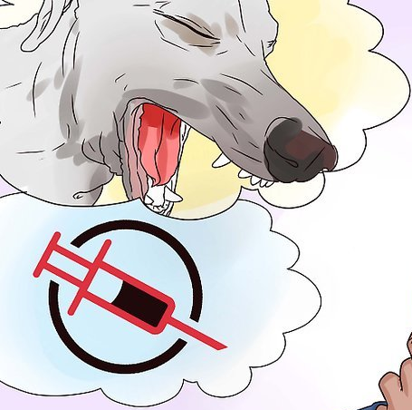
Immunization Stress Related Responses (ISRR)*)
* Developed based on the outline of the “Immunization stress-related response - A manual for program managers and health professionals to prevent, identify and respond to stress-related responses following immunization”
Draft
Notes:
Welcome
Introduction
Image: https://elem.hcdsb.org/stjohnpaulii/wp-content/uploads/sites/20/2018/01/Vaccine-pic.jpg

Slide 2
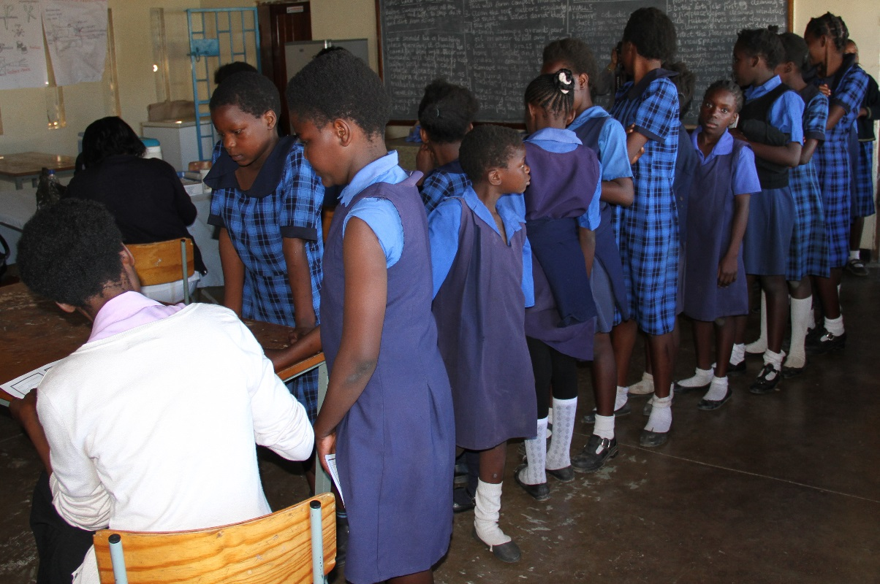
Case #1
KS is a 12 year old female.
After standing in line for 15 minutes with her two friends to get her HPV vaccine in the school program, she seems hesitant to receive it.
You let her know the vaccine is safe. Once you administer the vaccine, KS complains about light headedness.
She then faints approximately one minute after the vaccine was administered.
Notes:
Begin with a simple case.
This scenario may be familiar to front-line immunization workers.
Ask for initial impressions, thoughts, or comments.
Image: http://pinkribbonredribbon.org/where-we-work/zambia/

Slide 3
Questions To Consider:
What could likely cause these signs and symptoms?
How should you manage KS and her two friends also in line?
Should KS be given any medications and/or sent to the hospital?
Notes:
Comments:
1.) This is likely an ISRR. The anxiety prior to getting the vaccine, and the fainting (vasovagal syncope) happening so shortly after are all indicative of ISRR and help rule out a more serious cause like anaphylaxis.
2.) Remaining calm, letting the friends know that this is perfectly normal in a confident manner are crucial. You should allow PT to lay down somewhere comfortable and well-lit, monitoring her until she comes to, and continuing to observe her for 15-30min. You should make sure that Pt and her friends do not encounter anyone else getting a vaccine. This can be accomplished by having a separate space away from the waiting area or vaccine administration site. A simple curtain can accomplish this if necessary.
3.) No medications or hospitalization is needed for an ISRR. In fact, they can often make things worse.

Slide 4
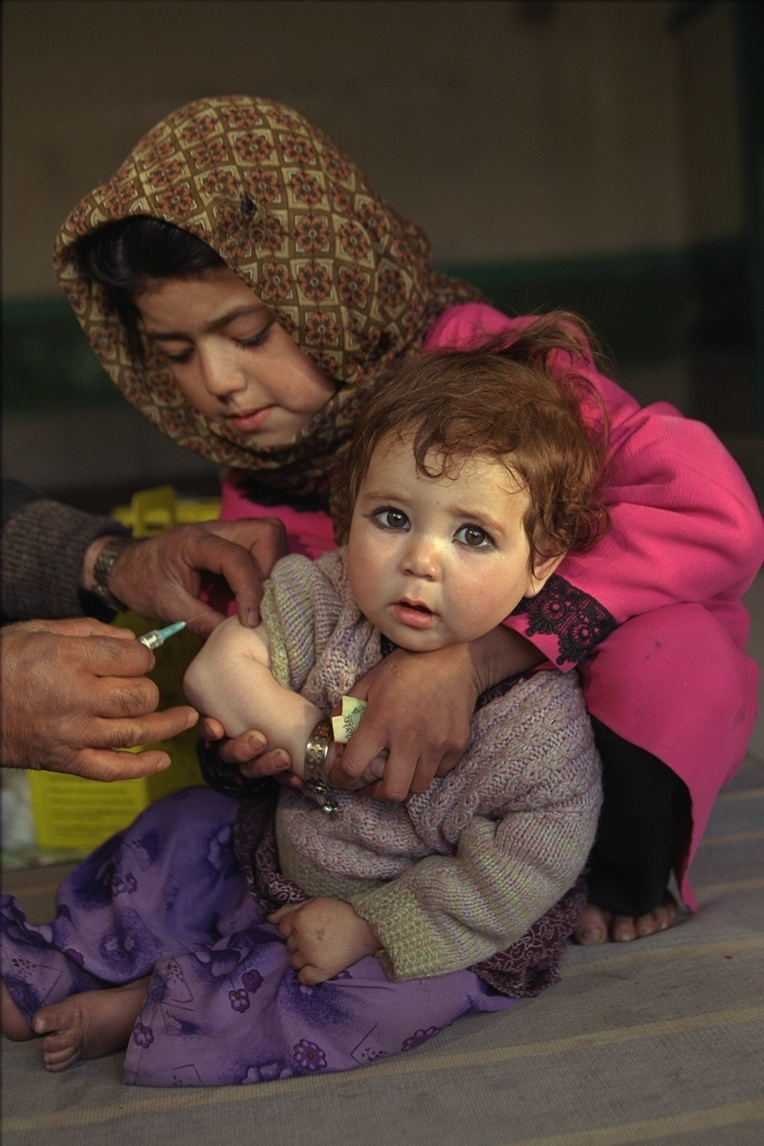
Why prioritize ISRR?
Immunizations crucial to health
Most vaccines given by injection
Public confidence can be eroded
Concerns about Safety
Notes:
According to the GVAP, 2.5mil deaths are averted each year thanks to immunizations. Most of these are given by injection, especially to children and adolescents.
Vaccine preventable diseases are now less common, so the memory of how dangerous and deadly they can be is often forgotten.
The public is often primarily concerned with safety. Social media and the internet can lead people to doubt the safety of vaccines due to misinformation. As a result, trust in vaccines and immunization programs can decrease. Learning how to prevent, minimize and manage ISRRs, can therefore help maintain public trust in vaccines and immunization.
Small pox was eradicated in 1978, and Polio could be next.
Image: https://patagoniahealth.com/wp-content/uploads/2017/07/immunizations.jpg

Slide 5
Why prioritize ISRR? Needle fear
Children are particularly at risk
Immunizations are the most common reason to have needles throughout childhood
Negative experiences
High levels of needle fear can create major problems
short term: longer procedures, increased risk of fainting, more distress and pain
long term: vaccine hesitancy, fearful memories, avoiding health care (& complications from mismanaged chronic diseases), fear of healthcare professionals, needle-related phobia, lack of benefit from pain management strategies
Notes:
Needles by injection are painful. Pain and fear have a bidirectional relationship
Typical onset of needle fear is 5 to 10 years of age (Bienvenu & Eaton, Psychol Med, 1998:28:1129-1136; LeBeau et al., Depress Anxiety, 2010;27:148-167; Thyer et al., J Clin Psychol, 1895;41:451-459).
Resource: Summary paper that can support all statements above: McMurtry et al., Clin J Pain, 2015;31S:3-11.
Other sources for consequences of needle fear:
Noel et al., J Pediatric Psychol, 2010;35:626-636
Deacon & Abramowitz, J Anxiety Disord, 2006;20:946-960.
Taddio et al., Vaccine, 2012;30:4807-4812.
Howe et al. MCN Am J Matern Child Nurs, 2011;36:25-31
Mohr et al., Ann Behav Med, 2001;23:125-132
Rzeszut, J Pediatr Nurs, 2011;26:589-592
Weisman et al., Arch Pediatr Adolesc Med, 1998;152:147-149
Marks, Am J Psychiatry, 1988;145:1207-1213
Hamilton, J Fam Pract, 1995;41:169-175
Wright et al, Aust Fam Physician, 2009;38:172-176
Armfield & Milgrom, S A A D Dig, 2011;27:33-39
Meade et al., J Psychosom Res, 1996;40:495-501
Kleinknecht, Beh Res Ther, 1994;32:817-823
Ost, Beh Res Ther, 1991;29;323-332
Ost, J Abnorm Psychol, 1992;101:68-74

Slide 6
Why Prioritize ISRR? ISRR Clusters
Clusters can happen in a variety of contexts:
Denmark
2013- increase in AEFI reporting following HPV vaccine.
Media reporting and public fears decreased trust in HPV program, lead to decreased uptake of vaccine.
Immunization providers were unprepared to discuss the problem, and lost trust in the vaccine themselves.
Columbia
2014- hundreds of young women sought medical attention in ER for unexplained symptoms following HPV vaccine.
Rumours, financial and litigation factors all played a role.

Slide 7
CIOMS/ WHO cause specific definition of AEFIs
2 Vaccine quality defect-related reaction
An AEFI that is caused or precipitated by a vaccine that is due to one or more quality defects of the vaccine product including its administration device as provided by the manufacturer.
3 Immunization error-related reaction
An AEFI that is caused by Inappropriate vaccine handling, prescribing or administration.
4 Immunization anxiety-related reaction
An AEFI arising from anxiety about the immunization.
An AEFI that is caused or precipitated by a vaccine due to one or more of the inherent properties of the vaccine product.
1 Vaccine product-related reaction
5
Coincidental event
An AEFI that is caused by something other than the vaccine product, immunization error or immunization anxiety

Slide 8
Why “ISRR” and not “immunization anxiety”?
Immunization anxiety related - term used to classify AEFIs
Too narrow and too "medically" focused.
Immunization Stress-Related Responses (ISRRs) includes the entire spectrum of signs and symptoms seen in a stress response- not just anxiety symptom
Notes:
ISRRs are a type of AEFI. There are 5 recognized types of AEFIs.
The old terminology was Immunization Anxiety Reaction, but it does not encapsulate all the elements of such events, and often there may be no symptoms of anxiety associated with ISRRs.
The Biopsychosocial framework underpins ISRRs. They are not merely a biological occurrence, but also one that has factors of a psychological and social nature. One's mental health, and Social interactions that they bring with them to the immunization and which they experience during the vaccination play a role in ISRRs.
The biopsychosocial framework is a very important model that is often used to understand health in all its complexity. We will be exploring it in detail to understand individuals’ responses to immunization

Slide 9
Characteristics - ISRR
Can happen before, during, or after immunization
Biopsychosocial framework: Help understand a person’s response to immunization
Pre-disposing factors: Historical, pre-existing factors brought into the immunization context
Precipitating factors: Dynamic, factors occurring in the peri-immunization context
Perpetuating factors: Factors occurring in the post-immunization context
Biological
Social
Psychological
Notes:
Next, we will review each of the time points in further detail. Watch the person as he/she goes through the process
The diagrams that will be reviewed are organized according to three broad time points: pre-immunization (historical, predisposing factors), peri-immunization (precipitating factors, initial response), and post immunization (delayed response influenced by perpetuating factors).
The person being immunized, in white, is represented at various time points with example risk factors leading to a cascade of symptoms (initial response, ongoing) consistent with an immunization stress-related responses however, not everyone will progress from one stage to another step by step or in a linear fashion.

Slide 10
ISRR - Pre-Immunization
(predisposing factors)
Biological
- Age
- Genetics (e.g., vulnerability to anxiety, vasovagal response, acute stress response)
- Low body mass
Social media
Psychological
- Previous negative needle experiences
- Anxiety re: vaccination, medical situations
- History of acute stress response
Social
- Receive negative info: family, friends, media, others
- Witnessing others' negative reactions
- Cultural beliefs
Notes:
Pre-existing or historical factors (also called pre-disposing) are things that a person brings “into” the immunization context. Using the biopsychosocial framework, we can see that these factors are numerous and can interact with each other.
The shapes with a patterned outline contain example potential risk factors for experiencing an immunization stress-related response; gears are used to represent the dynamic interactions among the various risk factors.
The potential for social media to provide negative information prior to the immunization (pre-existing), in the immunization context (peri-immunization), as well as to enable large scale communication of adverse events and perpetuate reactions is highlighted.

Slide 11
Peri-Immunization
(Precipitating factors)
Individual
Context
Mass
Context
Biological
- Prolonged standing - Vasovagal response
- Pain experience
Psychological
- Concerns re: evaluations from peers, authority figures
Social
- Witnessing peers' adverse reactions
- Behavior, attitude of others in context
- Pain expression in front of peers
Psychological
- Personal expectations
- Fear
- Pain experience
Social
- Behavior, attitude of clinicians, caregivers
- Pain expression
Notes:
Peri-immunization, dynamic (also called precipitating) factors
Additional risk factors (psychological, social) present in mass immunization contexts vs. individual contexts are noted.

Slide 12
Peri-Immunization (Precipitating factors )
Acute Stress Response and Vasovagal Response
Dizziness
Heart racing
Nausea
Blurred vision
Sweating
Vasovagal syncope

Slide 13
Post-Immunization
(Perpetuating factors)
Biological
- Ongoing cascade of stress response symptoms - HPA axis sensitization
Social media
Social
- Behavior, confidence, attitude of others (e.g., clinicians, authorities, family, peers, community)
- Media
Psychological
- Catastrophic interpretations
- Fear
- Hypervigilance to bodily experiences
Dissociative Neurological Symptom Reaction
With or without non-epileptic seizures
Notes:
Post-immunization (perpetuating) context
[acute stress response or vasovagal syncope in the peri-immunization context is likely a risk factor for post-immunization ISRR – note that the arrow from the top of the slide isn’t intended to show only leading to the biological factors but rather the biopsychosocial context as a whole. Similarly, the biopsychosocial factors listed in all 3 gears can interact and contribute as risk factors to the development of an ISRR post-immunization].

Slide 14
Non ISRR events, disorders or syndromes
Reported as AEFI post-immunization
Signs and symptoms are unexplained after appropriate medical investigations
Causal association with immunization has not been established.
Examples
Dissociative Neurological Symptom/Conversion Disorders with delayed onset of symptoms
Somatic Symptom Disorders
Complex Regional Pain Syndrome (CRPS) -Type 1 with delayed onset
Postural Orthostatic Tachycardia Syndrome (POTS)
Chronic Fatigue Syndrome (CFS).
Pathogenies of these conditions are poorly understood
All occur as background conditions which are unrelated to immunization
When the onset of symptoms is proximate to immunization this should be reported as an AEFI

Slide 15
Diagnosis- Types of ISRRs
Immunization Stress Related Response
PERI-IMMUNIZATION
Symptom Onset: Before/ During/ Immediately After Immunization (less than 2-5min)
Acute Stress Response
Vasovagal Response
POST-IMMUNIZATION
Symptom Onset: Within 7 days of immunization
Dissociative Neurological Symptom Response (DNSR) - With or without
non-epileptic seizures
Remember: these responses can also occur unrelated to immunization
Notes:
This diagram shows the two main types of ISRRs, their symptoms, and their main manifestations.
Source: A manual for immunization program managers 2018, p.15

Slide 16
Hypothesized prevalence of ISRR and its relationship to fear and anxiety
Moderate needle- related anxiety, moderate fear
Low needle-related anxiety, low fear
ISRR severity (→ increasing)
Hypothesized ISRR Prevalence (→ decreasing)
Dissociative Neurological Symptom Reaction
+/- non-epileptic seizures
Acute Stress Response
Vasovagal Syncope

Slide 17
Why differentiate ISRR from other serious AEFI?
ISRRs
More Common
Not usually life-threatening
No need for Epinephrine
Usually no Meds needed
Anaphylaxis
Rare
Life-threatening
Need Epinephrine
Medication
Epileptic Seizures
VS
Wrongly diagnosing and treating ISSR as Anaphylaxis (or other serious medical conditions) can have serious implications on the health of the vaccinee
Notes:
An important part of diagnosing ISRRs is ruling out other conditions.
Anaphylaxis is one of the more serious of these. It is important to remember that Anaphylaxis brought on by immunization is very rare, so it is unlikely that multiple individuals will all have an anaphylactic reaction to an immunization in the same place on the same day. If Anaphylaxis does occur, epinephrine (an epi-pen) should be used immediately, and they should be transported to the nearest hospital or health centre.
Epileptic Seizures can also be confused for peri-immunization Syncope seizures, or post-immunization non-epileptic seizures.

Slide 18
Differentiating acute stress response, vasovagal syncope, and anaphylaxis
 | Acute Stress Response |  | Anaphylaxis
 | General | Vasovagal Syncope
Onset | Before, During After <5min | Before, During, After <5min (less if pt. moves) | After >5min (usually < 60min)
Skin | Pale, Sweaty, Cold, Clammy | Pale, Sweaty, Cold, Clammy | Red itchy skin & eyes
Respiratory | Hyperventilation | Normal or Deep Breaths | Cough, Wheeze, Stridor
Cardio | Increased HR Normal or Elevated BP | Decreased HR +/-Transient Decreased BP | Increased HR Decreased BP
GI | Nausea | Nausea, Vomiting | Nausea, Vomiting, Abdominal Cramps
Neuro / Other | Fear, Dizzy, Numb, Weak, Tingling lips, Spasm in hands and feet | Transient LOC, respond well once supine, rarely +/- tonic-clonic seizure | Unease, restless, agitated, LOC, little response to lying supine
Notes:
This table shows how Acute Stress Responses, Vasovagal syncope and Anaphylaxis differ from each other.
Time frame is especially important for ruling our Anaphylaxis. If the symptoms arise in less than 5min after immunization than it is easier to rule out Anaphylaxis. If the symptoms arise more than 5min after immunization, it may be Anaphylaxis and further medical attention may be required.
Source: A manual for immunization program managers 2018, p.31

Slide 19
Pseudo-seizure & Seizure
Helpful For Distinguishing | Pseudo-Seizure* | Seizure
Duration >2min | Common | Rare
Closed eyes and mouth | Common | Rare
Resist eye opening | Common | Very Rare
Visible bite marks around mouth | Very Rare | Occasional
Rapid Respiration | Common | Ceases
'Ictal' cry | Rare | Common
Upset after Seizure | Occasional | Very Rare
Recall for period of unresponsiveness | Common | Very Rare
Violent movement | Common | Rare
Post-ictal stertorous breathing | Rare | Common
Attacks in medical/clinical situation | Common | Rare
Notes:
This table shows the differences between pseudo-seizures and seizures, and which differentiating signs and symptoms are helpful.
Source: A manual for immunization program managers 2018, p.32

Slide 20
Pseudo-seizure & Seizure
Characteristics | Pseudo-Seizures | Seizures
Stereotyped Attacks | Common | Common
Attack Arising from Sleep | Occasional | Common
Aura | Common | Common
Urinary or Fecal Incontinence | Occasional | Common
Injury | Common | Common
Report Tongue Biting | Common | Common
Notes:
This table shows the differences between pseudo-seizures and seizures, and which differentiating signs and symptoms are unhelpful.
Source: A manual for immunization program managers 2018, p.32

Slide 21
Prevention: Prior to immunization
Environment and Attitude
Calm, Friendly, Confident
Communication and Pain Reduction
Recipient and Caregiver
Physical, Psychological, Pharmacological
Identify high risk persons
Brief History:
Anxiety disorders
Developmental needs
Past negative experience
Notes:
Preventing an ISRR begins before the vaccine has even been administered.
The environment in which it is administered should be calm, well-lit, friendly and welcoming. The front-line worker giving the immunization should also be calm, friendly, and confident.
Communication with the recipient and any caregiver with them should build trust.
Mild crying should be considered normal, but pain reduction should be attempted whether through physical, psychological or pharmacological means.
Identifying people who are at higher risk of having an ISRR is crucial to prevention. A brief history can usually elicit the necessary information. Persons who have had Anxiety disorders in the past, developmental needs (such as Autism Spectrum Disorder), or past negative experience (painful needle procedure, fainting with an injection or blood taking).

Slide 22
Prevention: Screening questions for Patients
High levels of needle fear
5-8yo: How scared of needles are you? (not at all, a little bit, medium amount, a lot, very scared, most possible)
Do you try really hard to miss getting the needle because you are so scared?
Parents can also be asked similar questions about their children.
Adults and those >8yo: How afraid of needles are you? (not afraid, a little, moderate amount, a lot, the most afraid)
Past vasovagal reaction
5-8yo: Have you ever fainted or suddenly gone to sleep during a needle before? Also ask parents?
Adults and those >8yo:
Have you ever fainted (lost consciousness) during a needle before?
Have you ever felt really dizzy, seen spots, felt clammy?
Notes:
Identifying people who are at higher risk of having an ISRR is crucial to prevention.
There are targeted questions one can ask to screen for high levels of needle fear:
Parents can also be asked similar questions about their children.
If they do have severe needle fear, dealing with that fear before giving the immunization, or generally taking more time with them is important. Anyone with increased risk of ISRR should be immunized first, or scheduled separately, and immunized out of view of others who may become anxious witnessing their reaction.
If they have had a past vasovagal reaction (fainting), that can be decreased by using the muscle tension method (see slide 16). Such recipients can also be given their immunization in a supine position to help as well.

Slide 23
Prevention: Neutral words
Do Say
Do Not Say X
“Some of people we see here say the needle hurts; some say it doesn’t.”
“Do you want the needle in the right or left arm?”
“ Here we go 1,2,3 –tell me about –[distraction topic]….”
“This needle will not hurt.”
“This needle will hurt.”
“ I have to give this needle in your right arm.”
“Don’t worry ….it’s just a little poke.”
Notes:
These are some phrases that should and should not be used when discussing the immunization with patients of any age.

Slide 24
Prevention: Muscle Tension
Muscle Tension can Decrease the risk of fainting
Ask patient to tense his or her large muscle groups such as by squeezing a ball in the hand of the arm not being immunized, tensing leg muscles, and abdominal muscles.
Patient holds the tension for 15 to 30 sec until feeling warm or flushed.
Patient then returns to baseline muscle tension for 15 to 30 sec
Repeat tension and releasing cycles before , during and after the immunization procedure
Short bouts of exercise of arms/ legs 15 min before immunization
Decreases post immunization: tenderness, swelling, fever, post, pain, days feeling ill
Notes:
Muscle tension can decrease but not eliminate the risk of fainting in certain patients.

Slide 25
Prevention: Personal Control of Situation
Adolescent or Adult who is anxious and/or past history of fainting
Immunize privately, away from others
Offer option of sitting or lying down for the immunization
Use muscle tension process noted before
Listen to how he or she wants procedure to be done – e.g. look /not look and employ if possible etc.
Use the distraction he/she wishes to employ
When complete, compliment the vaccinee

Slide 26
Management: Responding to ISRR
Post-ISSR
Peri-ISSR
Health Care Worker
Should remain relaxed & calm
Most peri- ISSR resolve spontaneously
If distressing symptoms
exclude vaccine product related reactions such as anaphylaxis
calm and comfort in positive manner
Avoid medication and hospitalization
manage vasovagal reactions – supine, muscle tension-relaxation until more stable
Multi-disciplinary approach that
Focuses on interventions to reduce the functional disability.
Treatments tailored to the symptom constellation
may include physiotherapy, Cognitive Behavioural Therapy (CBT), or pharmacological interventions.
If ISRR causes community concern, communication to public is key
Notes:
Management differs slightly based on whether the ISRR is peri or post immunization.
Acute stress responses in peri-immunization usually resolve spontaneously, so observation and comfort are the main points of management. Taking vitals can help confirm or change your differential. If the symptoms are more severe in the presumed acute stress response, then Anaphylaxis should be ruled out.
Vasovagal reactions can be managed by putting the vaccine recipient in a supine position (because they have either fainted or are prone to faint), and the muscle tension method should be used. Observation until symptoms resolve spontaneously is also appropriate.
A post-immunization ISRR requires a multi-disciplinary team. It is quite a bit more complicated, so referral to a health care centre or professional who is experienced with conversion reactions and such is advised.
Source: A manual for immunization program managers 2018, p.XX

Slide 27
ISRR Clusters
Multiple (two or more) ISRRs ➔ a cluster
Common in Schools and large campaigns
Mass Immunization Stress-Related Response (MISRR)
Social Factors
Peers
Media/ Social Media
https://www.youtube.com/watch?v=EonxRK8E1pI
Notes:
Unlike Anaphylaxis, it is common for multiple people to have ISRRs. This can be due to social influences such as what their community and peers think of vaccines and how they react to the immunization, and what the media and social media are saying about immunizations.
There can also sometimes be unintended rewards for ISRR symptoms that once witnessed or heard about, may be internalized consciously or sub-consciously by others preparing to be immunized (e.g. A child who has an ISRR gets air lifted to the nearest health facility in the President's personal helicopter. Other children then begin to experience similar symptoms knowing they might also get the privilege of riding in the President's helicopter).
Such social factors are found more often in large groups where people know each other. Military barracks, schools and other communal gatherings are prime for clusters of ISRRs. This is because each person waiting in line for their vaccine sees the others before them get theirs. If they witness an ISRR, that might make them feel anxious and therefore prime them psychologically for their own ISRR.
The term "mass hysteria" used to be used to describe the phenomena of ISRR clusters, but we are trying to move away from that term. Instead MISRR is the preferred term.

Slide 28
AEFI Clusters & ISRR
Cluster of AEFI
All cases from only one facility? (assume same lot used elsewhere)
All cases got same vaccine or lot ?
Known vaccine reaction?
Similar illness in others who did not get vaccine?
No
No
No
No
Immunization error, coincidental or unknown
or ISSR
Yes
Yes
Yes
Yes
Immunization error
or ISSR
Coincidental event
or ISSR*
Similar illness in others who did not get the vaccine?
Rate of reaction within the expected rate?
Immunization Error
(transport/ storage
error) OR Vaccine
quality defect
Reaction OR
ISSR
No
No
Immunization error or vaccine quality defect reaction or
ISSR
Yes
Yes
Coincidental event
or ISSR*
Vaccine product
related reaction
*in some clusters of ISSRs may see patients with the symptoms who were not immunized; symptoms developed when heard about the cases or maybe coincidental event
Notes:
This diagram shows the algorithm for interpreting Clusters of ISRRs
Source: A manual for immunization program managers 2018, p.39

Slide 29
Responding to Mass ISSR
Planning
Be aware
Expect the possibility
Emergency Kits, posters and info
Separation
Affected from other affected persons
Affected from non- affected persons
Report
All AEFIs to local authority
Follow standard country protocols for reporting and investigation
Communication
Routes for spread of MISRRs: Social Media, Media, Word of Mouth
Move into crisis communication plan- try to preempt erroneous conclusions about the cause, emphasize care & support patients and families; not specific to the vaccine
Notes:
Failing to plan for MISRR is planning to fail. You have to be aware that immunization campaigns are the perfect storm for MISRRs, and therefore expect this possibility and have a plan in place. This should include creating emergency kits with the supplies and resources you need to deal with ISRRs and MISRRs (Posters explaining the difference between Anaphylaxis and ISRRs, contact information and addresses for primary responders, and a designated observation area that is relaxing and well-lit etc.)
It is important to not only separate high risk ISRR recipients from the rest of the crowd, but also to separate high risk ISRR recipients from other high risk ISRR recipients. Witnessing each other go through an ISRR may stir up anxiety, fear and stress in both individuals, leading them both down a downward spiral.
If an ISRR happens, and even more so if a MISRR happens, word will spread fast amongst the community. Communication via social media, media and word of mouth must be used in kind to counteract that message of panic. This should be done quickly and by a communications team.

Slide 30
ISRR clusters and phases of communication
1
“Routine comms”
building resilience
2
“Before”
Comms preps
3
Single event(s)
Efforts to reduce perpetuating factors
4
5
Follow up and consolidation
4
Mass or cluster event(s)
Managing crisis communications
Routine immunization - ongoing
Generate and maintain confidence with ‘resiliency’
Crisis communications
Notes:
4 Source: Communications plan template, 2017. World Health Organization Regional Office for Europe. http://www.euro.who.int/__data/assets/pdf_file/0014/333140/VSS-crisis-comms-plan.pdf

Slide 31
Communication
The general public often responds better to stories than numbers
An approach to combating misinformation about vaccine safety must incorporate both empathetic narrative and statistical reality
Traditional media (newspapers, TV) has been supplemented and for many people replaced by Social Media and the internet
Vaccine safety messages and clarifications must target all forms of media

Slide 32
ISRR as a part of AEFI surveillance
Report if
injury occurs e.g. syncope with injury
dissociative neurological symptom reactions including non- epileptic seizures that need investigation
causes parental or community concern
clusters of ISRR
Use standard AEFI reporting form ➔ describe signs and symptoms
Investigate and do causality assessment for serious ISRR e.g., Hospitalization or prolongation of existing hospitalization, or persistent or significant disability or incapacity or if the ISRR has caused significant parental or community concern

Slide 33
To summarize
Recognize that ISRR is a reality and can occur
Health care providers need to be trained on prevention, detection and response
Misdiagnosis and improper case management can aggravate the condition
ISRR clusters need to be rapidly identified and addressed
Managing communications is critical
Mismanaging ISRR can destabilize even strong immunization programs

Slide 34
Acknowledgements
Power point created by Cameron Taylor, Faculty of Medicine Dalhousie University, Halifax Canada
Contents developed by Professor Michael Gold from the Department of Allergy and Immunology, Discipline of Paediatrics, School of Medicine, University of Adelaide, Australia, Professor Noni McDonald, Dalhousie University, Faculty of Medicine, Halifax, Nova Scotia, Canada; Dr C. Meghan McMurtry, Associate Professor of Psychology, University of Guelph & Psychologist, Pediatric Chronic Pain Program McMaster Children’s Hospital, Ontario, Canada; Dr Robert Pless, Chief, Clinical Evaluation Division, Health Canada, Ontario; and Dr Ulrich Heininger, professor of paediatrics and a paediatric infectious diseases specialist, University of Basel Children's Hospital, Switzerland.
Produced by WHO under the coordination and supervision of Dr Madhava Ram Balakrishnan and Dr Patrick Zuber - Safety and Vigilance, WHO Department of Essential Medicines and Health products supported by Ms Lisa Menning from the WHO Department of immunization vaccines and Biologicals and Dr Oleg Benes from the Vaccine-preventable Diseases and Immunization in WHO EURO.

