Slide 1

Childhood Immunization Update
[INSERT NAME OF PRESENTERS]
[INSERT YOUR ORGANIZATIONAL LOGO]
Last updated March 2018

Slide 2
Instructions for Presenters
Be sure to customize the title slide, the resources slide and the contact information slide.
This slide deck should be adjusted to fit your allotted time and personal style of presenting.
Rather than deleting slides to shorten the presentation, simply hide the slides you do not want to show.
Replace the content on this slide with your disclosures statement.
2
Notes:
<please insert your disclosure statement here>

Slide 3
Learning Objectives
By the end of this session, you should be able to:
Cite current immunization coverage rates for young children and teens
Describe current challenges related to childhood immunization
Describe key research findings regarding parental attitudes, beliefs, and practices
Describe effective strategies for talking with parents about vaccines
Access CDC training and communication resources
3

Slide 4
Immunization Successes

Slide 5
Number of Diseases Prevented by Vaccines Included in the Routine Child/Adolescent Immunization Schedule
2018 (16)
Polio
Diphtheria
Pertussis
Tetanus
Measles
Rubella
Mumps
Hib
HepB
Varicella
1995 (10)
Polio
Diphtheria
Pertussis
Tetanus
Measles
Rubella
Mumps
1985 (7)
Smallpox
Polio
Diphtheria
Pertussis
Tetanus
Measles
1964 (6)
Polio
Diphtheria
Pertussis
Tetanus
Measles
Rubella
Mumps
Hib
Polio
Diphtheria
Pertussis
Tetanus
Measles
Rubella
Mumps
Hib (infant)
HepB
HepA
Varicella
Pneumococcal
Influenza
Meningococcal
Rotavirus
HPV
HepB
HepA
Chickenpox
Pneumococcal
Influenza
Meningococcal
Rotavirus
HPV
5
Notes:
This slide shows how the number of diseases that can be prevented by vaccines has increased steadily from 1964 to the present. There are now 16 diseases that can be prevented by vaccines in the routine child/adolescent schedule.
When parents say “We only had a few vaccines when I was a kid”, you may wish to remind them that having more vaccines now means that their kids are protected against more diseases than the parents were. It’s important to frame this in positive way.

Slide 6
Comparison of 20th Century Annual Morbidity and Current Morbidity
Comparison of 20th Century Annual Morbidity and Current Morbidity: Vaccine-Preventable Diseases
Disease | 20th Century Annual Morbidity† | 2016 Reported Cases † † | Percent Decrease
Smallpox | 29,005 | 0 | 100%
Diphtheria | 21,053 | 0 | 100%
Measles | 530,217 | 69 | > 99%
Mumps | 162,344 | 5,311 | 99%
Pertussis | 200,752 | 15,737 | 91%
Polio (paralytic) | 16,316 | 0 | 100%
Rubella | 47,745 | 5 | > 99%
Congenital Rubella Syndrome | 152 | 1 | 99%
Tetanus | 580 | 33 | 96%
Haemophilus influenzae | 20,000 | 22* | > 99%
Comparison of 20th Centertury Annual Morbidity and Current Morbidity
† JAMA. 2007;298(18):2155-2163
† † CDC. MMWR January 6, 2017/ 64(52);ND-924 – ND-941. (MMWR 2016 week 52 provisional data)
* Haemophilus influenzae type b (Hib) < 5 years of age. An additional 11 cases of Hib are estimated to have occurred among the 222 reports of Hib (< 5 years of age) with unknown serotype.
6
Notes:
This slide shows the impact that vaccines have had on disease morbidity in the United States. Reported cases of all vaccine-preventable diseases have declined dramatically from numbers seen in the 20th century. So if parents ask you if vaccines really work, the answer is a resounding “yes.”

Slide 7
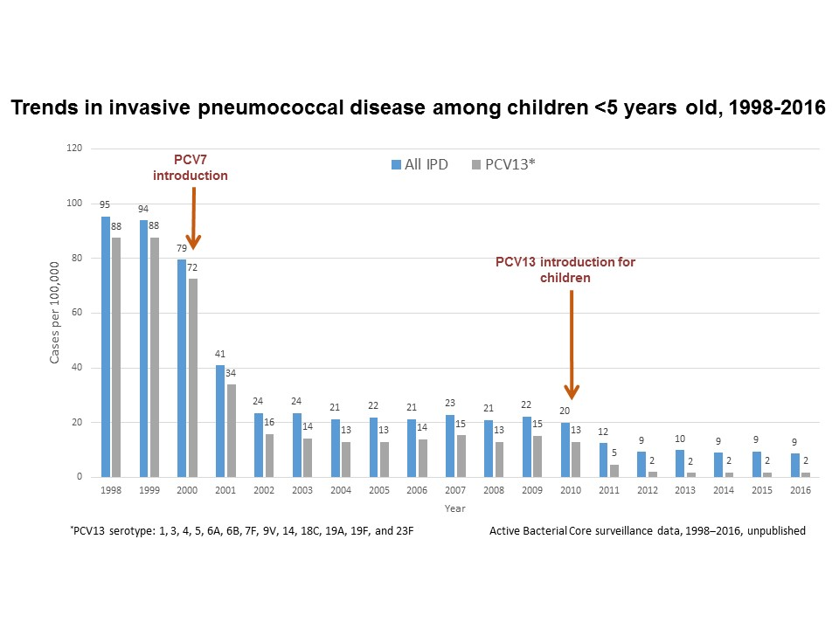
Protecting Children from Serious Disease through 1st and 2nd Generation Pneumococcal Conjugate Vaccines (PCV)
Source: Pneumococcal Disease Surveillance and Reporting. https://www.cdc.gov/pneumococcal/surveillance.html
7
Notes:
Following the introduction of the pneumococcal conjugate vaccines in the United States (PCV7 in 2000 and PCV13 in 2010), dramatic declines in invasive pneumococcal disease were reported among children less than 5 years old.
Overall, invasive pneumococcal disease decreased from 100 cases per 100,000 people in 1998 to 9 cases per 100,000 in 2016.
Invasive pneumococcal disease caused by the 13 serotypes covered by PCV13 decreased from 88 cases per 100,000 people in 1998 to 2 cases per 100,000 people in 2016.

Slide 8
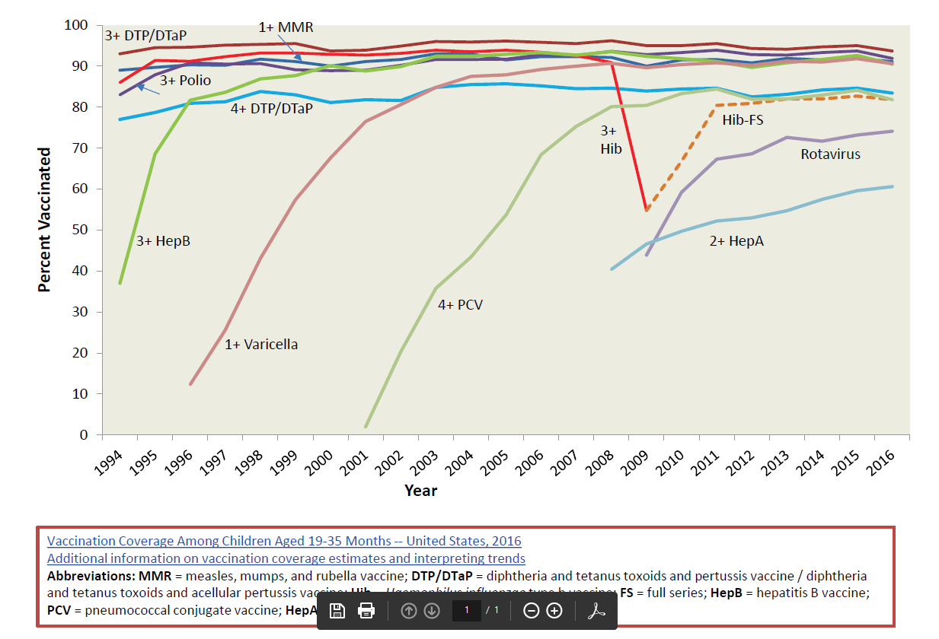
Vaccine Coverage among Children 19-35 Months,
National Immunization Survey, United States, 1994-2016
8
Notes:
At the same time that vaccine-preventable diseases have decreased, vaccination coverage rates have increased. This slide shows how vaccination rates have increased since 1994 among children 19-35 months, using data from CDC’s National Immunization Survey.
The big dip in Hib vaccination rates from 2007-2009 was due to the national Hib vaccine shortage during these years.

Slide 9
Very Few U.S. Toddlers Have Received No Vaccines
Very Few U.S. Toddlers Have Received No Vaccines
Years
SOURCE: CDC National Immunization Surveys
9
Notes:
As we can see from this slide, very few children – less than 1% of toddler nationally – are not receiving any vaccines at all. And this has stayed relatively stable for many years.
This is the good news because, we see that even though there is a lot of discussion and attention paid to parents who choose not to vaccinates their children on schedule, very few parents are actually choosing not to vaccinate at all. And most kids are up to date on their vaccines by 35 months.
NOTE: 95% confidence intervals are ±0.1 to 0.2 for each point estimate

Slide 10
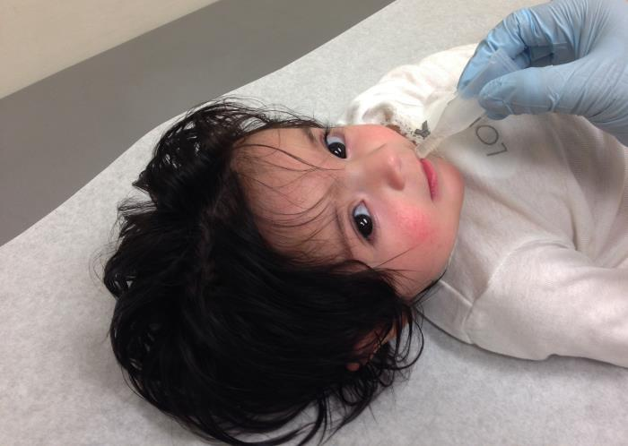
The Impact of Childhood Immunization
The Impact of Childhood Immunization
  CDC estimates that vaccination of U.S. children born between 1994 and 2016 will:
  Prevent 381 million illnesses
  Prevent 24.5 million hospitalizations
  Help avoid 855,000 early deaths
  Save nearly $360 billion in direct costs and $1.65 trillion in total society costs
Updated data from previous article: Benefits from Immunization During the Vaccines for Children Program Era – United States, 1994-2013. MMWR. 25 April 2014
10
Notes:
A few years ago, CDC did a study to evaluate the cost-benefit of immunizations during the Vaccines for Children period from 1994-2014. This data was subsequently updated to estimate the impact of immunizations in children born through 2016. Modeling estimated that, among children born during 1994– 2016, vaccination will prevent an estimated 381 million illnesses, 24.5 million hospitalizations, and 855,000 early deaths over the course of their lifetimes, at a net savings of $360 billion in direct costs and $1.65 trillion in total societal costs.
Costs were adjusted to 2016 dollars, and future costs related to disease were discounted at 3% annually.
The following vaccines were included in the study:
DTP/DTaP: 1994-2016
Polio: 1994-2016
MMR: 1994-2016
HepB: 1994-2016
Hib: 1994-2016
Varicella: 1996-2016
HepA*: 2006-2016 (* not included in the previous VFC20)
PCV7/13: 2001-2016
Rotavirus: 2007-2016

Slide 11
Vaccine Coverage
Vaccine Coverage among Adolescents 13-17 Years National Immunization Survey, United States, 2006-2016
New APD definition*
New APD definition*
11
Abbreviations: Tdap = tetanus toxoid, reduced diphtheria toxoid, and acellular pertussis vaccine; MenACWY = quadrivalent meningococcal conjugate vaccine; HPV = human papillomavirus; ACIP = Advisory Committee on Immunization Practices; APD=adequate provider data.
*APD = Adequate provider data; †≥2 doses MenACWY among adolescents aged 17 years
Walker et al. MMWR 2017.
Notes:
As you can see, vaccination rates for preteen vaccines have steadily increased over the past decade, especially for Tdap and meningococcal vaccine.
However, rates of first and third dose of HPV vaccine are not nearly as high as the coverage rates for the other vaccines routinely recommended for 11 and 12 year olds. What this slide does show us, though, is that the strong coverage rates for Tdap vaccine demonstrate that not only are most preteens and teens getting to the doctor, but they are also getting at least one of the recommended adolescent vaccines.
* ≥1 dose Tdap at or after age 10 years.
† ≥1 dose MenACWY or meningococcal-unknown type vaccine.
§ ≥2 doses MenACWY or meningococcal-unknown type vaccine, calculated only among adolescents aged 17 years at time of interview. Does not include adolescents who received their first and only dose of MenACWY at or after 16 years of age.
¶ HPV vaccine, nine-valent (9vHPV), quadrivalent (4vHPV) or bivalent (2vHPV). ACIP recommends 9vHPV, 4vHPV or 2vHPV for females and 9vHPV or 4vHPV for males. The routine ACIP recommendation was made for females in 2006 and for males in 2011.
** NIS-Teen implemented a revised adequate provider data definition (APD) in 2014, and retrospectively applied the revised APD definition to 2013 data. Estimates using different APD definitions may not be directly comparable. This graph includes two sets of estimates for 2013. NIS-Teen estimates from 2006-2013 connected with dashed lines are previously published estimates using the previous APD definition. NIS-Teen estimates from 2013-2016 connected with solid lines use the revised APD definition

Slide 12
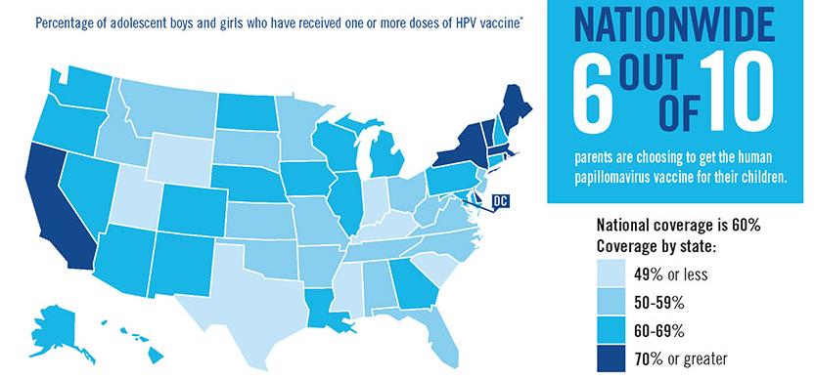
HPV vaccination is the best way to protect children from cancers caused by HPV
Percentage of adolescent boys and girls who have received one or more doses of HPV vaccine*
*Estimated coverage with ≥1 dose of human papillomavirus (HPV) vaccine among adolescents aged 13-17 years, National Immunization Survey–Teen (NIS–Teen),
United States, 2016 Source: MMWR August 25, 2017
12
Notes:
This map of the U.S. is colored to indicate percentage of adolescent boys and girls who have received one or more doses of HPV vaccine.
Nationwide 6 out of 10 parents are choosing to get the HPV vaccine for their children.
7 states have coverage of 49% or less; 16 states have coverage of 50% to 59%; 21 states have coverage of 60% to 69%; and 7 states have coverage of 70% or greater.
This is great news, but there are still challenges to address.

Slide 13
Immunization Challenges

Slide 14
Childhood Immunization Disparities
In spite of high national childhood immunization coverage rates:
We see lower coverage for some vaccines requiring doses in the second year of life, such as DTaP, Hib, and PCV.
For most vaccines, coverage among children living below the federal poverty level is lower than coverage among those living at or above the federal poverty level.
Coverage is lower among children on Medicaid and much lower among uninsured children.
CDC is currently working to identify reasons for disparities and evidence-based interventions.
Vaccination Coverage Among Children Aged 19–35 Months — United States, 2016. MMWR Weekly / November 3, 2017 / 66(43);1171–1177
14
Notes:
The first challenge is childhood immunization disparities.
While childhood immunization rates remain high overall, CDC’s National Immunization Survey results suggest that there are some significant disparities that still need to be addressed. These relate to poverty and rural residence. CDC also sees lower rates for vaccines that require doses in the second year of life.

Slide 15
Recent Disease Outbreaks
Notes:
Another challenge is disease outbreaks. Let’s briefly discuss three vaccine-preventable diseases that have caused outbreaks in recent years: measles, mumps, and pertussis.

Slide 16
Measles Cases Reported in the U.S.
Number of Measles Cases by Year
Although year-round transmission has been eliminated from the U.S., measles cases are still reported in the U.S., including among adults.
  Most cases importation-related
Measles is still common in many parts of the world including some countries in Europe, Asia, the Pacific, and Africa.
The majority of people who got measles were unvaccinated.
Year | Cases
2010 | 63
2011 | 220
2012 | 55
2013 | 187
2014 | 667
2015 | 188
2016 | 86
2017 | 118
2018 | 13*
*As of February 24, 2018
Measles Cases and Outbreaks. https://www.cdc.gov/measles/cases-outbreaks.html
Morbidity and Mortality Weekly Report (MMWR), Notifiable Diseases and Mortality Tables. https://www.cdc.gov/mmwr/publications/index.html
16
Notes:
This slide shows the number of measles cases that have been reported in recent years. The Disneyland outbreak started in December 2014 and continued into early 2015. For more information see this MMWR: https://www.cdc.gov/mmwr/preview/mmwrhtml/mm6406a5.htm
Measles is still common in many parts of the world and can be easily imported into the United States.
Measles is an acute viral respiratory illness. It is characterized by a prodrome of fever (as high as 105°F) and malaise, cough, coryza, and conjunctivitis -the three “C”s -, a pathognomonic enanthema (Koplik spots) followed by a maculopapular rash. The rash usually appears about 14 days after a person is exposed; however, the incubation period ranges from 7 to 21 days. The rash spreads from the head to the trunk to the lower extremities. Patients are considered to be contagious from 4 days before to 4 days after the rash appears. Of note, sometimes immunocompromised patients do not develop the rash.
MMWR:

Slide 17
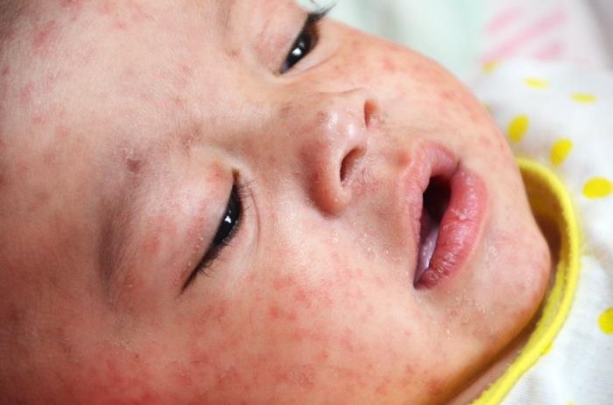
Measles, U.S. 2016 and 2017
2016: 86 measles cases reported in 19 states
  Total of 4 outbreaks reported in 2016 (defined as 3 or more linked cases)
  72% of cases reported were outbreak-related
2017: provisional 118 measles cases reported in 15 states and D.C.
  7 outbreaks were reported (defined as 3 or more linked cases)
  85% of cases in 2017 are outbreak-related
*Preliminary data reported to CDC’s National Center for Immunization and Respiratory Diseases, updated monthly.
17
Notes:
This slide shows the number of measles cases and outbreaks reported to CDC in recent years. An outbreak is defined as 3 or more linked cases.
There were 4 outbreaks in 2016 and 7 outbreaks in 2017. As you can see, the vast majority of cases have been outbreak-related.

Slide 18
Mumps Cases Reported in the U.S.
Number of Mumps Cases by Year
Year | Cases
2010 | 2,612
2011 | 404
2012 | 229
2013 | 584
2014 | 1,223
2015 | 1,329
2016 | 6,366
2017 | 5,629
2018 | 304**
2016: 6,366 mumps cases reported in 47 states and D.C.
  Highest number of cases in a year since 2006
2017: provisional 5,629* mumps cases reported in 48 states and D.C.
*-As of February 24, 2018
*Preliminary data reported to CDC’s National Center for Immunization and Respiratory Diseases, updated monthly. Mumps outbreaks are not reportable.
Mumps Cases and Outbreaks. https://www.cdc.gov/mumps/outbreaks.html
Morbidity and Mortality Weekly Report (MMWR), Notifiable Diseases and Mortality Tables. https://www.cdc.gov/mmwr/publications/index.html
18
Notes:
This slide shows the number of mumps cases reported in recent years. It’s important to note that mumps outbreaks, defined as3 or more linked cases, are not reportable. Therefore, CDC does not have data showing the number of mumps outbreak occurring each year.

Slide 19
Reported Mumps Cases, United states, Vaccine Era, 1968-2017
Reported Mumps Cases, United States,
Vaccine Era, 1968-2017
1st Dose
2nd Dose
1977
1st Dose
ACIP
Recommendation
1989
2nd Dose MMR
ACIP
Recommendation
MMR vaccine coverage
Source: National Notifiable Diseases Surveillance System (cases, passive surveillance); National Immunization Survey (NIS) (1st dose coverage 19-35 year olds), National Health Interview Survey & NIS-Teen (2nd dose coverage); 2017 case data is preliminary and subject to change
4
19
Notes:
This slide shows reported cases from 1968-2016. Although there have been some outbreaks in recent years, the number of mumps has dramatically declined since the years when the mumps vaccine was first implemented.

Slide 20
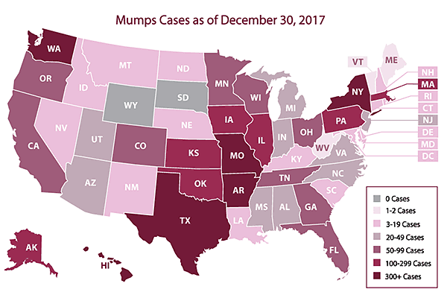
2017 Reported Mumps Cases and Outbreaks (n=5,629)
20
Notes:
This slide shows mumps cases by state in 2017.
Five states had more than 300 cases that year: Washington State, Texas, Arkansas, Missouri, and New York.
Seven states had between 100 and 300 cases.

Slide 21
Mumps Summary
Use of the mumps vaccine reduced disease levels ~99% versus pre-vaccine era in the United States
Since 2006, multiple mumps outbreaks have occurred in highly 2-dose vaccinated populations
Intense exposure settings and waning immunity appear to be risk factors for secondary vaccine failure
Current 2-dose schedule is sufficient for mumps control in the general population
ACIP Recommendation for 3rd Dose MMR Use During Mumps Outbreaks
In October 2017, ACIP recommended that persons previously vaccinated with two doses of a mumps-virus containing vaccine (MMR or MMRV) who are identified by public health authorities as being part of a group or population at increased risk for acquiring mumps because of a mumps outbreak should receive a third dose of a mumps-virus containing vaccine to improve protection against mumps disease and related complications.
21
Notes:
To summarize, use of the mumps vaccine has dramatically reduced disease levels since the pre-vaccine areas, but we have seen outbreaks in highly 2-dose vaccinated populations in the past decade.
Intense exposure settings, like college dorms, and waning immunity appear to be risk factors for secondary vaccine failure.
CDC has determined that the current 2-dose schedule is sufficient for mumps control in the general population, and the benefit of a 3rd MMR dose still needs to be assessed.
READ RECOMMENDATION.
A key part of this recommendation is that it depends on public health authorities to identify who the recommendation applies to, and that identification is for groups at-risk, rather than individual persons.

Slide 22
Pertussis Cases Reported in the U.S.
Number of Pertussis Cases by Year
Pertussis cases have steadily increased in recent decades
More than 20,000 cases per year in recent years
For U.S. infants under 1 year old:
  2,041 cases in 2016
  6 deaths in 2016
Year | Cases
2012 | 48,277
2013 | 28,639
2014 | 32,971
2015 | 20,762
2016 | 17,972
22
Sources: https://www.cdc.gov/pertussis/surv-reporting/cases-by-year.html
https://www.cdc.gov/pertussis/surv-reporting.html
https://wonder.cdc.gov/nndss/static/2016/annual/2016-table2k.html
Notes:
Finally, let’s look at pertussis. Pertussis is endemic in the United States, with peaks in reported disease every few years and frequent outbreaks
Although many pertussis cases are not diagnosed and therefore not reported, this slide gives us an idea of the number of cases we see each year. Pertussis cases have steadily increased in recent decades, with more than 20,000 reported cases in recent years.
However, we no longer see 200,000 cases each year like we did before we had pertussis vaccines.

Slide 23
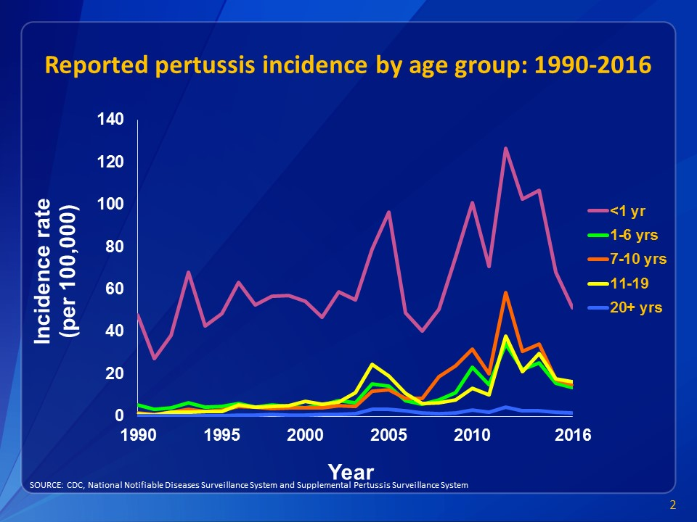
Pertussis Incidence from 1990-2016
23
Notes:
This graph shows reported pertussis incidence (per 100,000 persons) by age group in the United States from 1990–2016.
Infants aged <1 year, who are at greatest risk for serious disease and death, continue to have the highest reported rate of pertussis.

Slide 24
Pertussis Summary
Pertussis Summary
Pertussis incidence has increased since 1980s
Resurgence of childhood disease despite high DTaP coverage
  Young infants at risk
  Excellent initial vaccine effectiveness (98%)
  Moderate and immediate waning of immunity
    70% effective 5 years after receiving the 5th dose
Re-emergence of adolescent disease
  Tdap effectiveness 73% within 1 year of vaccination; 34% 2 to 4 years post vaccination
  Tdap boost in DTaP recipients may wane more quickly2
Switch to acellular pertussis vaccines is changing epidemiology
  Waning immunity driving disease incidence
Sources:
1Acosta AM, DeBolt C, Tasslimi A, Lewis M, Steward LK, Misegades LK, et al. Tdap vaccine effectiveness in adolescents during the 2012 Washington state pertussis epidemic. Pediatrics. 2015;135:981–9.
2CDC. MMWR 2012;61(28);517-522.
24
Notes:
The issues around pertussis incidence are complicated.
The United States switched from whole cell to acellular pertussis vaccines during the 1990s. This means the acellular vaccines we use now are made with key parts of the pertussis bacteria instead of the whole bacterium.
Acellular pertussis vaccines have fewer side effects than whole-cell vaccines. They are also effective for the first few years after vaccination, but do not provide long-lasting protection.
Whole cell pertussis vaccines are associated with higher rates of minor and temporary side effects such as fever and pain and swelling at the injection site. Serious neurologic adverse reactions, including chronic neurological problems, occurred rarely among children who had recently received whole cell vaccines. While studies have inconsistent results about whether the vaccine could cause chronic neurological problems, public concern in the United States and other countries led to a concerted effort to develop a vaccine with improved safety.
Acellular vaccines are highly effective (at least for several years), but do not provide long-lasting protection.
DTaP vaccines are about 98% effective within 1 year of receiving the fifth dose of the vaccine. However, 5 years later, protection declines to about 70%. In general, DTaP vaccination is effective for up to 8 or 9 out of 10 children who receive it, but protection fades over time. About 7 out of 10 children are fully protected 5 years after getting their last dose of DTaP.
Tdap vaccines are about 73% effective within 1 year of receiving a single dose of the vaccine. However, 2 to 4 years later, protection declines to about 34%. In general, Tdap vaccination protects 7 out of 10 people who receive it, but protection fades over time. About 3 or 4 out of 10 people are fully protected 4 years after getting Tdap.
Many children currently getting pertussis are up to date with their pertussis vaccines. This isn’t surprising since we know that protection does not last throughout childhood.
It is most important to use pertussis vaccines fully as recommended, with greatest emphasis on vaccinating pregnant women in each pregnancy to prevent the most serious disease that occurs in newborn infants, and young children according to the recommended schedule.
CDC continues to closely monitor the epidemiology of pertussis, including changes in the bacteria; promote appropriate uses of current vaccines and support work to advance development of improved vaccines.

Slide 25
Challenges in Normalizing HPV Vaccination and Raising Rates
Notes:
Finally, let’s talk about HPV vaccination, and the challenges that we face with normalizing vaccination and raising rates.

Slide 26
Barriers to On-Time HPV Vaccination for all Preteens
Parents
Healthcare Professionals
Not receiving a healthcare professional’s strong recommendation for the HPV vaccine
Need more information about the HPV vaccine
May believe that their child is too young to get vaccinated for HPV
May have concerns about vaccine adverse effects, safety, and newness
Cost of the HPV vaccine
Perceive parents’ attitudes are negative about HPV vaccine and think they have concerns
Knowledge gaps when it comes to talking about HPV vaccine
Inadequate insurance coverage and reimbursement
May prefer to wait and vaccinate older vs younger adolescents
Preference for vaccinating girls vs boys
Source: M Holman, Dawn & Benard, Vicki & Roland, Katherine & Watson, Meg & Liddon, Nicole & Stokley, Shannon. (2013).
Barriers to Human Papillomavirus Vaccination Among US Adolescents. JAMA pediatrics. 168(1)76-28. doi: 10.1001/jamapediatrics.2013.2752.
26
Notes:
In a 2014 Jama Pediatrics published a literature review looking at the barriers to HPV vaccination among US adolescents in order to inform future efforts to increase vaccine coverage.
Health care professionals cited financial concerns and parental attitudes and concerns as barriers to providing the HPV vaccine to patients. Parents often reported needing more information before vaccinating their children. Concerns about the vaccine’s effect on sexual behavior, low perceived risk of HPV infection, social influences, irregular preventive care, and vaccine cost were also identified as potential barriers among parents. Some parents of sons reported not vaccinating their sons because of the perceived lack of direct benefit.
Parents consistently cited health care professional recommendations as one of the most important factors in their decision to vaccinate their children.

Slide 27
Value Parents Place on the Vaccines
Source: Adapted from Healy et al. Vaccine. 2014;32:579-584.
27
Notes:
This chart shows data from research conducted by Dr. Mary Healy and colleagues in Texas, with parents regarding immunization for their children. When parents were asked how much value they placed on each of the vaccines, you can see that they ranked these vaccines similarly.

Slide 28
Clinicians underestimate the value parents place on HPV vaccine
Source: Adapted from Healy et al. Vaccine. 2014;32:579-584.
28
Notes:
In the same study, providers were asked to estimate how much value parents placed on the same vaccines. As you can see, they guessed correctly for vaccines protecting against meningitis, hepatitis, pertussis. However, they underestimated the value parents place on flu vaccine, HPV vaccine, and adolescent vaccines in general.
This is evidence of a disconnect between parents and clinicians.

Slide 29
Research to Practice
39
Notes:
Now let’s talk about how CDC has translated vaccine communication research into practice for its childhood and HPV immunization campaigns.

Slide 30
Understanding Vaccine Knowledge, Attitudes and Beliefs
CDC conducts formative and evaluation research with parents and healthcare professionals in order to inform its childhood and adolescent immunization education campaigns.
This research helps CDC to better understand audience’s knowledge of diseases and vaccines. It also helps CDC to track attitudes, beliefs and self-reported practices over time.
30
Notes:
CDC monitors parental knowledge, attitudes, and beliefs about childhood vaccines through bi-annual surveys and polls.
CDC has conducted research with women and healthcare professionals (HCPs) about maternal vaccines.
CDC also conducted a longitudinal survey of first time expectant mothers from 2014-2016.

Slide 31
CDC Longitudinal Survey of First Time Expectant Moms
Initial survey showed that over 85% of respondents had already made a plan for vaccinating their baby by their 2nd trimester.
However, only 6% of women were very satisfied with their current level of knowledge about childhood vaccines.
Internet search engines were their #1 source of information about childhood vaccines. Only 22.5% cited their ob-gyn or primary care provider.
Results suggest a need for midwives and ob-gyns to direct expectant women to credible sources of childhood immunization information.
Source: Weiner, J. et al. Childhood Immunizations: First Time Expectant Mothers’ Knowledge, Intentions, Beliefs, and Behaviors. Am J Prev Med 2015;49(6S4):S426–S434.
31
Notes:
This longitudinal study was a series of 7 surveys sent to panel of 200 women from 2nd trimester of pregnancy to child’s 19th month of life.
As we see here, the initial survey showed that over 85% of women had already made a plan for vaccinating their baby by their 2nd trimester. This is what they had decided:
75% were planning to receive all vaccines recommended by their child’s doctor or nurse
10.5% were planning to delay or space out some vaccines
4% planned to receive some but not all vaccines
10.5% had not yet made plans for vaccinating their baby

Slide 32
Parents’ Vaccination Plans for Youngest Child
Weighted Est. (95% CI) | 2015 (N = 749) Missing: n = 3
My child has already received all of the recommended vaccines | 79.1% (75.4, 82.4%)
I intend to have my child receive all as scheduled | 10.6% (8.3, 13.5%)
I intend to have my child receive all but will space-out or delay them | 5.8% (4.0, 8.4%)
I intend to have my child receive some but not all | 2.9% (1.8, 4.5%)
I intend to have my child receive none | 1.6% (0.9, 2.9%)
Source: Porter Novelli HealthStyles surveys of parents with one or more child under 7 years of age.
32
Notes:
CDC collaborates with the communications agency Porter Novelli to conduct a survey called HealthStyles every two years. This survey asks questions of parents with one or more children under 7 years of age.
As you can see form this slide, most parents report that their children has already received all of the recommended vaccines, or they intended to have their children receive all of them as scheduled. About 6% intend to space out or delay vaccines, while about 3% intend to decline some vaccines entirely. Only about 1% intend to not vaccinate their children at all, which is consistent with the National Immunization Survey data presented earlier.

Slide 33
Parents of Young Children: Trusted Vaccine Information Sources
 | 2016 (N = 2,511) | First choice | Second choice | Third choice
1 | Doctor or HCP | 94.9% | 0% | 0%
2 | Family members | 1.7% | 41.3% | 0%
3 | Scientific or medical journal | 0.4% | 6.9% | 29.6%
4 | Internet | 1.1% | 14.9% | 8.1%
5 | Friends | 0.7% | 3.5% | 14.4%
6 | Books | 0.1% | 4.6% | 3.7%
7 | Media (magazines, newspapers, etc.) | 0.1% | 2.5% | 2.5%
8 | Other | 0.5% | 0.4% | 2.7%
9 | Celebrity or public figure | 0.2% | 0.1% | 0.1%
Source: CDC National Poll of Parents 2016 (unpublished data)
33
Notes:
CDC conducts a national online poll of parents of children under 7 every two years. This slides shows parents’ must trusted sources of vaccine information in 2016.
As we can see, doctors or other healthcare professionals remain by far parents’ most trusted source of information. Family members often cited as the second choice for trusted vaccine information, followed by the internet. Scientific or medical journals are often cited as the third choice.
As a healthcare professional, you have an enormous influence on whether or not a parent decides to vaccinate.

Slide 34
Parents of Young Children: Vaccine Questions and Concerns
Weighted Frequencies | 2016 (N = 2,510)
Long-term side effects from shots | 30.1%
Short-term side effects from shots (e.g., fever, redness, etc.) | 27.8%
What ingredients are in vaccines | 26.0%
Whether vaccine ingredients are safe | 24.5%
The risks of combining vaccines together into one shot | 22.6%
What are the side effects I should look for | 21.1%
Can it be delayed until they are older | 21.1%
Does the child really need it | 20.5%
Has provider vaccinated his/her own child | 19.9%
Is it required or optional for daycare/school | 18.6%
Does provider recommend it | 17.3%
Usually don’t ask questions | 16.2%
How serious is the disease it prevents* | 15.9%
Source: CDC National Poll of Parents 2016 (unpublished data)
34
Notes:
This slide also shows findings from CDC’s national online poll of parents. As you can see from this slide, parents today still have a lot of questions and concerns about vaccines. The biggest concerns relate to long and short-term side effects, followed by vaccine ingredients and vaccine safety.
It’s important to note, however, that just because a parent has a question, this doesn’t always meant that it’s a concern that will keep them from vaccinating. If healthcare professionals are prepared to answer these questions, this can alleviate any potential concerns and help parents make the decision to vaccinate.

Slide 35
Reasons Parents Won’t Initiate HPV Vaccine Series for Their Children in the Next Year, NIS-Teen 2014
Source: Stokley et al. Human Papillomavirus Vaccination Coverage Among Adolescents, 2007–2013, and Postlicensure Vaccine Safety Monitoring, 2006–2014 — United States. MMWR Weekly July 25, 2014 / 63(29);620-4
35
Notes:
When we look at reasons for not initiating the HPV series, studies consistently show that a strong recommendation from you is the single best predictor of vaccination for any vaccine, including HPV vaccine.
In the 2014 National Immunization Survey-Teen nearly 15% of parents who said that they would not be getting their child vaccinated against HPV in the next 12 months stated not receiving a recommendation as one of the top reasons.

Slide 36
Summary
Most women make decisions about childhood vaccines while they are pregnant.
Most parents vaccinate or intend to vaccinate their infants according to the CDC recommended schedule.
Parents’ attitudes about childhood vaccines have remained consistently positive on a national level.
Parents do have questions and concerns about vaccines, but questions do not necessarily equal concerns. Parents have questions regardless of their immunization plans.
HCPs remain parents’ #1 trusted source of vaccine information.
Parents value HPV vaccine more than providers think they do.
Provider recommendation plays an important role in HPV uptake.
36
Notes:
In summary….
READ BULLETS

Slide 37
The Way Forward
Notes:
Now let’s talk about some ideas for how to address these challenges.

Slide 38
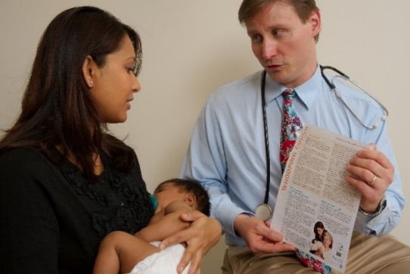
Talking with Parents about Infant Vaccines
Use a presumptive approach. Some studies suggest that this results in higher vaccine acceptance rates.
  Ex: Your daughter is going to get three shots today.
Give your strong recommendation
  Ex: I strongly recommend your daughter get these vaccines today
Listen to and respond to parents’ questions
  Assess the level of information that a parent wants—Some only want the basics, while others want to go in-depth.
  View common parent questions here: https://www.cdc.gov/vaccines/parents/parent-questions.html
Sources: Talking with Parents about Vaccines for Infants. https://www.cdc.gov/vaccines/hcp/conversations/downloads/talk-infants-color-office.pdf
Opel et al. The Influence of Provider Communication Behaviors on Parental Vaccine Acceptance and Visit Experience. 2015. American Journal of Public Health.
Sturm et al. Pediatrician-Parent Conversations About Human Papillomavirus Vaccination: An Analysis of Audio Recordings. 2017. Journal of Adolescent Health.
38
Notes:
First let’s talk about how to improve our communication with parents during vaccine visits.
CDC recommends using a three-step process.
First, use a presumptive approach, by simply stating the vaccines that the child will receive (as opposed to asking parents what they want to do about vaccines). This assumes that the parents will accept vaccines, because national data shows that most parents do.
IMPORTANT: The presumptive approach does not mean pushing or pressuring parents to vaccinate, both of which can erode the trust that a parent places in you.
If parents seem hesitant to vaccinate, give your strong recommendation. Explain why you personally believe that vaccines are important.
Finally, listen and respond to parents’ questions. Remember that questions do not always equal concerns. Many parents have questions about vaccines even if they intend to vaccinate. The presumptive approach does not exclude questions. On the contrary, by soliciting questions you can strengthen your relationship with parents.
Assess the level of information you think a parent is seeking when you respond. Some parents only need basic information, while others want more detail.
You can view common parent questions, along with CDC’s suggestions for how to respond, on this webpage.
You can find more information in their fact sheet Talking with Parents about Vaccines – see the link at the bottom of this slide.

Slide 39
More Tips for Talking with Parents
Acknowledge both the benefits and risks of vaccination—parents want to know about side effects.
Use a mix of science and personal anecdotes—The right mix will depend on the parent.
Reduce the stress of shots by teaching parents how to hold, comfort, and distract their children.
Respect a parent’s desire to work in partnership with you.
Keep the conversation going – even if a parent chooses not to vaccinate that day.
Document questions and concerns for future conversations.
If a parent expresses extreme worry or doubt, follow-up with a phone call or email.
39
Notes:
Here are some additional tips for having vaccine conversations with parents.
READ SLIDE.

Slide 40
Make Strong Recommendations for HPV Vaccine
An effective recommendation from a clinician is the main reason parents decide to vaccinate
Parents value the HPV vaccine and clinicians underestimate the value that parents place on HPV vaccine
Recommend HPV vaccination the same way and on the same day you recommend meningococcal and Tdap vaccines
Some parents may be interested in vaccinating, yet still have questions. Give a bundled recommendation grouping all of the vaccines together:
“Now that your child is 11/12, he/she is due for three vaccines today. These will help protect him/her from the infections that can cause meningitis, HPV cancers, and pertussis. We’ll give those shots at the end of the visit. Do you have any questions for me?”
Source: CDC and Smith et al. Vaccine. 2016.
40
Notes:
Now let’s review some strategies for discussing HPV vaccine with parents.
In CDC focus groups and surveys with moms, having a doctor recommend or not recommend the vaccine was an important factor in parents’ decision to vaccinate their child with the HPV vaccine. Not receiving a recommendation for HPV vaccine was listed as a barrier by mothers. Across the board and regardless of which vaccine, a clinician’s recommendation is the number one reason parents decide to protect their children with vaccination.
Give a bundled recommendation that groups all recommended preteen vaccines together. Most parents will accept the bundled recommendation without any questions. Other parents may be interested in vaccinating, yet still have questions. Here is an example of how to give a bundled recommendation. READ BLUE TEXT.
A question from a parents about HPV vaccine does not mean they are refusing or delaying. Many parents with questions about HPV vaccine are looking for additional reassurance from you. Taking the time to listen to parents’ questions helps you save time and give an effective response. Be sure to verify that you are addressing the right concern.

Slide 41


CDC Recommends HPV Vaccination at Age 11 or 12 Years
Girls & Boys can start HPV vaccination at age 9
Preteens should finish the HPV vaccine series before their 13th birthday
Plus girls 13-26 years old who haven’t started or finished HPV vaccine series
Plus boys 13-21 years old who haven’t started or finished HPV vaccine series
41
Source: Meites et al. MMWR. 2016.
Notes:
In case you are not familiar with them, these are the current CDC recommendations for HPV vaccine. [ADVANCE SLIDE]
Both girls and boys can start the HPV vaccine series at age 9 [ADVANCE SLIDE]
Ideally, preteens should finish the series by their 13th birthday [ADVANCE SLIDE]
Girls age 13-26 years old and boys age 13-21 years old who haven’t stared or finished HPV vaccine series should also be vaccinated [ADVANCE SLIDE]

Slide 42
HPV Vaccine Dosing Schedules
CDC Recommends HPV Vaccination at Age 11 or 12 Years
Starting the vaccine series
BEFORE the 15th birthday
Starting the vaccine series
ON OR AFTER the 15th birthday*
  Recommended schedule is
  2 doses of HPV vaccine
  Second dose should be administered 6–12 months after the first dose
    (0, 6–12 month schedule)
  Minimum interval between dose 1 and dose 2 in a 2-dose schedule is
  5 months
Recommended schedule is
3 doses of HPV vaccine
  Second dose should be administered 1–2 months after the first dose, and the third dose should be administered 6 months after the first dose (0, 1–2, 6 month schedule)
  Minimum interval between dose one and dose three in a 3-dose schedule is 5 months
42
Meites et al. MMWR. 2016.
*And immunocompromised persons 9-26 years
Notes:
The new recommendations for HPV vaccine dosing schedules are:
For persons initiating vaccination before the 15th birthday, the recommended immunization schedule is 2 doses of HPV vaccine. The second dose should be administered 6–12 months after the first dose (for a 0, 6–12 month schedule).
For persons initiating vaccination on or after the 15th birthday, the recommendation for a 3-dose schedule remains. The second dose should be administered 1–2 months after the first dose, and the third dose should be administered 6 months after the first dose (for a 0, 1–2, 6 month schedule).
For persons who initiated vaccination with nine-valent, quadrivalent or bivalent HPV vaccine before their 15th birthday, and received two doses of any HPV vaccine at the recommended dosing schedule (zero, six to twelve months), or three doses of any HPV vaccine at the recommended dosing schedule (zero, one to two, and six months), are considered adequately vaccinated. Persons who initiated vaccination with nine-valent, quadrivalent or bivalent HPV vaccine on or after their 15th birthday, and received three doses of any HPV vaccine at the recommended dosing schedule, are considered adequately vaccinated. Nine-valent HPV vaccine may be used to continue or complete a vaccination series started with quadrivalent or bivalent HPV vaccine.
For persons who have been adequately vaccinated with quadrivalent or bivalent HPV vaccine, there is no ACIP recommendation regarding additional vaccination with nine-valent HPV vaccine.

Slide 43
Free CDC Resources
Notes:
Before we wrap up the presentation, let’s learn about free resources that CDC has created to educate healthcare professionals and parents about immunization issues.

Slide 44

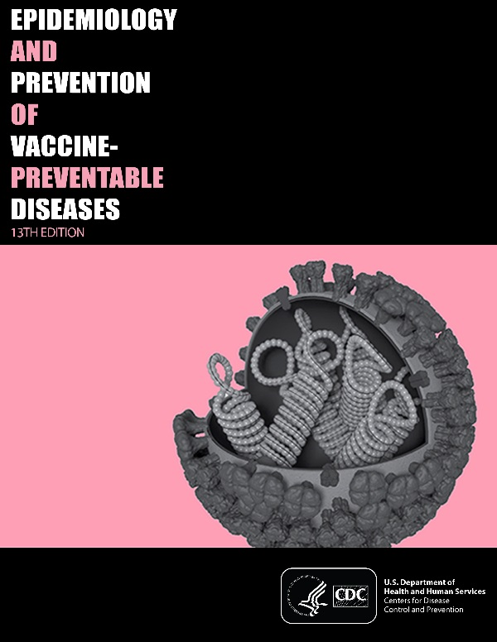
Immunization Training for Clinicians
You Call the Shots: Web-based modules that discuss vaccine-preventable diseases (VPDs) and explain the latest recommendations for vaccine use. CE/CME credit offered.
Current Issues in Immunization Net Conference (CIINC): Live 1-hour audio and visual presentations with on-demand replays. Offered 4-5 times per year. CE/CME credit offered.
Pink Book Webinar Series: Online series of 15 1-hour webinars. Provides an overview of the principles of vaccination, general recommendations, immunization strategies for providers, and specific information about VPDs and vaccines. CE/CME credit offered.
Webcasts: Topics include HPV, pertussis, flu, vaccine storage and handling, and more. CE credits offered.
www.cdc.gov/vaccines/ed/index.html
44
Notes:
CDC offers a wide range of FREE trainings for clinicians, most of which offer CE/CME credit. These include:
The You Call the Shots online modules about vaccine-preventable diseases and vaccine recommendations
Live net conferences about current issues in immunization
A series of online webinars about the content of the Pink Book, which discusses the epidemiology and prevention of vaccine-preventable diseases; and
Webcasts on a host of other topics.
Visit this website for more details.

Slide 45
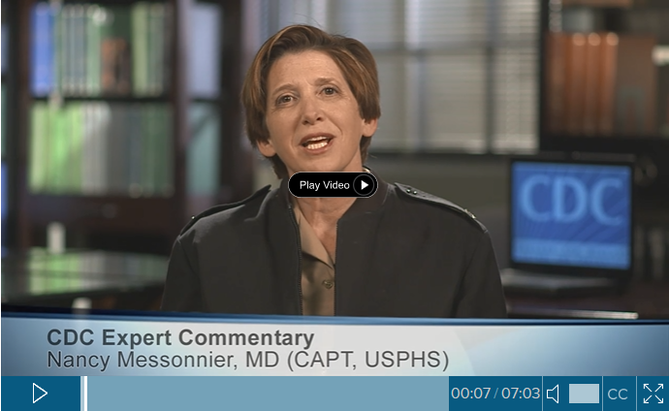
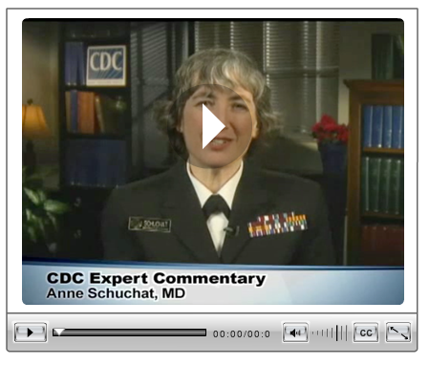
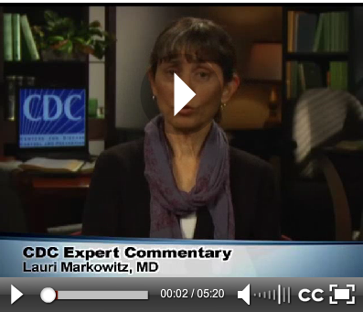
CDC Medscape Expert Commentaries
Vaccine Communication with Parents: Best Practices– Nancy Messonnier, MD
  http://www.medscape.com/viewarticle/882865?src=par_cdc_stm_mscpedt&faf=1
Overcoming Vaccine Concerns and Refusals – Anne Schuchat, MD http://www.medscape.com/viewarticle/742313
Common Questions about 9-Valent HPV Vaccine— Lauri Markowitz, MD http://www.medscape.com/viewarticle/846509
45
Notes:
CDC also collaborates with Medscape to produce expert commentaries on a wide variety of public health topics, including immunization. Here are three recent commentaries related to childhood immunization.
The first commentary about vaccine communication features Dr. Nancy Messonnier, head of the National Center for Immunization and Respiratory Diseases, or NCIRD
The second features Dr. Anne Schuchat, back when she was the head of NCIRD.
The third features Dr. Laurie Markowitz, an HPV subject matter expert at CDC.

Slide 46
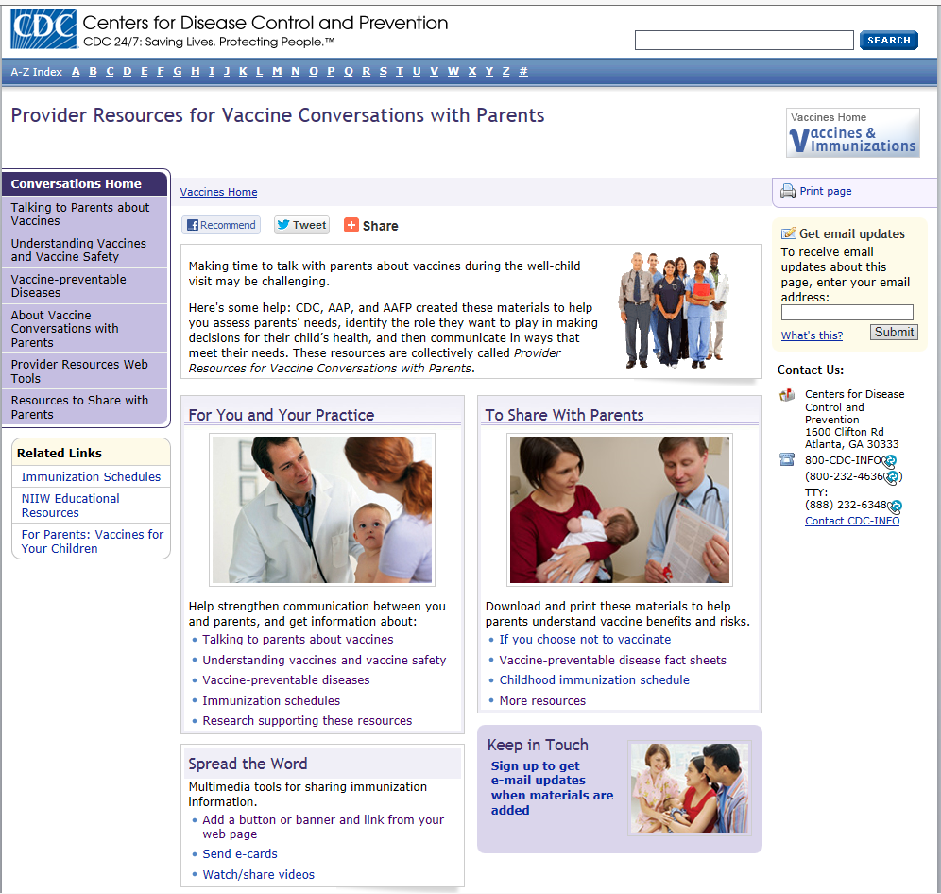
Provider Resources for Vaccine Conversations with Parents
Talking to Parents about Vaccines
Understanding Vaccines and Vaccine Safety
  How Vaccines Work
  The Recommended Childhood Immunization Schedule
  Ensuring the Safety of U.S. Vaccines
  Understanding MMR Vaccine Safety
  Understanding Thimerosal, Mercury, and Vaccine Safety
  The Advisory Committee on Immunization Practices
Diseases and the Vaccines that Prevent Them
If You Choose Not to Vaccinate, Understand the Risk and Your Responsibilities
www.cdc.gov/vaccines/conversations
46
Notes:
One of the conversations you probably have with parents on a daily basis is about protecting their children from vaccine-preventable diseases. CDC, AAP, and AAFP created a suite of online materials to help you assess parents' needs, identify the role they want to play in making decisions for their child’s health, and then communicate in ways that meet their needs. These resources are collectively called Provider Resources for Vaccine Conversations with Parents.
They include:
Guidance for how to talk with parents about vaccines, including how to answer some common questions
Plain language fact sheets about vaccine-preventable diseases – in English and Spanish
Fact sheets about vaccine safety
Information for parents who choose not to vaccinate
Videos
And more!
These resources may help you start or continue a vaccine conversation with parents; the materials also are effective educational tools for parents to supplement the conversations you have with them.

Slide 47
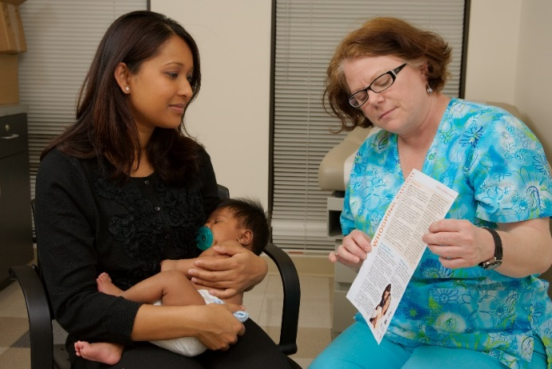
How to Use Provider Resources
Review Talking to Parents about Vaccines and vaccine safety sheets with your staff; vaccine safety sheets may also be given to high information seeking parents with specific safety concerns.
Give parents fact sheets about any diseases/vaccines that they have questions about. Time permitting, talk through the fact sheet together with them.
Share If You Choose Not to Vaccinate, Understand the Risk and Your Responsibilities with parents who are considering skipping vaccines.
Create a waiting room display with fact sheets and the current CDC immunization schedule.
47
Notes:
There are many ways that you can use the materials in Provider Resources with Vaccine Conversations for Children.
READ LIST

Slide 48

HPV Specific Resources for Clinicians
Clinical guidance
HPV vaccination coverage info
CE courses
#PreteenVaxScene webinars
#HowIRecommend videos
Tips for talking with parents
Fact sheets for parents
https://www.cdc.gov/hpv/partners/outreach-hcp/clinician-resources.html https://www.cdc.gov/vaccines/ed/hpv/index.html
48
Notes:
CDC also has many HPV resources for clinicians, listed here.
The short How I Recommend videos are one of the new resources—They are very helpful for hearing how real healthcare professionals talk about HPV with their patients.
You can find all of the resources on these webpages.

Slide 49
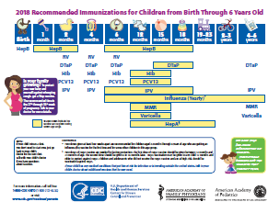
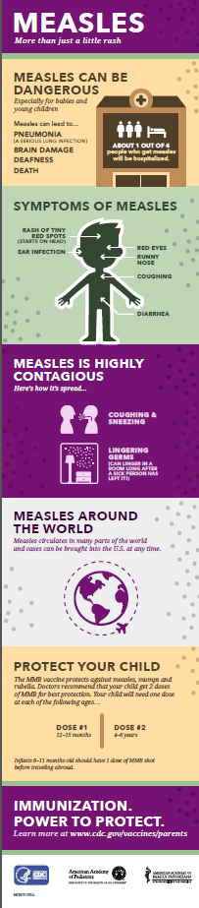
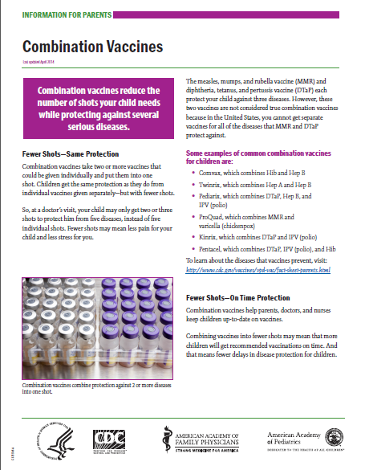
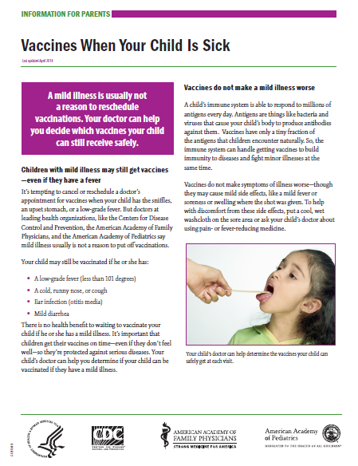
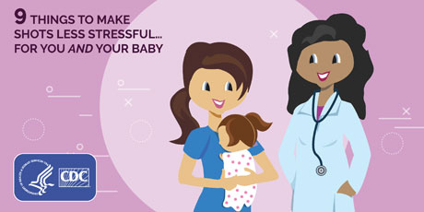
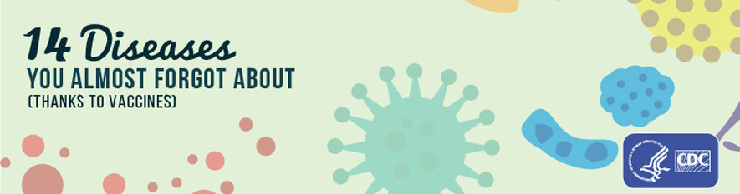
Childhood Immunization Materials to Share with Parents
www.cdc.gov/vaccines/parents/resources
49
Notes:
This slide shows CDC childhood immunization resources that you can share with parents:
Fact sheets
Easy-to-read immunization schedules in English and Spanish
Infographics and listicles
Go to the URL listed on this slide to see these items and more, like posters and videos.
I will talk more about how to use these in a few minutes.

Slide 50
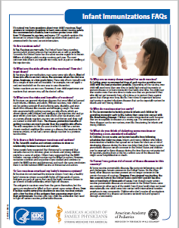
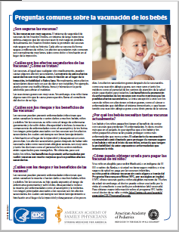
Infant Immunization FAQs
Written for parents of children ages 0-2
English and Spanish
HTML and PDF
Co-branded with AAP and AAFP
www.cdc.gov/vaccines/parents/parent-questions.html
50
Notes:
Here are screen shots of CDC’s frequently asked questions about infant immunizations. A few examples include:
Are vaccines safe?
Can vaccines overload my baby’s immune system?
What’s wrong with delaying my baby’s vaccines if I’m planning to get them all eventually?
These fact sheets are written for parents of children 0-2 and CDC developed them together with The American Academy of Pediatrics and The American Academy of Family Physicians.
They are available in English and Spanish, and you can view them online or download a PDF to print and copy for parents in your practice.

Slide 51
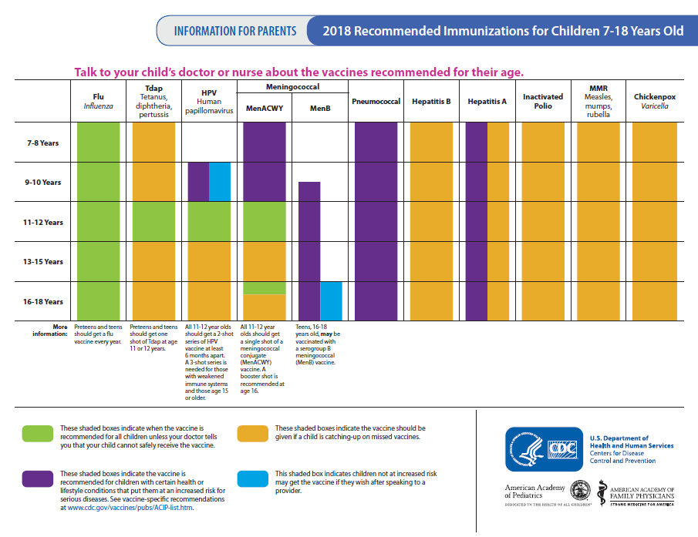
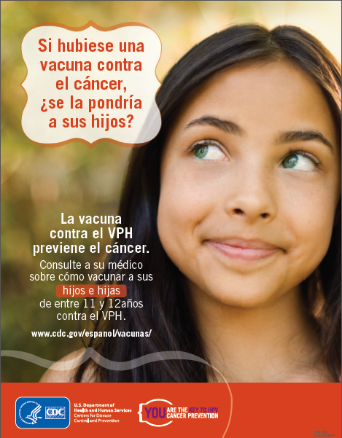
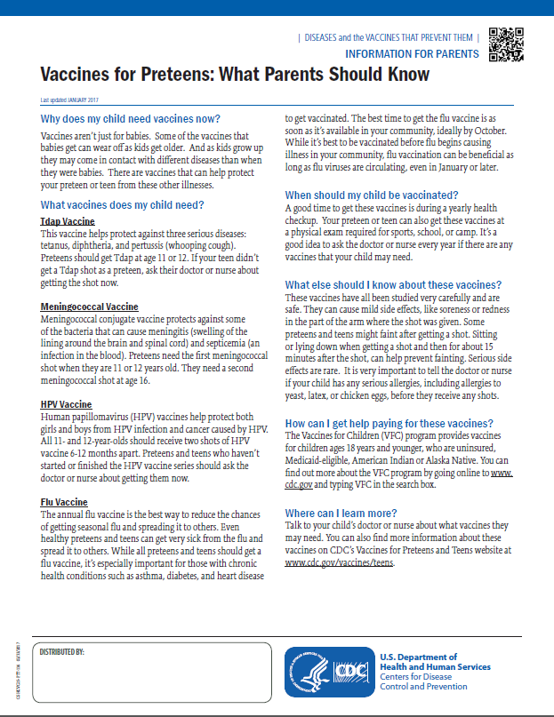
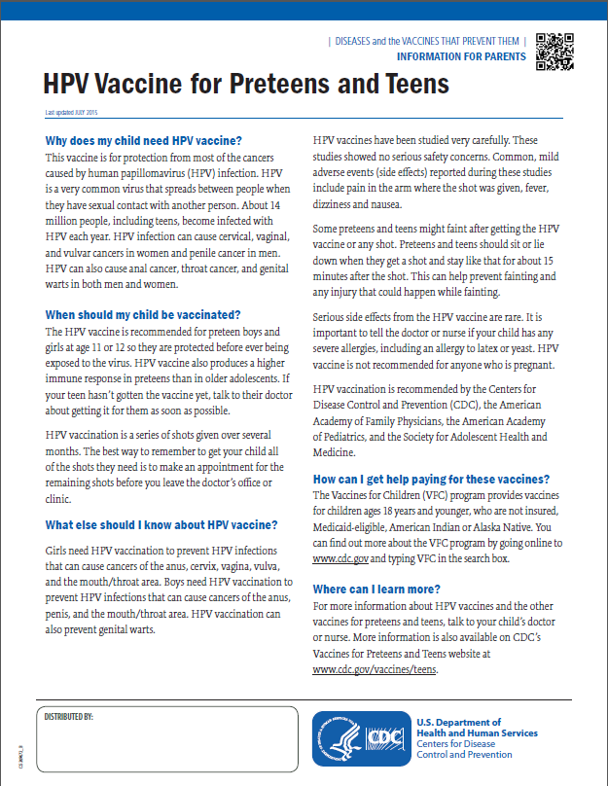
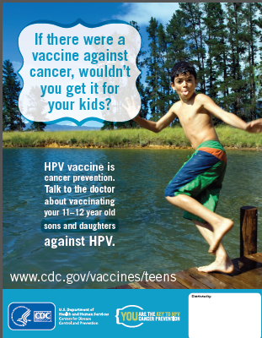
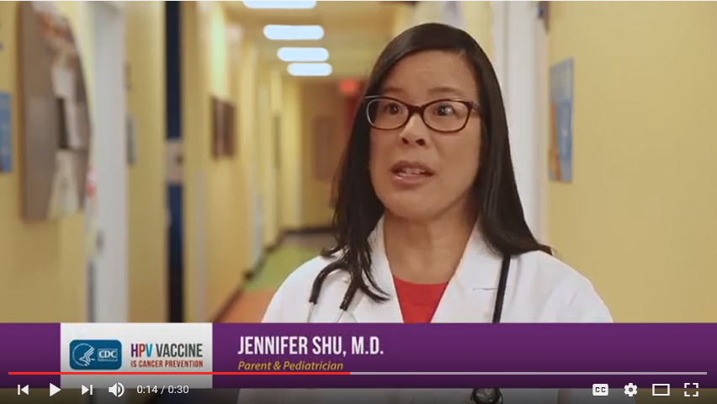
Adolescent Immunization Materials to Share with Parents
https://www.cdc.gov/hpv/partners/outreach-parents/materials-parents.html
51
Notes:
This slide shows CDC adolescent immunization resources that you can share with parents:
Fact sheets
Easy-to-read immunization schedules in English and Spanish
Posters
Videos
Go to the URL listed on this slide to see these items and more.

Slide 52
How to Use Communication Resources
Share with parents and also your peers.
Syndicate CDC web content on your practice website: https://tools.cdc.gov/medialibrary/index.aspx#/learnmore#gethelp
Share infographics and listicles via your practice’s social media channels.
Order posters and hang them in your waiting rooms or exam rooms.
Give copies of parent-friendly CDC immunization schedules to parents.
Order or download fact sheets and make them available:
  Include in information packets for new patients
  Create a waiting room display
  Have copies available in exam rooms or a central location so that you can give them to parents who have specific concerns
All CDC materials are available for free download; certain materials can be ordered from CDC-INFO On Demand: https://wwwn.cdc.gov/pubs/CDCInfoOnDemand.aspx
52
Notes:
Here are some ideas for how to use these communication resources in your practice.
You can share them with parents and peers—either in hard copy, via email, or via your practice’s social media channels. For example, you could print out hard copies of the parent-friendly immunization schedule, and then share CDC infographics and listicles via your practice Facebook page.
You can syndicate CDC web content and web features for your own website. It’s easy and efficient, because when CDC makes updates, the updates will appear on your website as well.
You can order CDC posters and hang them in your waiting room or exam room.
You can also download fact sheets and include them in new parent packets, put them in a waiting room display, or leave them out in exam rooms.
All CDC materials are free to download and some can be ordered in hard copy at the CDC-INFO On Demand website listed here.

Slide 53
STATE OR LOCAL RESOURCES
[ADD ANY RESOURCES AVAILABLE FROM YOUR HEALTH DEPARTMENT OR IMMUNIZATION COALITION]
53

Slide 54
Questions?
[ADD YOUR CONTACT INFORMATION HERE]
54

