Slide 1
How Your Child Care Program Can Support Immunization
[INSERT NAMES OF PRESENTERS]
[INSERT YOUR ORGANIZATION’S NAME AND LOGO]
Last updated April 2017

Slide 2
Learning Objectives
After participating in this training, participants should be able to:
Understand the role that immunizations play in early childhood development and the health of your child
Describe vaccine-preventable diseases that commonly occur in child care settings
Describe ways that their child care program can support immunization

Slide 3
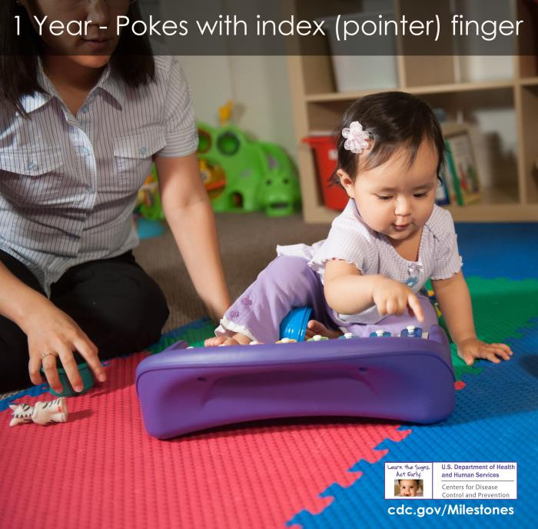
Immunization and Early Childhood Development
Early years important to childhood growth and development
Multiple milestones in 1st year of life
  Social and Emotional
  Language/Communication
  Cognitive (learning, thinking, problem solving)
  Movement/Physical Development
SOURCE: Centers for Disease Control and Prevention. Child Development. https://www.cdc.gov/ncbddd/actearly/pdf/checklists/all_checklists.pdf
Notes:
As you all know, a child’s early years are very important for his childhood growth the development.
A child will achieve multiple milestones in his first year of life. These include:
Social and emotional milestones – like smiling, looking at herself in the mirror, and playing with others
Language and communication milestones – like responding to her own name, pointing at things, and saying mama and dada
Cognitive milestones related to learning, thinking and problem solving – like showing curiosity about things, looking for things you hide, and following verbal commands
Milestones related to movement and physical development – like sitting without support, crawling, and walking
A child’s health can impact her physical development.

Slide 4
Immunization and Early Childhood Development (cont.)
Factors that impact healthy development
  Social, emotional factors
    Positive – singing, reading, talking
    Negative – emotional neglect
  Physical factors
    Positive – proper nutrition, exercise, rest, immunization
    Negative – physical neglect, illness
Poor health in young children can have negative impacts on development
Immunizations can provide protection from serious illnesses during development and beyond
SOURCES:
Centers for Disease Control and Prevention. Child Development. https://www.cdc.gov/ncbddd/childdevelopment/index.html
Centers for Disease Control and Prevention. Child Maltreatment Surveillance. https://www.cdc.gov/violenceprevention/pdf/CM_Surveillance-a.pdf
National Institute on Deafness and Other Communication Disorders. Ear Infections in Children. https://www.nidcd.nih.gov/health/ear-infections-children
Notes:
There are many factors that can impact a child’s healthy development in both positive and negative ways.
For example, growing up in safe and loving home can have a positive impact on a child’s development.
Emotional neglect can have a negative impact.
Proper nutrition, exercise, and rest can have a positive impact on development. But poor nutrition and physical neglect, like not having proper medical care, can have a negative impact on development. Illness can also have a negative impact on a child’s development. For example, chronic ear infections can impact a child’s speech and language development.
Immunizations can provide protection from serious illnesses that can have a negative impact on a child’s development. For example, the PCV shot, which protects against pneumococcal disease, can help prevent ear infections.

Slide 5
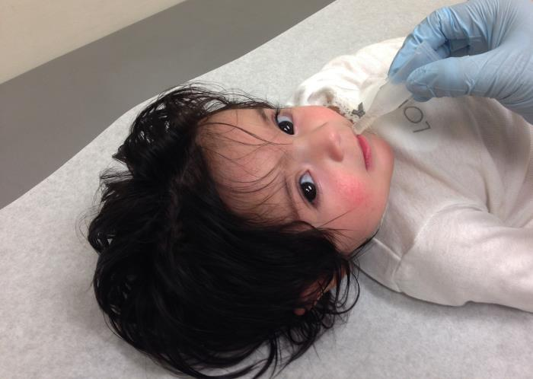
Childhood Immunization Provides Big Savings
  CDC estimates that vaccination of children born between 1994 and 2016 will:
  Prevent 381 million illnesses
  Prevent 24.5 million hospitalizations
  Help avoid 855,000 early deaths
  Save nearly $360 billion in direct costs and $1.65 trillion in total societal costs
SOURCE: Updated from previous publication: Benefits from Immunization During the Vaccines for Children Program Era – United States, 1994-2013. MMWR. 25 April 2014.
Notes:
This slide shows the powerful impact of childhood immunizations. This data comes from a study that looked at hypothetical groups of children born from 1994 to 2013 (also known as birth cohorts). If these children were all vaccinated against 12 diseases,
322 million illnesses would be prevented;
42,000 lives would be saved; and
Nearly $1.4 trillion societal costs would be saved over the course of their lifetimes.
Societal costs include things like loss of productivity from time taken off work due to illness.
NOTE: This study did not include the flu vaccine or the hepatitis A vaccine.

Slide 6
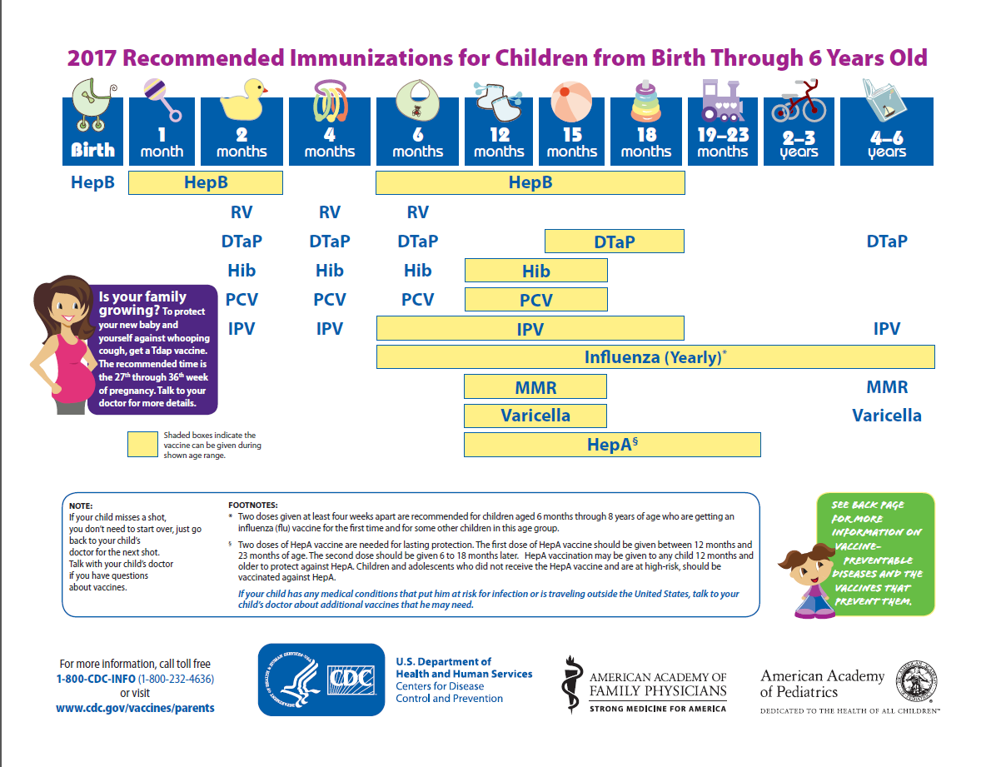
Immunization Schedule
Recommended immunizations help protect infants and young children from 14 diseases
Chickenpox
Diphtheria
Flu (influenza)
Hepatitis A
Hepatitis B
Hib
Measles
Mumps
Pneumococcal
Polio
Rotavirus
Rubella
Tetanus
Whooping cough (pertussis)
SOURCE: Centers for Disease Control and Prevention. https://www.cdc.gov/vaccines/index.html
Notes:
The CDC recommended schedule for children 0-6 years old protects children from 14 vaccine-preventable diseases, which are listed here. The schedule is designed the way it is to provide protection early in life, before they are exposed to potentially life-threatening diseases.
Many of these can spread in a child care setting. I only have time to talk about three of most common ones – flu, measles, whooping cough

Slide 7
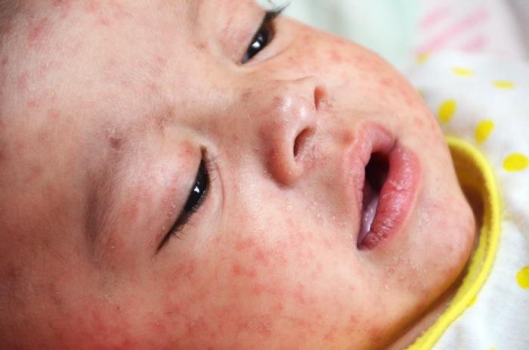
Measles: The Disease
Measles is a respiratory (breathing) disease caused by a virus.
Measles symptoms include high fever, cough, runny nose, red and watery eyes, tiny white spots inside the mouth, and rash.
Measles is one of the most contagious diseases.
  It spreads when people cough or sneeze.
  People who are infected can spread measles 4 days before they get the rash through 4 days after it appears.
Measles is more serious in children under 5 years old and adults over 20 years.
Millions of people worldwide get measles each year, thousands die.
SOURCE: Centers for Disease Control and Prevention. Measles (Rubeola). https://www.cdc.gov/MEASLES/
Notes:
Measles is a respiratory disease caused by a virus.
You may think of a red rash when you think of measles, but there are other symptoms, including high fever, cough, runny nose red and water eyes, and tiny white spots inside the mouth.
It’s especially important for child care centers to be aware of measles because it is one of the most contagious diseases, meaning that it spreads very easily when people cough or sneeze. People who are infected can spread measles 4 days before they get a rash through 4 days after the rash appears. A child can get measles just by being in a room where a person with measles has been, even up to two hours after that person has left.
Measles is more serious in children under 5 years old and adults over 20 years old.
Measles is very common in other countries, and outbreaks have also happened in the United States in recent years. Millions of people worldwide get measles each year, and thousands die from it.

Slide 8
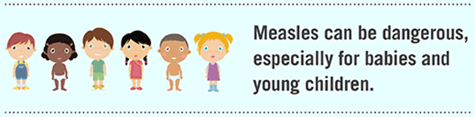
Measles: Who Should Be Vaccinated?
Children
  First dose at 12 through 15 months of age, second dose at 4 through 6 years of age.
  Infants 6 months to 11 months old should have 1 dose of MMR shot before traveling abroad.
Two doses of MMR (measles-mumps-rubella) vaccine are 97% effective at protecting against measles
MMR vaccine protects you and people who are unable to be vaccinated because they are too young or have weakened immune systems.
SOURCES: Centers for Disease Control and Prevention. Measles (Rubeola). https://www.cdc.gov/MEASLES/
Centers for Disease Control and Prevention. Measles and the Vaccine (Shot) to Prevent It. https://www.cdc.gov/vaccines/parents/diseases/child/measles.html
Notes:
This slide explains who should be vaccinated for measles. CDC recommends that children receive two doses of MMR vaccine, which prevents measles, mumps, and rubella. They need the first dose at 12 through 15 months of age and the second dose at 4 through 6 years of age.
The vaccine is very effective – two doses of MMR vaccine are 97% effective at protecting against measles.
The vaccine doesn’t just protect babies and young children who receive it – it also protects other babies around them who can’t be vaccinated because they are too young or they have weakened immune systems.

Slide 9
Whooping Cough (Pertussis): The Disease
Respiratory (breathing) disease that spreads very easily.
Most dangerous for babies. Most whooping cough deaths are in early infancy.
Many babies catch whooping cough from their close family members.
Early symptoms include runny nose, mild, occasional cough, apnea (pause in breathing) in babies.
Later symptoms include fits of rapid coughs followed by a high-pitched “whoop” and vomiting during or after coughing fits.
Whooping cough is on the rise in the United States.
SOURCE: Centers for Disease Control and Prevention. Pertussis (Whooping Cough). https://www.cdc.gov/pertussis/index.html
Notes:
Whooping cough, or pertussis, is another respiratory disease that spreads very easily. It is dangerous for babies. Most whooping cough deaths occur in early infancy, when babies are just a few months old or younger. Following the introduction of pertussis vaccines in the 1940s when the number of cases frequently exceeded 100,000 cases per year, reports declined dramatically to fewer than 10,000 by 1965. During the 1980s pertussis reports began increasing gradually, and by 2015 more than 20,000 cases per year were reported nationwide.
Many babies catch whooping cough from their close family members. They could also potentially catch it from other caregivers, like child care center workers, who are in close contact with the baby.
Early symptoms include those listed here. Later symptoms include fits of rapid coughs followed by a high-pitched “whoop” and vomiting during or after the coughing fits.
Whooping cough is on the rise in the United States.

Slide 10

Whooping Cough: Who Should Be Vaccinated
Vaccination is recommended for people of all ages.
  Infants and children (DTaP vaccine)
    --One dose at 2, 4, 6, 15-18 months and 4 to 6 years
  Adolescents (Tdap vaccine)
  Adults, including child care workers (Tdap vaccine, if not received as an adolescent)
  Pregnant women (Tdap vaccine)
Vaccinating women during each pregnancy is the best way to help prevent pertussis in infants before they are old enough to get their own vaccines.
SOURCE: Centers for Disease Control and Prevention. Pertussis (Whooping Cough). https://www.cdc.gov/pertussis/index.html
Notes:
Whooping cough vaccine is recommended for many age groups. Infants and children need 5 doses of the DTaP vaccine at 2 months, 4 months, 6 months, 15-18 months, and 4-6 years.
Adolescents, adults and pregnant women all need the Tdap vaccine. In some states, child care workers are required to be vaccinated against whooping cough. INSERT INFORMATION ABOUT REQUIREMENTS IN YOUR STATE.
Even if this is not required by state regulations, it’s a good idea for child care workers to receive Tdap vaccine, especially if they care for very young babies.
It’s also important to note that vaccinating women during each pregnancy is the best way to prevent pertussis in infants before they are old enough to get their own vaccines. This is because moms pass the protection to their babies when they are vaccinated during pregnancy.
The recommended time for vaccination is the 27th through 36th week of pregnancy and preferably during the earlier part of this timeframe. You may serve families with multiple children in which the mother is pregnant. You can help ensure that her children are protected against whooping cough by reminding her about the Tdap vaccine.

Slide 11
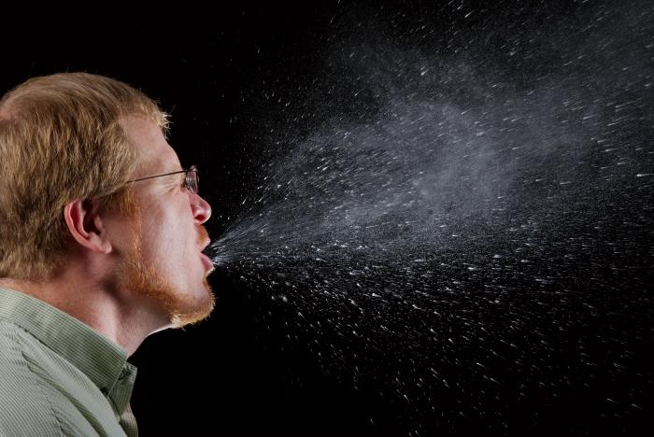
Flu (Influenza): The Disease
Respiratory (breathing) disease that spreads very easily.
Spread by droplets (coughing, sneezing, etc).
Symptoms:
  Fever or feeling feverish/chills
  Cough
  Sore throat
  Runny or stuffy nose
  Muscle or body aches
  Headaches
  Fatigue (tiredness)
  Some people may have vomiting and diarrhea, though this is more common in children than adults.
SOURCE: Centers for Disease Control and Prevention. Key Facts about Influenza (Flu). https://www.cdc.gov/flu/keyfacts.htm
Notes:
Finally, let’s talk about influenza, or flu. Flu is another respiratory disease that spreads very easily. It is different from a cold.
Flu spreads most often by droplets from coughing or sneezing.
Flu symptoms usually come on suddenly. They include fever, cough, sore throat, runny or stuffy nose, muscle or body aches, headaches and tiredness. Some people, especially children, may also have vomiting and diarrhea.

Slide 12
The Health Impact of Flu
Anyone can get the flu (even healthy people), and serious problems related to the flu can happen at any age.
Some people are at risk of developing serious flu-related complications. This includes people 65 years and older, people of any age with certain chronic medical conditions (such as asthma, diabetes, or heart disease), pregnant women, and young children.
Each year, millions of children get sick with seasonal flu; thousands of children are hospitalized and some children die from flu.
Children younger than 5 years old and especially those younger than 2 years old are more likely to end up in the hospital from flu.
SOURCES:
Centers for Disease Control and Prevention. Key Facts about Influenza (Flu). https://www.cdc.gov/flu/keyfacts.htm
Centers for Disease Control and Prevention. Children, the Flu, and the Flu Vaccine. https://www.cdc.gov/flu/protect/children.htm
Notes:
Flu can have a bigger impact on your child care than you might imagine.
Anyone, even healthy people, can get the flu. Serious problems related to the flu can happen at any age.
Some people are at risk of developing serious complications from flu. Young children are one of these groups. Others include people 65 and older, people with chronic medical conditions, and pregnant women.
Each year, millions of children get sick with seasonal flu, thousands are hospitalized, and some children die. It’s important for child care workers to be aware of this, because children younger than 5 years and especially those younger than 2 years old are more likely to end up in the hospital from flu.

Slide 13
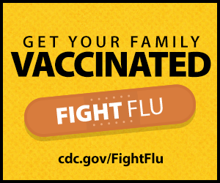
Flu: Who Should Be Vaccinated
Children 6 months and older should be immunized against the flu every year.
  Children less than 9 years old who are getting vaccinated for the first time will require two doses of flu vaccine, spaced at least 28 days apart.
Women pregnant during flu season should get a flu shot.
Other adults, including child care workers, should also be vaccinated each flu season.
Getting vaccinated before flu activity begins—if possible by October—helps protect you once the flu season starts in your community.
  However, CDC recommends flu vaccination as long as flu viruses are circulating - even into January and later.
SOURCE: Centers for Disease Control and Prevention. Preventing Seasonal Flu With Vaccination. https://www.cdc.gov/flu/protect/vaccine/index.htm
Notes:
A yearly flu vaccine is the first and most important step in protecting against flu viruses. Children 6 months and older should be immunized against the flu every year.
Women pregnant during flu season should also get a flu shot. Women can get the flu shot at any time, during any trimester, while they are pregnant.
Child care workers should also be vaccinated each flu season to avoid getting and spreading flu to babies and young children. INSERT INFORMATION ABOUT REQUIREMENTS IN YOUR STATE.
Getting vaccinated before flu activity begins, if possible by October, helps protect you once flu season started in your community. However CDC recommends flu vaccination as long as flu viruses are circulating, even info January and later.

Slide 14
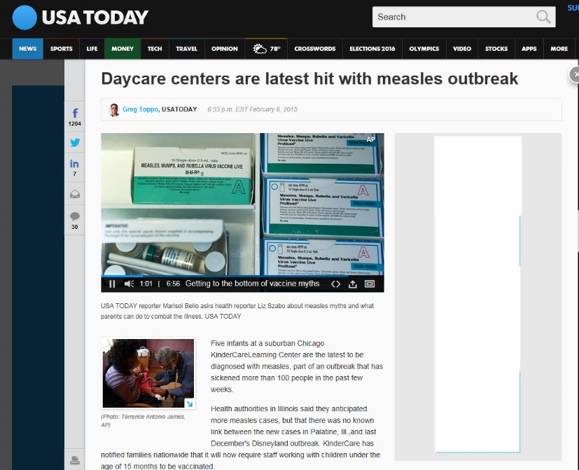
Outbreaks in Child Care Centers
Outbreaks of vaccine preventable diseases have occurred in childcare centers.
  Whooping cough (pertussis)
  Measles
  Chickenpox (varicella)
Unvaccinated children in your center/home are at risk.
  Babies too young for vaccination
  Children unable to be vaccinated due to medical conditions
Children who are not caught up on their vaccinations may be excluded from child care if there are outbreaks. Check your state guidelines.
Notes:
Outbreaks of vaccine preventable diseases have occurred in childcare centers. In recent years there have been outbreaks of measles and whooping cough, which we discussed, and also of chickenpox.
Unvaccinated children in your child care center or home are at risk of getting diseases if they are not vaccinated. This includes babies that are too young for vaccination and children who cannot be vaccinated due to medical conditions.
Children who are not caught up on their vaccinations may be excluded from child care if there are outbreaks. INSERT INFORMATION ABOUT WHERE TO FIND GUIDELINES IN YOUR STATE.

Slide 15

You Can Help Maintain and Strengthen Immunization Rates Among Families
Vaccination is one of the best ways parents can protect young children from 14 serious diseases.
Most parents vaccinate, but some have questions.
Many pregnant women may not know they need vaccination to protect themselves and their baby from flu and whooping cough.
  Encourage them to learn about the safe, proven protection vaccines provide
YOU play a key role in ensuring families are up-to-date on their vaccinations and keeping the children in your care protected and healthy.
Notes:
This talk of outbreaks may sound worrisome, but it is possible to prevent them.
Vaccination is one of the best ways that parents can protect young children from 14 serious diseases.
It’s also important to know that despite what you may hear in the media, most parents DO choose to vaccinate, although some may have questions. In 2015, more than 90% of children aged 19-35 months were up to date on vaccination against polio; hepatitis B; measles, mumps, and rubella; and varicella. Less than 1% of children had received no vaccines at all.
As we have discussed, pregnant women need flu and whooping cough vaccines, but they might not know it. You may serve families where the mom is pregnant. Encourage these moms to learn about the safe, proven protection that vaccines provide.
Finally, as a child care provider, YOU play a key role in making sure that families are up-to-date on their vaccinations.

Slide 16

3 Ways to Support Immunization in Your Child Care Program
Check immunization records regularly to ensure each child in your care is up to date on their vaccinations.
Educate yourself and ensure that you and your staff are vaccinated.
Educate parents in your program and help connect them to credible resources.
Notes:
Making sure that children that you are caring for are immunized according to the CDC’s recommended immunization schedule is the best way to ensure they are protected from 14 very serious diseases. The purpose of the recommended immunization schedule is to protect infants and children by providing immunity early in life, before they are exposed to potentially life-threatening diseases. Each vaccine is tested during the licensing process to be sure that it is safe and effective for children to receive at the recommended ages. When children get behind schedule for one reason or another, this puts them at risk of becoming ill with a disease during the time they are unprotected. But the good news is that they can work with their child’s doctor to get them caught up on their vaccines.
So, making immunization a priority in the early childcare setting really is critical – it’s about fostering an environment that promotes health.
Today I’m going to talk about 3 ways to do this.
Checking immunization records to make sure each child is up to date on their vaccinations
Educating yourself and ensuring that you and your staff are vaccinated.
Educating parents in your program and connecting them to credible resources

Slide 17
Check Immunization Records Regularly
Ensure that children in your program are up to date on their recommended vaccines –Refer to CDC’s easy to read schedule: https://www.cdc.gov/vaccines/schedules/easy-to-read/child.html
Check vaccines when children first enter your care. Keep checking their records on a regular basis to make sure they stay on track with your state requirements and the CDC schedule.
If you determine a child may be behind, refer the parent to their child’s healthcare professional.
Notes:
The first step is making sure you know which children in your program are up to date on their vaccines and which need to catch up.
As children are enrolled in the program, check their vaccine records against the recommended immunization schedule (pictured here) to see if they have received all their recommended vaccine doses. Then, as children get older, check their vaccine records again on a regular basis to make sure they are staying up to date.
It may be helpful to set a regular schedule for reviewing immunization records of all children, like on a quarterly basis.
If you determine that a child may be behind on her vaccines, ask the parent to make an appointment with the child’s healthcare provider as soon as possible to get caught up.

Slide 18
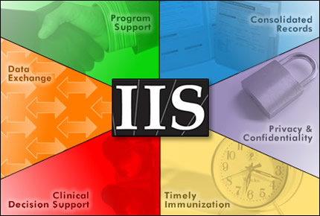
Immunization Information Systems
Almost every state has an immunization information system (IIS) or immunization registry.
  IIS are computerized databases that providers can use to record all immunizations given to children.
In [YOUR STATE], child care providers can access the IIS to see which immunizations children have already gotten [EDIT THIS INFORMATION AS NEEDED].
  Parents can also request IIS immunization records from their child’s medical provider.
Contact [YOUR HEALTH DEPARTMENT OR COALITION] if you have questions about accessing the IIS.
Notes:
Immunization Information Systems can help make your job of tracking immunizations much easier.
IIS are confidential, computerized databases that record all immunization doses administered by participating medical providers. In other words, when a health care professional like a nurse gives a vaccine to a child, they enter this information into their state’s IIS.
INSERT NOTES ABOUT YOUR STATE’S IIS.
The IIS is probably the best way to get the most accurate, up-to-date immunization information for a given child. I’m guessing that you will find it far easier and faster to just look up the immunization records for children in your program through your IIS then to have to go through the potentially lengthy process of reaching out to parents to get this information, and the follow up and record keeping that goes along with that.
INSERT NOTES ABOUT WHETHER OR NOT CHILD CARE PROVIDERS CAN ACCESS IIS INFORMATION IN YOUR STATE.
.INSERT INFORMATION ABOUT HEALTH DEPARTMENT OR COALITIONS THAT CAN POTENTIALLY PROVIDE TRAINING.

Slide 19
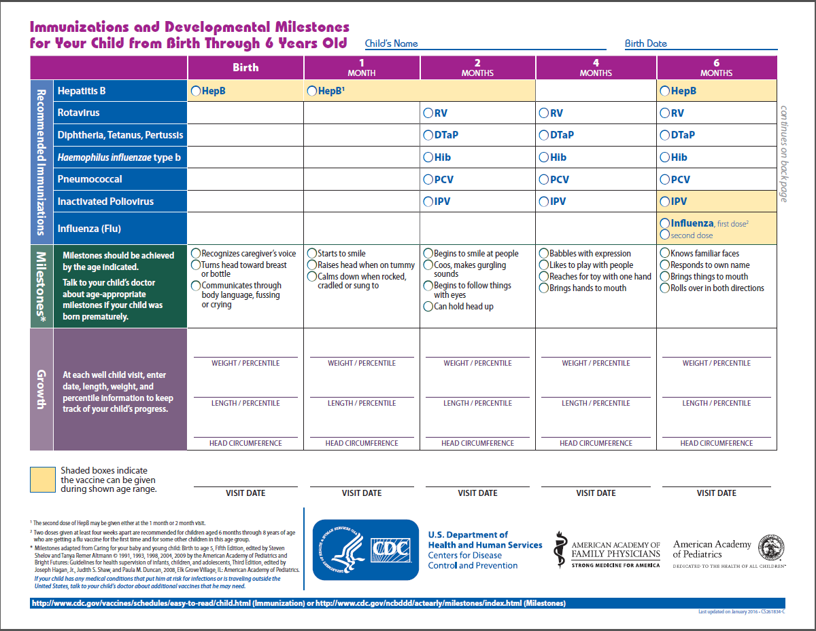
Keeping Track of Vaccinations: Making a Parent’s Job Easier
Parents should request a shot record from their child’s doctor. They can also use CDC’s vaccine tracker for their own personal records.
Parents should keep the child’s shot record in a safe place with other important documents.
Encourage parents to check to make sure that their children are up to date on all recommended vaccine doses.
Make sure parents know about vaccines that are required as their children get older.
https://www.cdc.gov/vaccines/parents/downloads/milestones-tracker.pdf
Notes:
Parents should request a shot record from their doctor as official proof of vaccination. However, it can also be helpful for parents to track shots themselves in order to see what is coming up and which shots their child may be missing. They can then discuss upcoming or missing shots with their child’s doctor and make sure their children stay on schedule.
This slide shows a tool that parents can print out from the CDC website and use it to record and track both their children’s immunizations and their developmental milestones for their personal records. These are not official records that should be accepted by child care centers. [INSERT ANY INFORMATION ABOUT ADDITIONAL TRACKERS THAT YOUR STATE OFFERS]
All doses of the recommended vaccines are need for the best protection possible against these diseases. We know from CDC immunization coverage, data, however, that many parents find it challenging to get final doses. By encouraging them to get these final doses, you can help ensure that the children get fully immunized.
As children get older, different vaccines are recommended at different ages, so be sure parents are aware, and a tool like this can help.

Slide 20
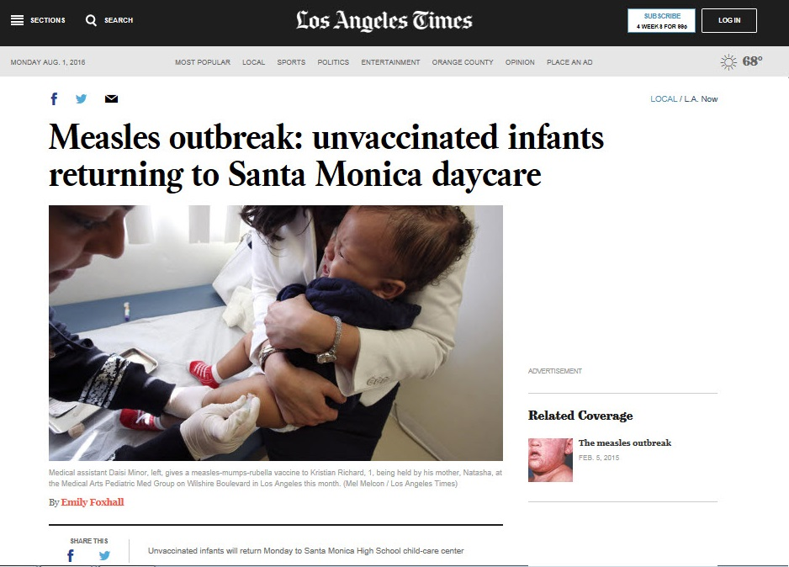
Notifiable Diseases
Promptly notify [YOUR HEALTH DEPARTMENT] if any children in your child care center are diagnosed with a notifiable disease (Ex: measles or whooping cough).
Check with [YOUR HEALTH DEPARTMENT] for a list of notifiable diseases in [YOUR STATE].
Notes:
Many of the Vaccine preventable diseases are notifiable diseases, meaning that they should be reported to your state or local health department, who then in turn reports to CDC.

Slide 21
Educate Yourself and Your Staff
Educate yourself and any staff about:
  The childhood immunization schedule
  The benefits and risks of vaccination
  Vaccine-preventable diseases (including symptoms)
Key messages to tell parents:
  Look into your state’s child care vaccination requirements.
  Vaccines are the best way protect infants and children from 14 serious diseases.
  Vaccines protect their children—and they also protect other children.
  The Vaccines for Children Program provides eligible children vaccines at no cost.
Notes:
I encourage you to do some reading about vaccines and educate yourself and any staff you may have. You don’t have to become an expert on this topic, but there are materials that can help you be prepared to answer some of the more common questions that parents ask about vaccines. I’ll highlight these shortly, and going through these ahead of time may help you feel more comfortable discussing the importance of following the immunization schedule when you talk with parents.
I encourage you to learn about:
The childhood immunization schedule
The benefits and risks of vaccination
Vaccine-preventable diseases (including symptoms)
When you’re talking with parents, key messages to tell them are:
Look into your state’s child care vaccination requirements.
Vaccines are the best way to protect infants and children from 14 serious diseases, like bacterial meningitis and polio.
Vaccines protect their children—and they also protect other children. For example, some children are too young to be protected with immunization or cannot be vaccinated due to medical conditions, such as cancer, and vaccines help protect them too.
The Vaccines for Children Program provides eligible children vaccines at no cost.

Slide 22

Vaccines for Children Program
Federal program that provides vaccines at no cost for children 18 and younger who are:
  Medicaid-eligible
  Uninsured
  American Indian or Alaska Native
  Underinsured (Their insurance doesn’t cover vaccines or certain vaccines)
May still be a fee for the office visit.
VFC providers: Private doctors, private clinics, hospitals, public health clinics, community health clinics, schools
To find a VFC provider, contact [NAME AND CONTACT INFORMATION FOR YOUR STATE VFC COORDINATOR]
Notes:
The Vaccines for Children, or VFC, Program is a federal program that provides vaccines at no cost for eligible children. You can see the eligibility criteria listed here.
If a family gets vaccines through the VFC program, the vaccines themselves are free, but families may still be asked to pay a fee for the office visit.
A wide variety of providers participate in VFC, including 40,000 doctors, hospitals, public health clinics, and community clinics. Some schools also participate.

Slide 23
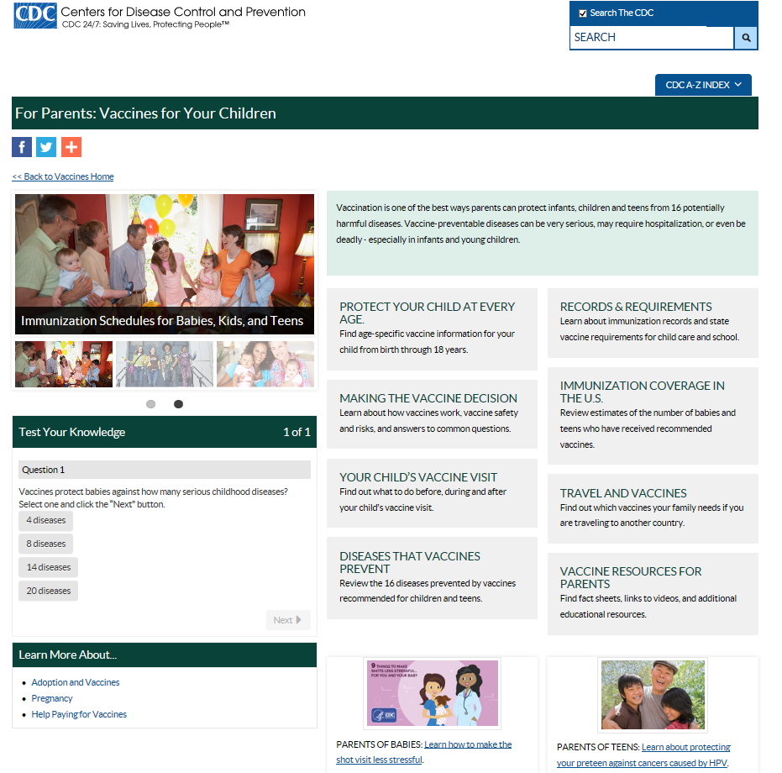
Where to Learn About Immunization
CDC Vaccine Website for Parents
                Easy-to read immunization schedules
                Basic information about vaccine-preventable diseases (English and Spanish)
                Information parents need to make the decision to vaccinate
                How to have a successful vaccine visit
                Records and requirements
                Videos, posters, and other educational resources
https://cdc.gov/vaccines/parents
Notes:
A great place to start as you are learning about childhood vaccines is the CDC’s vaccine website for parents.

Slide 24
Other Ways to Learn About Immunization
[TRAINING PROVIDED BY YOUR HEALTH DEPARTMENT OR COALITION]
Take advantage of CDC’s FREE online trainings (NOTE: Some are geared more for doctors and nurses): https://www.cdc.gov/vaccines/ed/index.html
Other immunization websites:
  American Academy of Pediatrics – Healthy Children https://www.healthychildren.org
  Children’s Hospital of Philadelphia Vaccine Education Center http://www.chop.edu/centers-programs/vaccine-education-center
  Vaccinate Your Family - http://vaccinateyourfamily.org/
  [YOUR HEALTH DEPARTMENT OR COALITION WEBSITE]
Notes:
Here are some other ways to learn about immunization.
INSERT INFORMATION ABOUT TRAINING PROVIDED BY YOUR HEALTH DEPARTMENT OR COALITION.
CDC also offers free online training courses about immunization. Some of them are geared more for doctors and nurses, so they may be more appropriate for child care staff with clinical backgrounds.
Here are some other websites that offer immunization information for parents and the general public. INSERT YOUR HEALTH DEPARMENT OR COALITION WEBSITE IF APPROPRIATE.

Slide 25
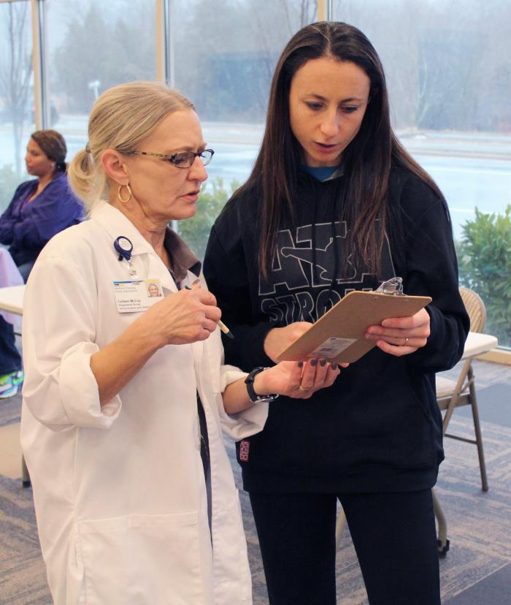
Get Vaccinated Yourself
Get vaccinated to protect yourself and so you don’t spread vaccine-preventable diseases to the children you care for.
Take CDC’s adult vaccine quiz to find out what other vaccines you may need. https://www2.cdc.gov/nip/adultimmsched/
Some states require child care staff to be vaccinated.
[INFORMATION ABOUT LAWS IN YOUR STATE]
Notes:
As a child care worker, it’s also important to get vaccinated yourself, so that you can protect yourself and don’t pass disease onto children.
You can find out what other vaccines you may need by taking CDC’s adult vaccine quiz.
Some states require that child care workers be vaccinated against certain diseases. INSERT INFORMATION ABOUT YOUR STATE’S LAWS.

Slide 26





Vaccines Are needed Throughout the Lifespan
www.cdc.gov/vaccines/adultquiz
Notes:
Vaccines aren’t just for children – they protect us throughout our lives. The URL at the bottom of this slide takes you to a quiz you can take to see what vaccines you may need as an adult.

Slide 27
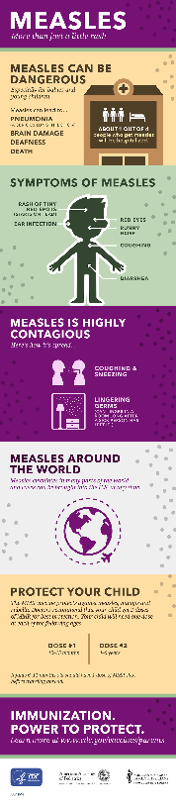
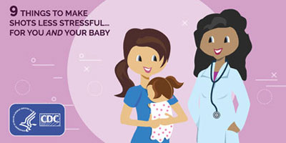


Free Materials for Parents
CDC vaccine website for parents (mentioned earlier): https://cdc.gov/vaccines/parents
Educational resources:
  Vaccine preventable disease fact sheets (English/Spanish)
  Vaccine safety fact sheets
  Posters and print ads
  Useful lists
  Infographics
  Videos
https://www.cdc.gov/vaccines/parents/resources/childhood.html
Notes:
CDC has a lot of free materials that you can share with parents. As a first step, you can refer parents to the CDC vaccine website for parents, which was mentioned earlier.
On this website, you can find a lot of educational resources, like those listed here.

Slide 28
Infant Immunization FAQs
https://www.cdc.gov/vaccines/events/niiw/ed-resources/downloads/f_provider-qa-color.pdf
https://www.cdc.gov/vaccines/events/niiw/ed-resources/downloads/f_provider-qa-color-sp.pdf
Notes:
I mentioned this piece earlier – Infant Immunization FAQs - This is a particularly good resource available in English and Spanish that provides answers to common vaccine questions that parents ask.

Slide 29
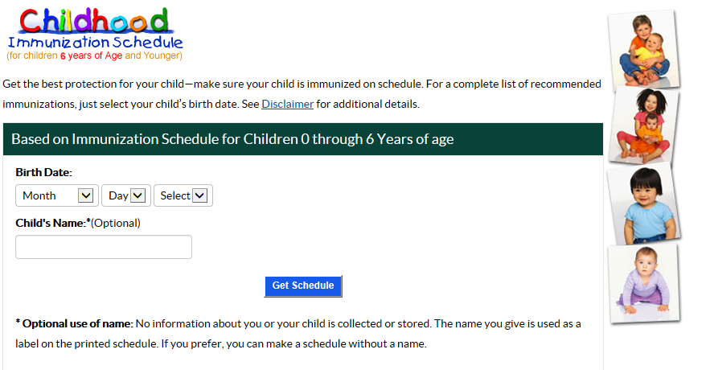
CDC Immunization Schedules
Updated every year and endorsed by the American Academy of Pediatrics (AAP) and the American Academy of Family Physicians (AAFP)
Easy-to-read versions in English and Spanish https://www.cdc.gov/vaccines/schedules/easy-to-read/child.html
Interactive online tool provides a tailored schedule for a child: https://www2a.cdc.gov/nip/kidstuff/newscheduler_le/
Notes:
It’s also a good idea to review the CDC immunization schedules, which are updated every year and endorsed by the American Academy of Pediatrics and the American Academy of Family Physicians.
CDC has easy-to-read, parent-friendly versions of the schedules in English and Spanish.
CDC also has an interactive online tool that provides a tailored schedule for a particular child according to his birthdate.

Slide 30
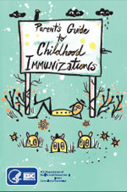
Parent’s Guide to Immunizations
60-page guide to vaccines and the diseases they prevent
Order hard copies and distribute to parents (max: 25) or encourage them to order a copy
https://wwwn.cdc.gov/pubs/CDCInfoOnDemand.aspx
See the next slide for detailed instructions.
Notes:
Another good resource is CDC’s 60-page Parent’s Guide to Childhood Immunizations. You can order up to 25 hard copies and distribute them, or encourage parents to order a copy themselves. I’ll show you how to do this on the next slide.

Slide 31
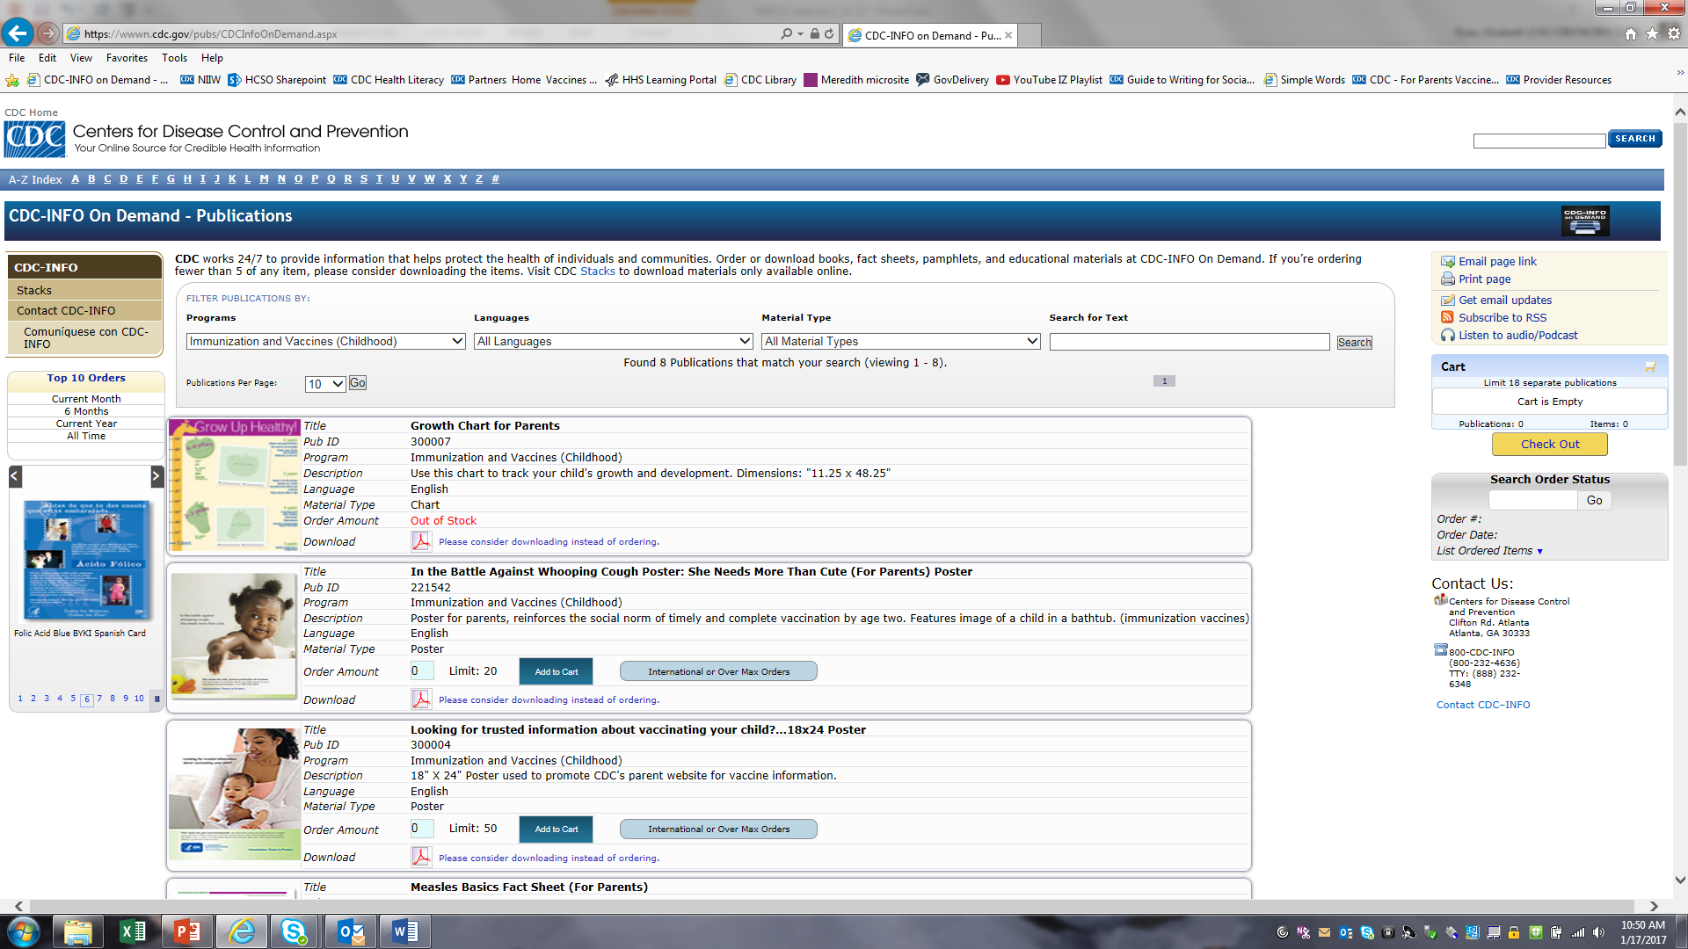
Ordering Materials
You can order copies of CDC’s Parents Guide, immunization schedules and selected CDC posters.
All materials are free of charge.
Visit the CDC-INFO On Demand website:
  https://wwwn.cdc.gov/pubs/CDCInfoOnDemand.aspx
  Under Programs, choose “Immunization and Vaccines (Childhood)” or “Immunization and Vaccines (Booklets and Schedules)”
  Press SEARCH
  Add items to your cart
  Check out
Notes:
To order a copy, go to the CDC-INFO ON Demand website. You can also order other things, like copies of the immunization schedule and selected immunization posters. Following the instructions here to place your order.
All materials are free of charge.

Slide 32
Educating Parents
Put CDC immunization schedules and fact sheets in new parent packets.
Hang posters, print ads, and flyers in your child care center.
Promote immunization in emails to parents. CDC has pre-written articles you can share: https://www.cdc.gov/vaccines/partners/childhood/matte-articles-features.html
Link to CDC website and resources from your website. You can find web buttons here:
  https://www.cdc.gov/vaccines/partners/childhood/multimedia.html#parents-buttons
Promote immunization through your social media channels https://www.cdc.gov/vaccines/partners/childhood/multimedia.html
Notes:
We all know there is a lot of information out there online about childhood vaccines, and unfortunately not all of it is accurate. Throughout your education efforts with parents, it is very important for you to always encourage them to seek information from credible sources of information. I’ve been sharing the CDC’s URL with you today, and that is an example of a website that you can feel comfortable sending parents to for information that is accurate, credible, and presented in a balanced manner.
Here a few ideas and suggestions for how to share credible information with parents.

Slide 33
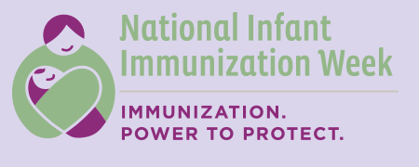

Immunization Observances
National observances = good time to promote immunization
National Infant Immunization Week (late April) https://www.cdc.gov/vaccines/events/niiw
National Immunization Awareness Month (August) https://www.nphic.org/niam
Notes:
Educating parents as soon as they join your child care center is a great idea, but there are also specific times of year when CDC has special immunization observances. These provide another opportunity to educate parents and encourage vaccination. They include National Infant Immunization Week in late April and National Immunization Awareness Month in August. You can find out more by visiting these websites.

Slide 34

Summary
Immunization keeps children healthy so that they can spend more time learning, growing and socializing with peers.
It’s important for child care programs to make immunization a priority and foster an environment of health through child care policies, education of staff, and parent education.
There are many ways that you can educate parents using resources from CDC and other credible organizations.
Notes:
To summarize what we have learned today, immunization keeps children healthy so that they can spend more time lowing, growing, and socializing with their peers.
It’s very important for child care programs to make immunization a priority and foster an environment of health by having child care vaccination policies, educating staff, and educating parents
And there are many ways that you can educate parents using resources from CDC and other credible organizations.

Slide 35

THANK YOU!
It Takes a Village to Protect Our Children, Families, and Communities Against Vaccine-Preventable Diseases
Notes:
In closing, I want to thank you for your time and attention today, and for your commitment to keeping children, families, and communities healthy and free of vaccine preventable diseases.

Slide 36
Questions?

Slide 37
Contacts
[YOUR CONTACT INFORMATION]

