Slide 1
Safe and Healthy Babies
Protecting Babies through Immunization

Slide 2
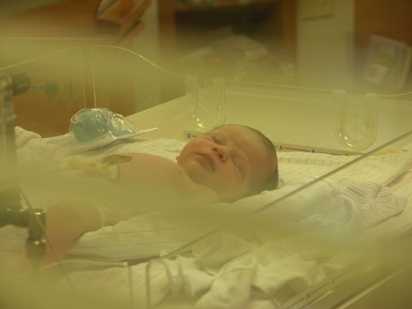
Are vaccines necessary?

Slide 3
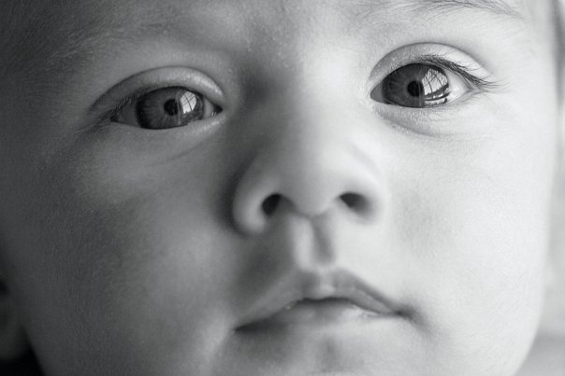
Are diseases still a risk?
Some people think vaccine-preventable diseases are gone, but we see measles, pertussis, chickenpox and other diseases in the unvaccinated. In 2011, 222 people in the US had measles; 1/3 ended up hospitalized
Notes:
2011 measles outbreak: http://www.cdc.gov/mmwr/preview/mmwrhtml/mm6115a1.htm?s_cid=mm6115a1_w
2009 Hib outbreak: http://children.webmd.com/vaccines/news/20090123/hib-outbreak-kills-unvaccinated-child

Slide 4
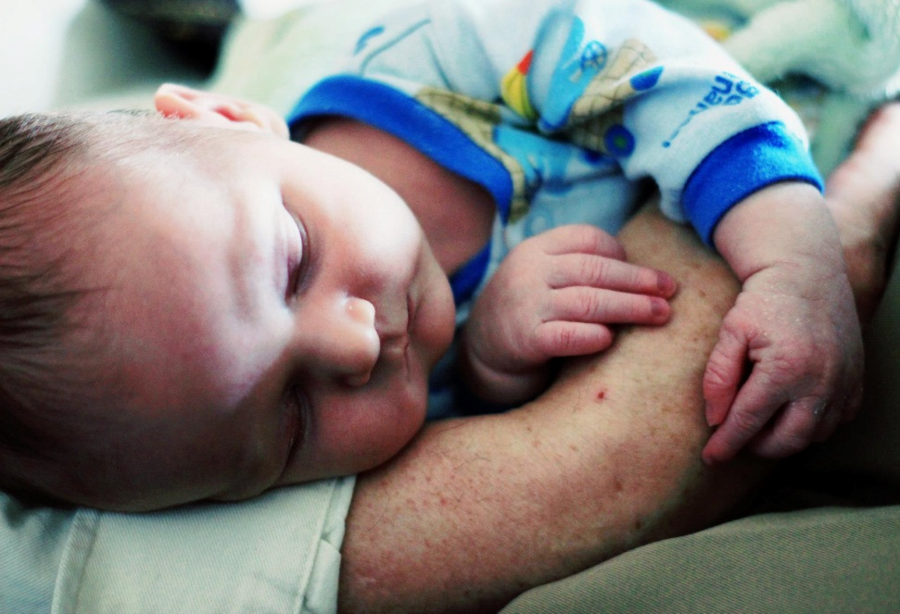
Can’t medicine treat disease?
It is far easier to prevent VPDs (vaccine-preventable disease) than to treat them since VPDs often have no cure.
Notes:
Most cases of pertussis caught too late for treatment: http://www.ncbi.nlm.nih.gov/pubmedhealth/PMH0002528/
No treatment for rotavirus: http://www.mayoclinic.com/health/rotavirus/DS00783/DSECTION=treatments-and-drugs
No treatment for established measles: http://www.mayoclinic.com/health/measles/DS00331/DSECTION=treatments-and-drugs

Slide 5

Are vaccines safe?

Slide 6
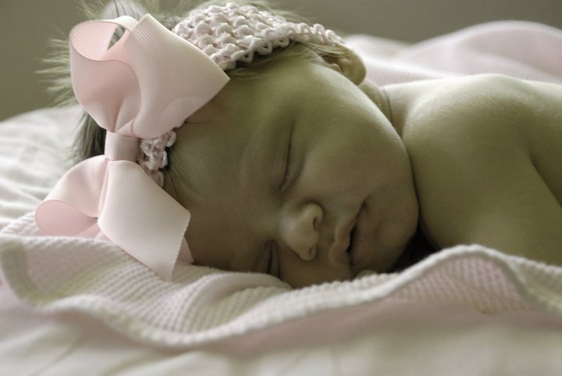
Big benefit, little risk
Vaccines, like anything else, do carry the risk of side effects, like fever and soreness. Serious side effects from vaccines, such as allergic reaction, are incredibly rare.

Slide 7

How vaccines are approved
After being tested on thousands of subjects, vaccines are licensed by the FDA. The CDC, along with independent doctors’ groups, review safety and effectiveness before adding vaccines to the immunization schedule. Vaccines are continuously monitored for safety.
Notes:
Infographic—the journey of a child’s vaccine: http://www.cdc.gov/vaccines/parents/infographics/journey-of-child-vaccine.html

Slide 8
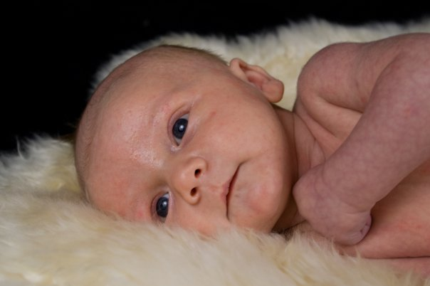
Overwhelming evidence of safety
The Institute of Medicine has reviewed thousand of studies and found that for almost all people vaccines do not cause long-lasting, severe, or chronic effects.
Notes:
IOM Adverse Events and Vaccines: http://www.iom.edu/Reports/2011/Adverse-Effects-of-Vaccines-Evidence-and-Causality.aspx
IOM Vaccination Schedule: http://www.iom.edu/Reports/2013/The-Childhood-Immunization-Schedule-and-Safety.aspx

Slide 9
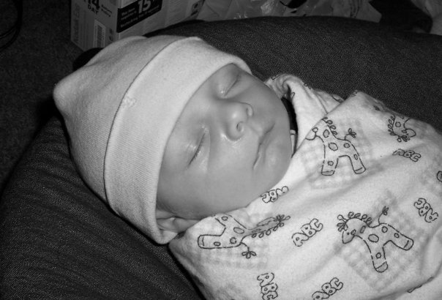
Benefits far outweigh risks
As with anything, vaccines carry a slight risk of side effects. Most side effects are minor, such as fever or injections site soreness. Severe reactions are incredibly rare.

Slide 10
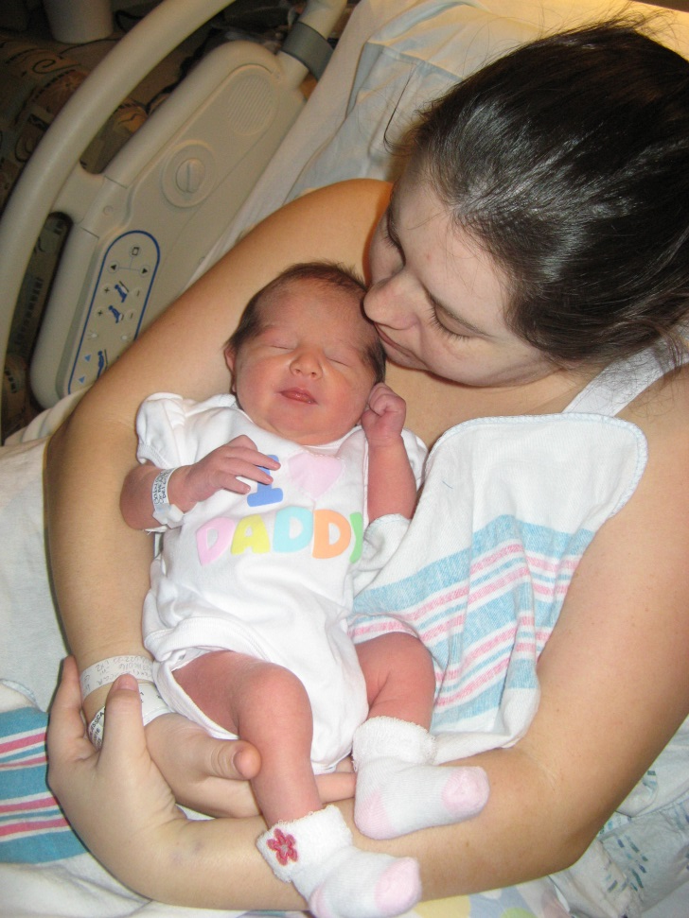
Protection begins before birth
Pregnant women need vaccines!
Tdap (Tetanus Diphtheria, and Pertussis) vaccine protects mom and baby
Influenza (flu) vaccine is safe and important in pregnancy.
Notes:
Tdap in pregnancy: http://www.acog.org/Resources%20And%20Publications/Committee%20Opinions/Committee%20on%20Obstetric%20Practice/Update%20on%20Immunization%20and%20Pregnancy%20Tetanus%20Diphtheria%20and%20Pertussis%20Vaccination.aspx
Flu shot in pregnancy: http://www.cdc.gov/features/pregnancyandflu/

Slide 11
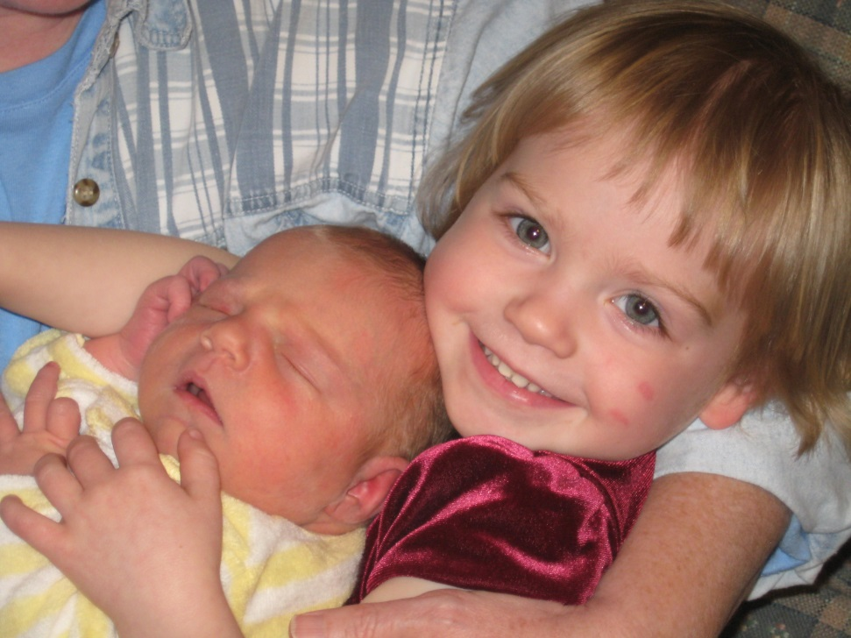
Provide a cocoon of protection
Some illnesses, like pertussis (whooping cough) are particularly dangerous to newborns. Any adults in close contact with a newborn should check on what shots they need.
Notes:
Cocooning new babies through immunization http://www.immunize.org/cocooning/

Slide 12
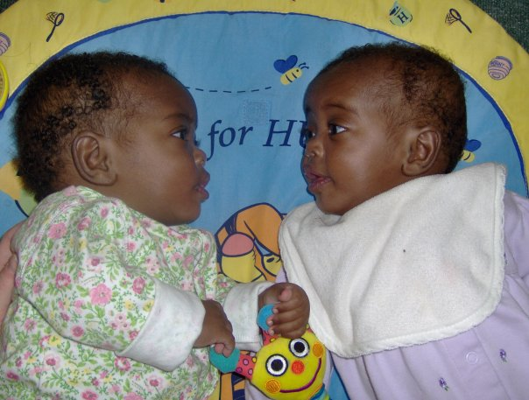
What vaccines will my baby receive?
Vaccines given in the first six months of life.

Slide 13
Hepatitis B vaccine
The hepatitis B virus can be spread through contact with blood, saliva, body tissues, or the fluids of an infected person.
Many people who contract hepatitis B never discover the source of their infection.
Infants are at special risk because if they become infected at birth, 90% of them will develop a life-long hepatitis B infection and 25% of those will develop liver cancer or liver failure later in life.
Reactions to the vaccine, if any, tend to be mild, such as soreness at the injection site or slight fever
Notes:
http://www.chop.edu/service/vaccine-education-center/a-look-at-each-vaccine/hepatitis-b-vaccine.html

Slide 14
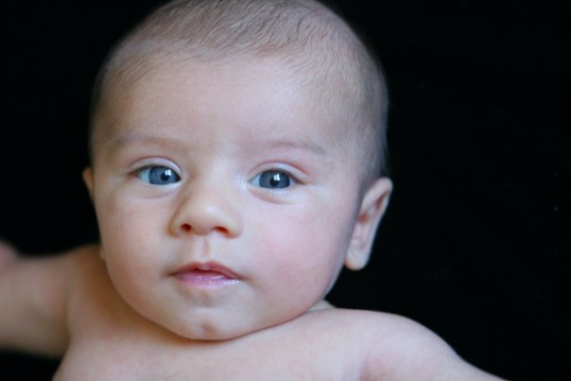
Rotavirus vaccine
Rotaviral gastroenteritis causes vomiting, diarrhea, and fever.
Once ill, infants can quickly become dehydrated.
Rotavirus is spread from person to person, regardless of the hygienic condition of the environment.
Before the vaccine was added to the childhood immunization schedule, up to 70,000 children were hospitalized annually in the U.S. due to rotavirus.
This vaccine, which is given by mouth, is notable for its extremely low incidence of side effects which, if they occur, are very mild, and can include fever and diarrhea.
Notes:
http://www.chop.edu/service/vaccine-education-center/a-look-at-each-vaccine/rotavirus.html

Slide 15
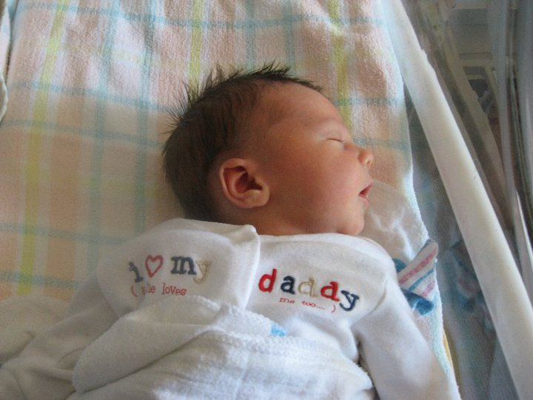
DTaP (Diphtheria, Tetanus, and acellular Pertussis) vaccine
Diphtheria, tetanus, and pertussis were significant causes of death before these vaccines were introduced.
Pertussis, a particularly dangerous disease in babies, used to cause 8,000 deaths a year in the U.S., primarily in infants.
While diphtheria and tetanus cases have been kept at bay through vaccination, pertussis outbreaks still occur in the U.S. and are on the rise.
Side effects of the vaccine may include fever, fussiness, and soreness at the injection site.
Notes:
http://www.chop.edu/service/vaccine-education-center/a-look-at-each-vaccine/dtap-diphtheria-tetanus-and-pertussis-vaccine.html

Slide 16
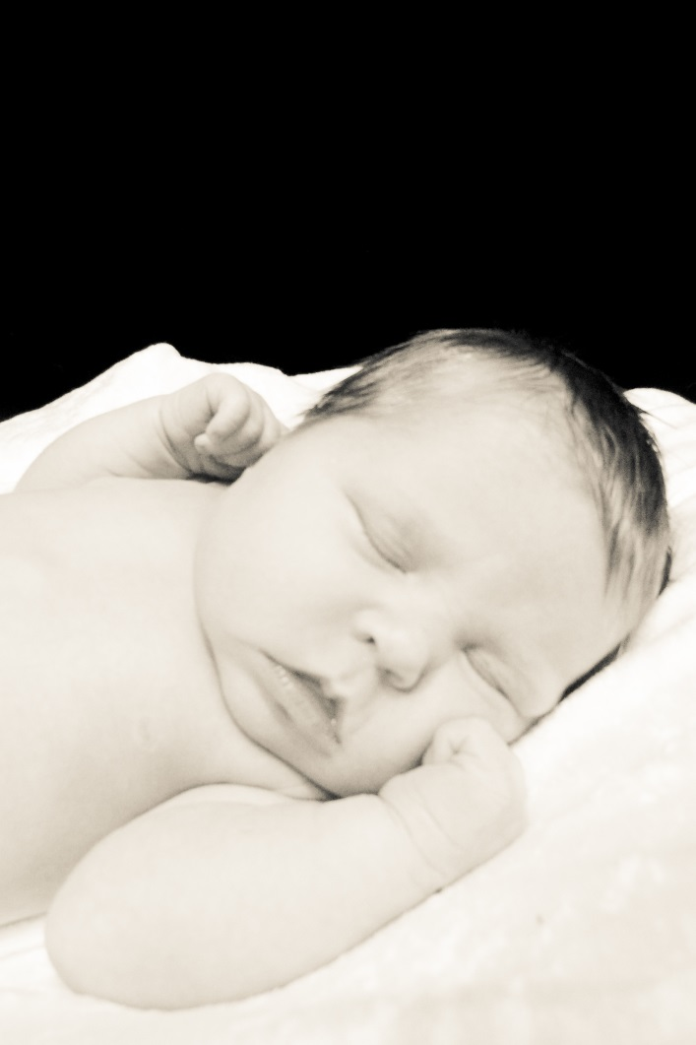
Haemophilus influenzae type b (Hib)vaccine
Hib is a bacterial infection often spread through coughing or from contact with an infected person’s saliva.
It can lead to severe infections of the brain, throat, and blood.
Hib infection of the brain (meningitis) is an extremely serious illness that is fatal in 5% of patients and causes brain damage in 10% to 30% of survivors.
Hib vaccine can cause soreness at the injection site, but is not associated with serious side effects.
Notes:
http://www.chop.edu/service/vaccine-education-center/a-look-at-each-vaccine/hib-vaccine.html

Slide 17
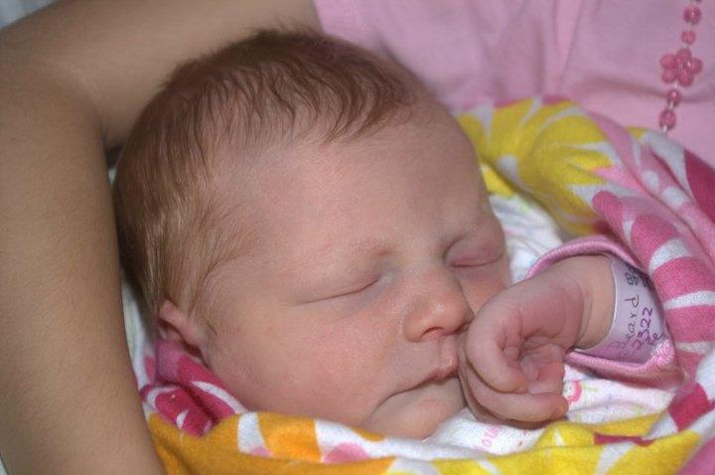
PCV (pneumococcal conjugate vaccine)
An infection caused by pneumococcus bacteria can lead to ear infections, pneumonia, blood infections, meningitis, and death.
Prior to the use of this vaccine, pneumococcal disease caused 5 million ear infections, 13,000 blood infections, 700 cases of meningitis, and 200 deaths in the U.S.
Pneumococcal conjugate vaccine can cause soreness at the injection site and low-grade fever, but is not associated with serious side effects.
Notes:
http://www.chop.edu/service/vaccine-education-center/a-look-at-each-vaccine/pneumococcus-vaccine.html

Slide 18
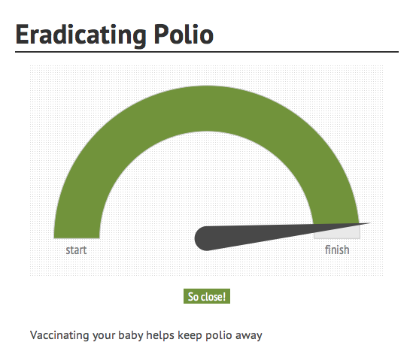
IPV (Inactivated Poliovirus Vaccine)
Polio virus can spread to the nervous system and cause temporary or permanent paralysis.
While polio was eliminated from the U.S. in 1979, it is still endemic in Afghanistan, Pakistan, and Nigeria, and is only a plane ride away.
The world is trying to eradicate polio for good, and vaccinating your child is a crucial way to help attain this goal.
Polio vaccine may cause soreness at the injection site, but is not associated with serious side effects.
Notes:
http://www.chop.edu/service/vaccine-education-center/a-look-at-each-vaccine/polio-vaccine.html

Slide 19
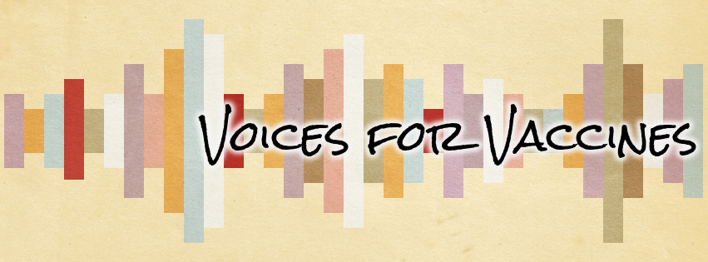
Get vaccine information from trusted sources
Not all sources of vaccine information are created equal.
Always check who is behind the source and how its information is reviewed before being given out
Notes:
Evaluating online health sources: http://www.vaccineinformation.org/internet-immunization-info/

Slide 20
Suggested websites
Voices for Vaccines: VoicesForVaccines.org
Immunization Action Coalition: VaccineInformation.org
Children’s Hospital of Philadelphia Vaccine Education Center: chop.edu/vaccine-education-center/home.html

Slide 21
For further questions
Always bring questions about immunizations to your doctor or nurse practitioner. They are usually a fantastic first source of information.
This presentation was prepared by Voices for Vaccines and is intended to be downloaded, presented, and distributed without alteration for non-commercial purposes only. © Voices for Vaccines 2013

