Slide 1
10 Ways to Create a Culture of Immunization Within Our Pediatric Practice
[INSERT NAMES OF PRESENTERS]
[INSERT YOUR PRACTICE’S NAME AND LOGO]
Last updated March 2019
Notes:
INSERT PRESENTER NAMES, YOUR PRACTICE NAME, AND YOUR LOGO.

Slide 2
HOW TO PREPARE FOR THIS PRESENTATION
Review your practice’s current immunization procedures. If they differ from the recommendations presented here, be prepared to discuss these differences and how you plan to change your procedures.
Gather your practice’s immunization coverage data for infants/young children and adolescents through your EMR or immunization information system (IIS). Contact your state or local IIS coordinator if you need assistance. Insert your rates into slide 5.
Insert your practice’s immunization policy or philosophy into slide 8.
Customize slide 11 to indicate where staff can find CDC clinical resources.
Insert the name of your state immunization information system (IIS) into slide 12.
Make copies of the FAQ fact sheet listed on slide 15.
If applicable, customize slide 19 to include similar text from your electronic medical record (EMR) system.
DELETE THIS SLIDE.
Notes:
This slide provides guidance for how to customize the slide deck. DELETE THIS SLIDE after you are done.
HOW TO CONTACT YOUR IIS COORDINATOR
You can find contact information for your IIS coordinator here: https://www.cdc.gov/vaccines/programs/iis/contacts-registry-staff.html
IMMUNIZATION POLICY
If you do not have a practice immunization policy, the Immunization Action Coalition has developed one that you can tailor: http://www.immunize.org/catg.d/p2067.pdf
Here is a sample policy from Gwinnett Pediatrics & Adolescent Medicine in Georgia:
Vaccines have contributed to a significant reduction in many life threatening childhood diseases. We strongly believe in the importance of vaccines. All of our providers believe it is important to adhere to an immunization schedule. If you feel differently and do not wish to immunize your child according to our schedule, we may not be a good fit for you and your child. If your child has not been vaccinated, we may utilize a fever workup at an Emergency Department. We do not feel that you are a "fit" for our practice if you refuse vaccinations after our discussions regarding the need for vaccination. Parents refusing vaccinations will be asked to find another practice.

Slide 3
Learning Objectives
After today’s session you should be able to:
Understand why we need a culture of immunization
Cite our current immunization coverage rates
Describe how all office staff play a part in creating a culture of immunization
Describe several ways to create a culture of immunization
Notes:
Today’s session will aim to accomplish four objectives. After the session, you should be able to:
Understand why we need a culture of immunization in our practice
Cite our current immunization coverage rates
Describe how all office staff play a part in creating a culture of immunization
AND
Describe several ways to create a culture of immunization

Slide 4
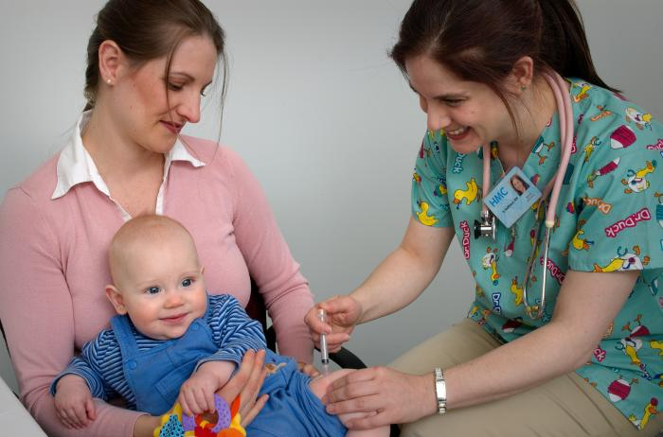
Why do we need a culture of immunization?
We are committed to protecting children through full coverage and on-time immunization.
Healthcare professionals are parents’ most trusted source of information about vaccines.
Parents’ confidence is increased when they receive the same information from different people.
Inconsistent messages from staff may confuse parents and create mistrust.
Notes:
There are many reasons that having a culture of immunization is important to our practice.
First of all, it helps us protect children through full immunization coverage and on-time immunization. Protecting children is something that we are all committed to.
Second, research from CDC and others has shown time and time again that healthcare professionals like us are parents’ most trusted source of vaccine information. So we need to be sure that we are conveying the right information.
We also know that parents are more confident in their healthcare decisions when they receive the same information from different people. For example, the doctor and the medical assistant and what they read on the CDC website.
Finally, parents can get confused and lose trust in us if they are hearing different messages from our staff. For example, if one of us strongly recommends a vaccine, but another says that she has chosen not to get it for her own children.

Slide 5
How well is our practice doing?
Healthy People 2020 Objectives
90% coverage for individual infant vaccines (children 19-35 months)
80% coverage for the 7-vaccine series* (children 19-35 months)
80% coverage for Tdap, meningococcal conjugate and HVP (adolescents 13-15 years)
INSERT YOUR PRACTICE IMMUNIZATION RATES
Infants and young children
Adolescents
*DTaP, polio, MMR, Hib, hepatitis B, varicella, PCV
Source: https://www.healthypeople.gov/2020/topics-objectives/topic/immunization-and-infectious-diseases/objectives
Notes:
Healthy People objectives are 10-year national objectives for improving the health of all Americans. On this slide you see the Healthy People 2020 objectives, and how well our practice is doing in comparison.
INSERT ANY DATA YOU HAVE AVAILABLE FOR CHILDHOOD AND ADOLESCENT VACCINATION COVERAGE. EXPLAIN HOW THE DATA IS COLLECTED.
HIGHLIGHT AREAS WHERE YOU ARE DOING WELL AND AREAS WHERE YOUR RATES FALL BELOW THE HEALTHY PEOPLE 2020 OBJECTIVES.

Slide 6
Everyone plays a part
A culture of immunization starts at the front desk and extends into the waiting room, into the exam room, and finally to the check out desk.
Everyone plays a part:
Receptionists and other support staff
Nurses and nurse practitioners
Physicians and physician assistants
Medical assistants
Office manger
Vaccine coordinator
Check in
Exam room
Check out
Waiting room
Notes:
Doctors, nurses and MAs give vaccines, but they are not the only ones who are responsible for creating a culture of immunization – everyone in this practice places a part. It starts at the front desk, then extends into the waiting room, then into the exam room, and finally to the checkout desk.
All of the staff listed can work together to ensure that we keep up to date on the latest recommendations and communicate consistent messages to parents. But what exactly do we need to do? There are 10 concrete steps that we can take.

Slide 7
10 Ways to Create a Culture of Immunization
Make parents aware of our immunization philosophy and policy.
Keep up to date on current CDC vaccine recommendations.
Make clinical resources readily available to staff.
Assess a child’s immunization status at every visit.
Give strong recommendations for immunization.
Help parents feel supported by welcoming questions and knowing how to answer them.
Give Vaccine Information Statements (VIS) and handouts to answer specific questions
Make immunization resources easy for parents to find.
Schedule follow-up immunization appointments before the child leaves the office.
Remind parents about upcoming immunization appointments and contact those who miss appointments.
Notes:
Here are 10 ways that we can create a culture of immunization. Some of these things we may be doing already, and some maybe not. I’ll go through each of these in detail.

Slide 8
1. Make parents aware of our practice immunization philosophy/policy
INSERT YOUR PRACTICE PHILOSOPHY/POLICY OR PROVIDE HARD COPIES IF IT IS TOO LONG TO FIT ON THIS SLIDE.
Ways to make parents aware of our policy:
Posting it on our website
Inserting a copy in new parent packets
Telling parents about it during their first visit
Posting it in the waiting room
Notes:
Here is a our practice’s immunization philosophy or policy. Let’s all take a minute to read it to ourselves.
PAUSE
Does anyone have any questions about this policy?
It’s important for us to ensure that every parent is aware of this policy when they first join our practice. Ways to do this include posting it on our website, inserting a copy in new parent packets, telling parents about it during their first visit, and posting it in the waiting room. SPECIFY THE ITEMS THAT YOU ARE ALREADY DOING AND WHICH ONES YOU WILL START DOING IN THE FUTURE.

Slide 9
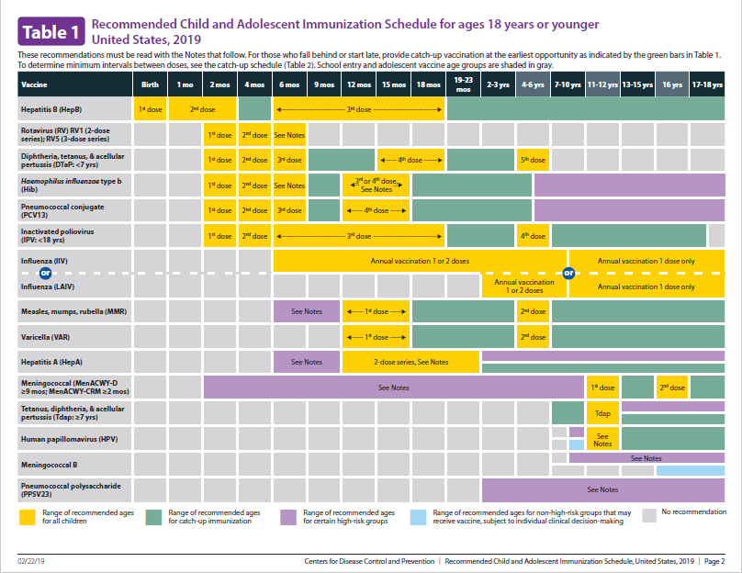
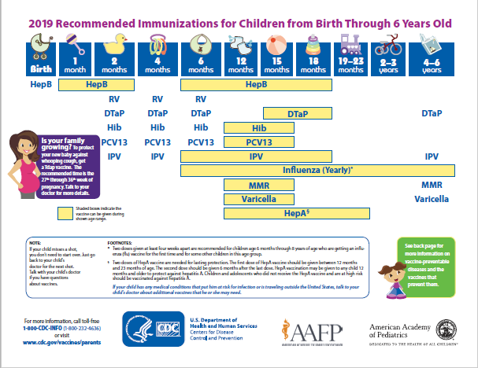
2. Keep up to date on CDC recommendations
CDC updates the immunization schedules every February.
Immunization guidance may change during the year based on recommendations by the Advisory Committee on Immunization Practices (ACIP).
Two versions of the schedule
Clinician version—different ways to access
Parent-friendly version (English and Spanish)
www.cdc.gov/vaccines/schedules
Notes:
We also need to keep ourselves up to date on the latest CDC vaccine recommendations. CDC updates its immunization schedules for children 0 to 6 years old and 7 to 18 years old each winter, usually in February.
It’s important to note, though, that CDC’s immunization guidance may change during the year if recommended by the Advisory Committee on Immunization Practices, or ACIP. The ACIP is a group of medical and public health experts who develop recommendations on the use of vaccines in the civilian population of the United States. The ACIP meets three times a year to review the latest vaccine research and make recommendations as needed.
There are two versions of the childhood immunization schedule – a clinician version and a parent-friendly version. The parent-friendly version is available in English and Spanish. They are both available on the CDC website at the address in the blue box.
EXPLAIN WHO IN YOUR PRACTICE IS RESPONSIBLE FOR OBTAINING NEW SCHEDULES AND KEEPING UP TO DATE ON VACCINE RECOMMENDATIONS.
ALSO EXPLAIN WHERE STAFF IN YOUR PRACTICE CAN FIND SCHEDULES FOR CLINICIANS AND PARENTS. FOR EXAMPLE:
Schedule for clinicians
In your EMR system
Posted in the medication room
Apps on your smartphone
Schedule for parents
Posted in exam rooms
Included in new parent packets
Given out during well visits

Slide 10
How else can we stay up-to-date?
Participate in CDC educational programs for healthcare professionals on immunization recommendations and related topics including:
Current Issues in Immunization NetConference (CIINC)
Pink Book webinar series
You Call the Shots
All educational program have CE available
Sign up for CDC email alerts
Vaccine questions? Email CDC at nipinfo@cdc.gov
www.cdc.gov/vaccines/ed/index.html
Notes:
There are also other ways that we can all stay up to date on the latest vaccine recommendations and best practices.
CDC has free immunization education programs for healthcare professionals on immunization recommendations and related topics including live webinars and web-based educational programs.
Immunization NetConferences and the Pink Book Webinar series are live, 1-hour presentations combining an online visual presentation with simultaneous audio via telephone conference call and a live question and answer session. On-demand replays and presentations will be available shortly after each event. You Call the Shots is a self-paced web-based education program on each vaccine plus other vaccine related topics including storage and handling, and vaccine administration.
If you go to the CDC webpage listed in this blue box, you ca sign up for email alerts to be notified when materials are updated or upcoming webinar. Boxes, such as the one pictured on the slide are located on the left hand side of the webpage. Just type your email address and submit- it’s as easy as that.
When we have vaccine related questions that our staff can’t answer, we can send the question to CDC. NIPINFO is an email service that answers questions.

Slide 11
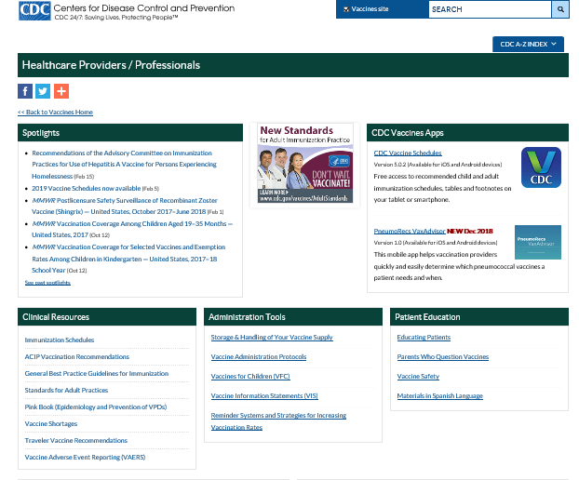
3. Make clinical resources readily available to staff
Use CDC clinical guidelines, resources and job aids including those on:
Vaccine storage and handling
Vaccine administration
Videos are available on vaccine administration, storage and handling best practices and guidelines
You can find CDC clinical resources [Describe where they can find them. Ex: bookmarked on your web browsers, in a binder, etc.]
www.cdc.gov/vaccines/hcp/index.html
Notes:
Another important part of keeping up to date is making sure that clinical resources are readily available to staff. We already talked about immunization schedules, but there are other resources that are helpful like clinical guidelines, job aids, and videos.
These resources can teach you about vaccine storage and handling, vaccine administration, and other topics.
You can find these resources on the CDC website at the address listed in this blue box. You can also find them SPECIFY WHERE RESOURCES ARE AVAILABLE IN YOUR PRACTICE.

Slide 12
4. Assess a child’s vaccination status at every visit
Check [INSERT NAME OF YOUR STATE IIS] for the child’s vaccines.
Assess the status at well visits, sick visits, and follow-up visits.
Screen for contraindications and precautions each time vaccines are given.
Give all eligible vaccines in the same visit
This strategy will…
reduce missed opportunities to vaccinate
reinforce the message that vaccinations are important
Notes:
Now let’s talk about how to create a culture of immunization in our interactions with parents.
The first step is to assess a child’s vaccination status at every visit. This is most relevant for the clinicians who are deciding which vaccines to administer, but all staff should know that this is a priority.
A clinician should check the [NAME OF YOUR STATE IIS] to see which vaccines the child has already received. This should be done at every well visit, a sick visit, or a follow-up visit.
The clinician should screen for any contraindications and precautions before giving any vaccines.
All eligible vaccines should be given in the same visit. There are no known benefits to spacing out vaccines—it just leaves children vulnerable to diseases during the time they are not protected by vaccines.
By assessing vaccination status at every visit, we can reduce missed opportunities to vaccinate children and reinforce the message for parents that vaccinations are important.

Slide 13
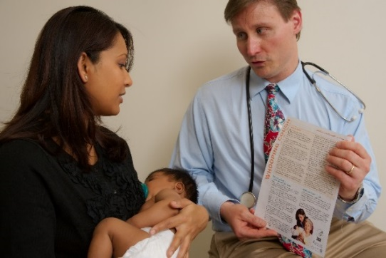
5. Give strong and compelling recommendations for immunization
An effective recommendation from a healthcare professional is the main reason parents decide to vaccinate.
Office staff should reinforce recommendations given by doctors and nurses.
Bundle all vaccines into one recommendation and use a presumptive approach: “Michael is going to get 5 vaccines today: DTaP, rotavirus, Hib, pneumococcal, and polio.”
Explain the importance of each vaccine and every dose.
Share personal experiences with vaccine-preventable diseases and vaccinating your own children.
Notes:
Research has shown that an effective recommendation from a healthcare professional is the main reason parents decide to vaccinate. So, whenever our clinicians give strong recommendations for vaccination, other staff should reinforce them.
When talking about the vaccines that a child will get that day, it can help to take a “presumptive approach”, which means that you simply announce which vaccines the child will be getting. This has been shown to be more effective than asking parents what they want to do about vaccines. The third bullet shows an example of how this can be done.
Explaining the importance of each vaccine and every dose can help ensure that parents follow our recommendations.
Anyone in the practice can share a personal experience with a vaccine preventable disease or talk about why you decided to vaccinate your own children. These stories also help to reinforce vaccine recommendations.

Slide 14
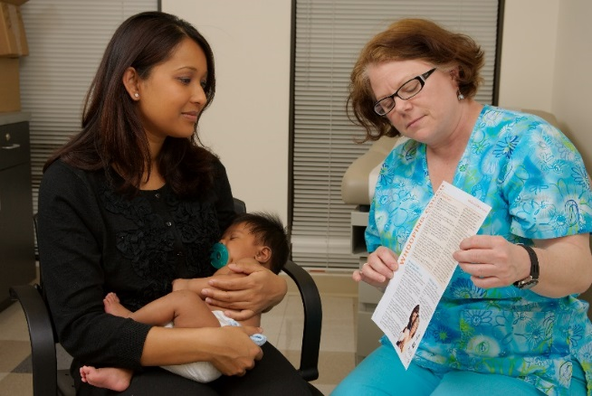
6. Help parents feel supported by welcoming questions and knowing how to answer them
Most parents have questions, even if they plan to vaccinate.
Questions do not necessarily equal concerns.
Learn how to answer common questions from parents (see following slide).
If you are unsure how to answer a question, refer it to the doctor, nurse or other vaccine expert in the practice.
Notes:
Emotions can play a strong role in how we make decisions. How we make parents feel is equally as important as what we say to them. We we want parents to feel supported when they bring their child to our practice. We can do this by welcoming their questions and knowing how to answer them.
It’s important to recognize that just because a parent has questions about vaccines doesn’t mean that the parent has concerns or is opposed to vaccines. Most parents have questions, even if they plan to vaccinate.
If we all learn how to answer common vaccine questions, we can help save time in the exam room and increase parents’ confidence in our practice. I will go through some common questions and answers on the next slide.
If you don’t know how to answer a question, that’s okay. You can always refer the question to a doctor, nurse or other vaccine expert.
PRESENTER NOTE:
IF THERE IS SOMEONE IN YOUR OFFICE WHO IS THE “GO TO” PERSON FOR VACCINE QUESTIONS, YOU CAN CUSTOMIZE THE 4TH BULLET BY INSERTING THEIR NAME.

Slide 15
Common questions about infant immunization
Are vaccines safe?
What are the side effects of vaccines? How do I treat them?
What are the risks and benefits of vaccines?
Is there a link between vaccines and autism?
Can vaccines overload my baby’s immune system?
Why are so many doses needed for each vaccine?
Why do vaccines start so early?
What do you think of delaying some vaccines or following a non-standard schedule?
Haven’t we gotten rid of most of these diseases in this country?
What are combination vaccines? Why are they used?
Can’t I just wait until my child goes to school to catch up on immunizations?
Why does my child need a chickenpox shot? Isn’t it a mild disease?
My child is sick right now. Is it okay for her to still get shots?
What are the ingredients in vaccines and what do they do?
Don’t infants have natural immunity? Isn’t natural immunity better than the kind from vaccines?
Do I have to vaccinate my baby on schedule even if I’m breastfeeding him?
What’s wrong with delaying some of my baby’s vaccines if I’m planning on getting them all eventually?
Get answers at: www.cdc.gov/vaccines/parents/parent-questions.html
Notes:
PRESENTER NOTE:
Go through these questions and answers. If time is limited, only review the questions that your staff hear most often. If possible, distribute copies of the CDC fact sheet: www.cdc.gov/vaccines/parents/parent-questions.html.
Q: Are vaccines safe?
A: Yes. Vaccines are very safe. The United States’ long-standing vaccine safety system ensures that vaccines are as safe as possible. Currently, the United States has the safest vaccine supply in its history. Millions of children safely receive vaccines each year. The most common side effects are typically very mild, such as pain or swelling at the injection site.
Q: What are the side effects of the vaccines? How do I treat them?
A: Vaccines, like any medication, may cause some side effects. Most of these side effects are very minor, like soreness where the shot was given, fussiness, or a low-grade fever. These side effects typically only last a couple of days and are treatable. For example, you can apply a cool, wet washcloth on the sore area to ease discomfort. Serious reactions are very rare. However, if your child experiences any reactions that concern you, call the doctor’s office.
Q: What are the risks and benefits of vaccines?
A: Vaccines can prevent infectious diseases that once killed or harmed many infants, children, and adults. Without vaccines, your child is at risk for getting seriously ill and suffering pain, disability, and even death from diseases like measles and whooping cough. The main risks associated with getting vaccines are side effects, which are almost always mild (redness and swelling at the injection site) and go away within a few days. Serious side effects after vaccination, such as a severe allergic reaction, are very rare and doctors and clinic staff are trained to deal with them. The disease-prevention benefits of getting vaccines are much greater than the possible side effects for almost all children.
Q: Is there a link between vaccines and autism?
A: No. Scientific studies and reviews continue to show no relationship between vaccines and autism. Some people have suggested that thimerosal (a compound that contains mercury) in vaccines given to infants and young children might be a cause of autism. Others have suggested that the MMR (measles- mumps-rubella) vaccine may be linked to autism. However, numerous scientists and researchers have studied and continue to study the MMR vaccine and thimerosal, and reach the same conclusion: there is no link between MMR vaccine or thimerosal and autism.
Q: Can vaccines overload my baby’s immune system?
A: Vaccines do not overload the immune system. Every day, a healthy baby’s immune system successfully fights off thousands of germs. Antigens are parts of germs that cause the body’s immune system to go to work to build antibodies, which fight off diseases. The antigens in vaccines come from the germs themselves, but the germs are weakened or killed so they cannot cause serious illness. Even if babies receive several vaccinations in one day, vaccines contain only a tiny fraction of the antigens they encounter every day in their environment. Vaccines give your child the antibodies they need to fight off serious vaccine-preventable diseases.
Q: Why are so many doses needed for each vaccine?
A: Getting every recommended dose of each vaccine provides your child with the best protection possible. Depending on the vaccine, your child will need more than one dose to build high enough immunity to prevent disease or to boost immunity that fades over time. Your child may also receive more than one dose to make sure they are protected if they did not get immunity from a first dose, or to protect them against germs that change over time, like flu. Every dose is important because each protects against infectious diseases that can be especially serious for infants and very young children.
Q: Why do vaccines start so early?
A: The recommended schedule protects infants and children by providing immunity early in life, before they come into contact with life-threatening diseases. Children receive immunization early because they are susceptible to diseases at a young age. The consequences of these diseases can be very serious, even life-threatening, for infants and young children.
Q: What do you think of delaying some vaccines or following a non-standard schedule?
A: Children do not receive any known benefits from following schedules that delay vaccines. Infants and young children who follow immunization schedules that spread out or leave out shots are at risk of developing diseases during the time you delay their shots. Some vaccine-preventable diseases remain common in the United States and children may be exposed to these diseases during the time they are not protected by vaccines, placing them at risk for a serious case of the disease that might cause hospitalization or death.
Q: Haven’t we gotten rid of most of these diseases in this country?
A: Some vaccine-preventable diseases, like pertussis (whooping cough) and chickenpox, remain common in the United States. On the other hand, other diseases vaccines prevent are no longer common in this country because of vaccines. However, if we stopped vaccinating, the few cases we have in the United States could very quickly become tens or hundreds of thousands of cases. Even though many serious vaccine-preventable diseases are uncommon in the United States, some are common in other parts of the world. Even if your family does not travel internationally, you could come into contact with international travelers anywhere in your community. Children who don’t receive all vaccinations and are exposed to a disease can become seriously sick and spread it through a community.
Q: What are combination vaccines? Why are they used?
A: Combination vaccines protect your child against more than one disease with a single shot. They reduce the number of shots and office visits your child would need, which not only saves you time and money, but also is easier on your child. Some common combination vaccines are Pediarix® which combines DTap, Hep B, and IPV (polio) and ProQuad® which combines MMR and varicella (chickenpox).
Q: Can’t I just wait until my child goes to school to catch up on immunizations?
A: Before entering school, young children can be exposed to vaccine-preventable diseases from parents and other adults, brothers and sisters, on a plane, at child care, or even at the grocery store. Children under age 5 are especially susceptible to diseases because their immune systems have not built up the necessary defenses to fight infection. Don’t wait to protect your baby and risk getting these diseases when he or she needs protection now.
Q: Why does my child need a chickenpox shot? Isn’t it a mild disease?
A: Your child needs a chickenpox vaccine because chickenpox can actually be a serious disease. In many cases, children experience a mild case of chickenpox, but other children may have blisters that become infected. Others may develop pneumonia. There is no way to tell in advance how severe your child’s symptoms will be.
Before vaccine was available, about 50 children died every year from chickenpox, and about 1 in 500 children who got chickenpox was hospitalized.
Q: My child is sick right now. Is it okay for her to still get shots?
A: Talk with your child’s doctor, but children can usually get vaccinated even if they have a mild illness like a cold, earache, mild fever, or diarrhea. If the doctor says it is okay, your child can still get vaccinated.
Q: What are the ingredients in vaccines and what do they do?
A: Vaccines contain ingredients that cause the body to develop immunity. Vaccines also contain very small amounts of other ingredients. All ingredients play necessary roles either in making the vaccine, or in ensuring that the final product is safe and effective.
Q: Don’t infants have natural immunity? Isn’t natural immunity better than the kind from vaccines?
A: Babies may get some temporary immunity (protection) from mom during the last few weeks of pregnancy, but only for diseases to which mom is immune. Breastfeeding may also protect your baby temporarily from minor infections, like colds. These antibodies do not last long, leaving your baby vulnerable to disease. Natural immunity occurs when your child is exposed to a disease and becomes infected. It is true that natural immunity usually results in better immunity than vaccination, but the risks are much greater. A natural chickenpox infection may result in pneumonia, whereas the vaccine might only cause a sore arm for a couple of days.
Q: Do I have to vaccinate my baby on schedule if I’m breastfeeding him?
A: Yes, even breastfed babies need to be protected with vaccines at the recommended ages. The immune system is not fully developed at birth, which puts newborns at greater risk for infections.
Breast milk provides important protection from some infections as your baby’s immune system is developing. For example, babies who are breastfed have a lower risk of ear infections, respiratory tract infections, and diarrhea. However, breast milk does not protect children against all diseases. Even in breastfed infants, vaccines are the most effective way to prevent many diseases. Your baby needs the long-term protection that can only come from making sure he receives all his vaccines according to the CDC’s recommended schedule.
Q: What’s wrong with delaying some of my baby’s vaccines if I’m planning to get them all eventually?
A: Young children have the highest risk of having a serious case of disease that could cause hospitalization or death. Delaying or spreading out vaccine doses leaves your child unprotected during the time when they need vaccine protection the most. For example, diseases such as Hib or pneumococcus almost always occur in the first 2 years of a baby’s life. And some diseases, like Hepatitis B and whooping cough (pertussis), are more serious when babies get them at a younger age. Vaccinating your child according to the CDC’s recommended immunization schedule means you can help protect him at a young age.

Slide 16
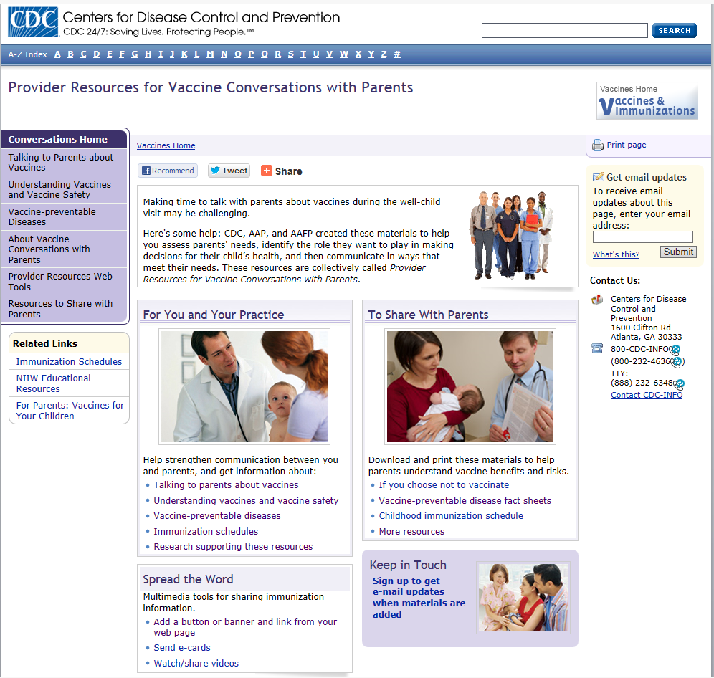
CDC’s Provider Resources for Vaccine Conversations with Parents
Guidelines for talking to parents about vaccines
Vaccine safety fact sheets
Vaccine preventable disease fact sheets (English and Spanish)
Information for parents who choose not to vaccinate
Video showing pediatrician answering moms’ questions
www.cdc.gov/vaccines/conversations
Notes:
CDC also has a suite of materials to help healthcare professionals communicate more effectively with parents about vaccines. It’s called Provider Resources for Vaccine Conversations with Parents. CDC developed these together with AAP and AAFP. The materials include:
Guidelines for talking to parents about vaccines – this 4-page fact sheet provides tips for how to have a successful conversation and examples of how to answer tough questions.
Fact sheets on different vaccine safety topics, like how vaccines work, MMR vaccine safety, VAERS, and how the government ensures vaccine safety. This is great knowledge for you and we can also share these with high information seeking parents who have specific vaccine safety questions.
Vaccine-preventable disease fact sheets for parents. These are written in plain language and are available in English and Spanish. They are a great resource for parents who have questions about specific diseases. We can also distribute these if there is a disease outbreak in our community.
Fact sheet for parents who choose not to vaccinate – this fact sheet explains responsibilities of parents who choose not to vaccinate and specific steps that they need to take in case of an outbreak or if their child gets sick. While we work hard to ensure that all children in our practice are vaccinated, this may be useful for sharing with parents who are considering not vaccinating.
There are also other resources on this website, like a video showing a doctor speaking with a moms’ group about vaccine questions, and fact sheets on other topics like combination vaccines and vaccinating when a child is sick.

Slide 17
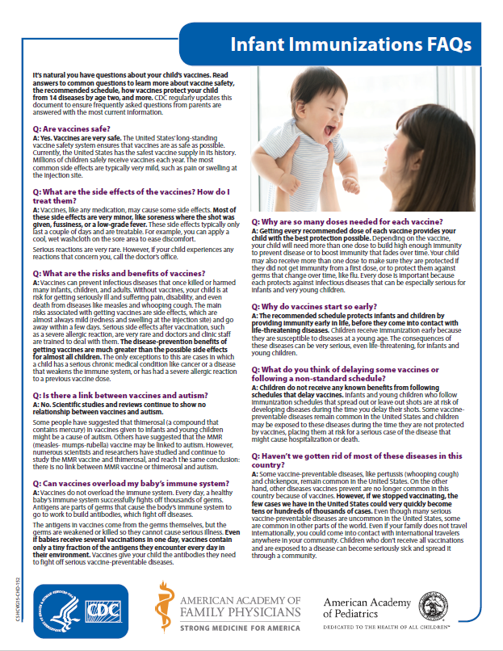
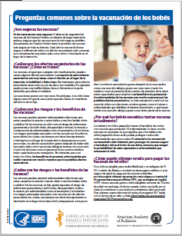
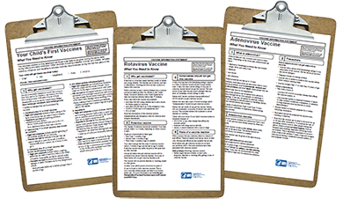
7. Give Vaccine Information Statements (VIS) and handouts to answer specific questions
Federal law requires that VIS be given with each vaccine.
Give the VIS before administering any vaccines.
If parents have specific questions, give handouts from credible sources:
CDC’s Provider Resources (see previous slide)
CDC Infant Immunization FAQ (English and Spanish)
Children’s Hospital of Philadelphia Vaccine Education Center
Immunization Action Coalition
www.cdc.gov/vaccines/hcp/vis
www.cdc.gov/vaccines/parents/parent-questions.html
www.chop.edu/centers-programs/vaccine-education-center
www.immunize.org/handouts/
Notes:
Giving out Vaccine Information Statements, or VIS, and other handouts is another way to show parents that we value immunization.
Federal law requires that VIS be given at every vaccine visit.
If you are involved in administering vaccines, make sure that the VIS are given before any vaccines are given. Parents are unlikely to read VIS if you give it to them as they are walking out the door.
There are also many other handouts from CDC, the Children’s Hospital of Philadelphia, and the Immunization Action Coalition that can answer specific questions about vaccine safety, vaccine ingredients, or other topics. It’s worth taking time to review these other resources and keep copies on hand for parents who have questions. EXPLAIN WHERE HANDOUTS CAN BE FOUND IN YOUR PRACTICE.

Slide 18
8. Make immunization resources easy for parents to find
Include information in new patient packets.
Display posters, flyers and/or immunization schedules in exam rooms.
Syndicate CDC content or post CDC web buttons on our website.
Share resources via social media or email blasts.
Insert auto-text dot phrases into electronic medical records for easy printing (see following slide).
www.cdc.gov/vaccines/partners/childhood/multimedia.html
Notes:
As I mentioned earlier, many parents have questions about vaccines, even if they intend to vaccinate their children. We can help parents get their questions answered by making immunization resources easy for them to find.
We can do this by:
Including the immunization schedule and other handouts in new patient packets
Creating a waiting room display with handouts
Posting parent-friendly versions of the immunization schedules in exam rooms
Syndicating CDC web content on our website
Posting a web button on our website that links to CDC’s vaccine website for parents
Customizing our EMR to include information like dot-phrases that we can easily print and give to parents
PRESENTER NOTE:
Explain which of these things you are already doing and which you plan to do in the future

Slide 19
Sample auto-text dot phrase
Information about Immunization
We are so excited that you want to learn more about protecting your child through on-time immunization! Our healthcare professionals trust these websites:
Centers for Disease Control and Prevention: creating-culture-of-IZ-in-your-practice-UPDATES 2_26_19.pptx
Children’s Hospital of Philadelphiawww.chop.edu/vaccine
AAP’s Healthy Children website: https://www.healthychildren.org
Immunization Action Coalition: http://immunize.org/
Vaccinate Your Family: http://www.vaccinateyourfamily.org/
Please call us at (xxx) xxx-xxxx and ask to speak with [NAME] if you have any questions.
Notes:
Here’s an example of text that we could insert into our EMR and print for parents who are interested in finding more information.
PRESENTER NOTE:
If you already have similar text in your EMR, insert it into this slide.

Slide 20
9. Schedule follow-up immunizations before the child leaves the office
Schedule the next immunization appointment before a parent leaves.
Make sure that the next appointment falls within the recommended timeframe of the CDC schedule.
If a parent defers scheduling the appointment, offer to call them a few days later.
Give older children a sticker or other small prize and tell them they did a great job.
Notes:
Once the immunizations are given, there are still a few more things to do before a parent walks out the door. We should encourage parents to schedule their child's next immunization appointment before leaving the office. The clinician should ensure that this appointment falls within the recommended timeframe of the CDC schedule.
If a parent defers scheduling for any reason, offer to call them a few days later.
During checkout, tell older children that they did a great job and offer them a sticker or other small prize.
PRESENTER NOTE:
Customize the 4th bullet if your office offers something else to children.

Slide 21
10. Remind parents about upcoming immunization appointments and contact those who miss appointments
Give reminders by phone, text, email, or postcard.
Give reminders when children are in for sick visits.
Explain why: A child is not fully protected until she receives all doses.
If a child misses an appointment, call the parents to follow-up.
Notes:
We can continue to remind parents about the importance of immunizations even when they are not in the office for well visits. We can do this by :
Reminding them about upcoming appointments by phone, text, email, or postcard
Reminding about immunizations when children are in for sick visits.
Calling parents to follow-up if their child misses an appointment.
It can be helpful to tell parents why you are being so diligent about reminders and follow-up: Because their children are not fully protected until they receive all doses of a vaccine.
PRESENTER NOTE:
If your office has other ways of sending reminders and following-up with parents, feel free to customize the slide.

Slide 22
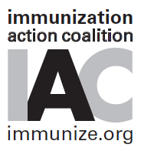
Other resources for healthcare professionals
CDC immunization training: https://www.cdc.gov/vaccines/ed/index.html
CDC-Medscape Expert Commentaries: http://www.medscape.com/partners/cdc/public/cdc-commentary
AAP Immunization Resources: https://www.aap.org/en-us/advocacy-and-policy/aap-health-initiatives/immunizations/Pages/Immunizations-home.aspx
Immunization Action Coalitionhttp://immunize.org/
Medical Assistants Resources and Training on Immunization (MARTI): http://marti-us.org/
Notes:
Thank you for taking the time to listen today. I hope that we can work together to create a culture of immunization in our practice. I only had time to present a few ideas and steps, but hopefully it will get us started. Here are some credible resources to consult if you would like to learn more about immunization best practices.

Slide 23
Questions?
Questions?
Notes:
PRESENTER NOTE:
After answering questions, explain any next steps that you will be taking to implement the suggestions presented.

